Slide 1
Emailing with Flexmail Training session
Solweb project team
& Web support

Slide 2
AGENDA
>>
Introduction /10 min
Flexmail presentation /10 min
Manage your contacts /30 min
Create a message /30 min
Email campaigns /45 min
Follow up (with the reports) /30 min
Conclusion /10 min
Total duration - 3:00
-------- Break -------- /15 min

Slide 3



Introduction
Flexmail was selected by the group to manage all of its newsletters (Marketing, Group, Internal to GBUs and functions
Is actually replacing Tridion Emailing or any other Newsletters tools
In course of world wide deployment
Recommended browser:
Google Chrome is also supported.
Solvay.com publisher training – Web support department

Slide 4
Governance rules
Inform the Internal Communication Department before creating a new newsletter
Flexmail is mandatory to create and send a newsletter
Links contained in newsletter must be targeted to articles published in Solvay ONE
Recommended browser:
Google Chrome is also supported.
RED LINE: The Corporate Communications Function is the only entity allowed to operate internal media targeting all employees
Solvay.com publisher training – Web support department

Slide 5
AGENDA
>>
Introduction /10 min
Flexmail presentation /10 min
Manage your contacts /30 min
Create a message /30 min
Email campaigns /45 min
Follow up (with the reports) /30 min
Conclusion /10 min
Total duration - 3:00
-------- Break -------- /15 min

Slide 6
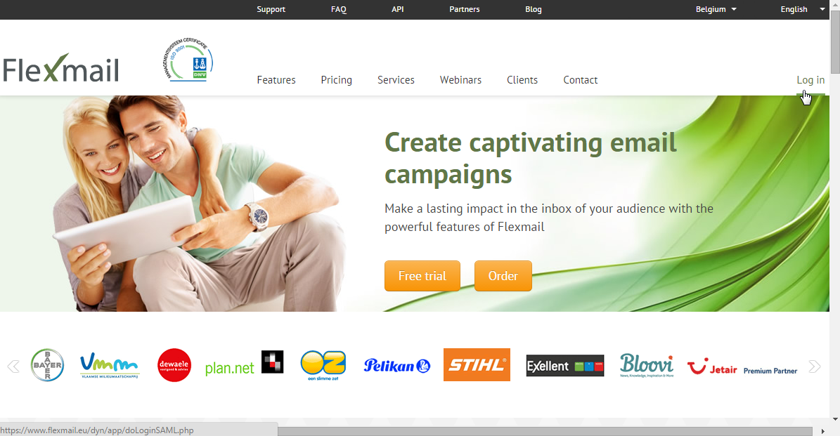
Access
http://solvay.flexmail.eu
No credential, press “Login” and connect to your Solvay Google account if needed

Slide 7
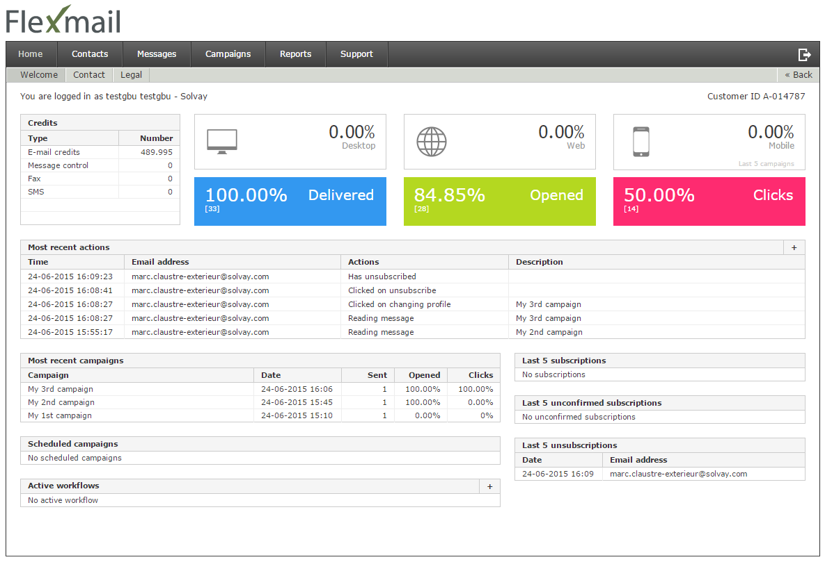
Home
Solvay.com publisher training – Web support department

Slide 8
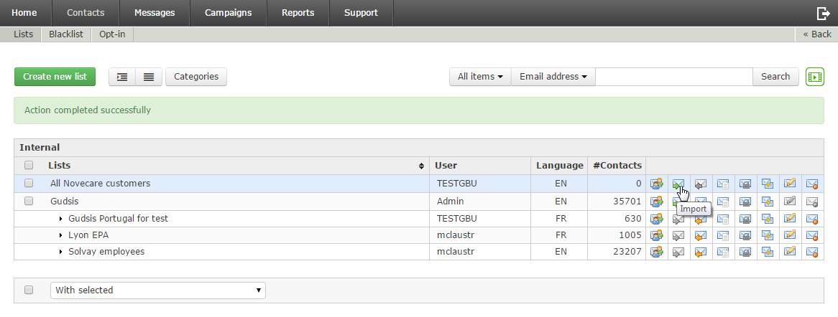
User interface
1
3
2
Most of the screens are made of:
Some global buttons and a search engine
A list of items (Contacts lists, Messages, Campaigns …)
A collection of icons for each item (point it to know more)
Solvay.com publisher training – Web support department

Slide 9
Good to know
Use the web browser of your choice
(Internet explorer or Google chrome)
Recommended browser:
Google Chrome is also supported.
Be sure about what you delete, there is no trash bean.
Solvay.com publisher training – Web support department

Slide 10
AGENDA
Introduction /10 min
Flexmail presentation /10 min
Manage your contacts /30 min
Create a message /30 min
Email campaigns /45 min
Follow up (with the reports) /30 min
Conclusion /10 min
Total duration - 3:00
>>
-------- Break -------- /15 min

Slide 11
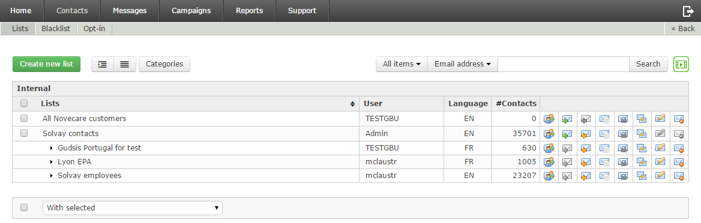
Manage your contacts
Any emailing starts with a precise target selection.
External contacts
Create a new list with
Import contacts with
Import from a file
or from a spreadsheet copy-paste
Solvay contacts
Are all contained in the « Solvay contacts » list
Do not update these contacts
Create sub-lists with (Segmentation)
Solvay.com publisher training – Web support department
Notes:
Ajuster screen shots pour voir le titre
A discuter ensemble cet aprem

Slide 12
Good to know
Solvay contacts: to know which information is available for segmentation, edit any of your targeted contacts to view its properties.
If a contact information looks wrong, ask a correction:
use ‘Ask HR’ from eServices (for solvay employees)
or contact the local helpdesk (for externals)
Only the corporate communication is authorized to target globally the Solvay contacts.
Solvay.com publisher training – Web support department

Slide 13


External Contacts management in practice
https://solvay.flexmail.eu
Objective: Create a new list of external contacts
Login to Flexmail
Create a new list to contains some external contacts
Quick import some contacts with a speadsheet copy-paste
Import some more contacts in it by importing an XLS file
It’s your turn!
Duration: 10 minutes
Solvay.com publisher training – Web support department

Slide 14
Solvay Contacts management in practice
https://solvay.flexmail.eu
Objective: Create a dynamic sub-list of Solvay contacts.
Login to Flexmail
Edit any contact to know its properties
Create a segmentation including this contact
It’s your turn!
Duration: 5 minutes
Solvay.com publisher training – Web support department

Slide 15
AGENDA
Introduction /10 min
Flexmail presentation /10 min
Manage your contacts /30 min
Create a message /30 min
Email campaigns /45 min
Follow up (with the reports) /30 min
Conclusion /10 min
Total duration - 3:00
>>
-------- Break -------- /15 min

Slide 16
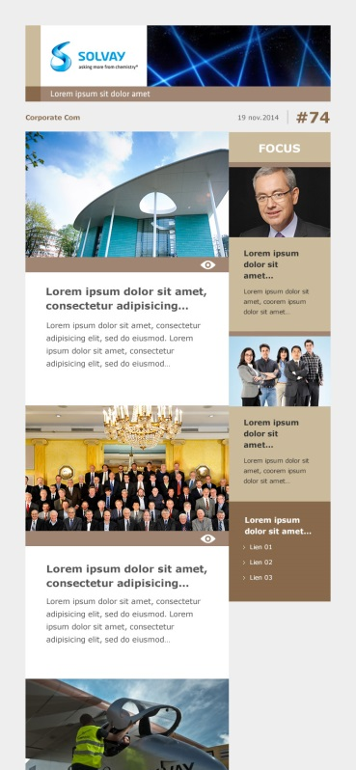
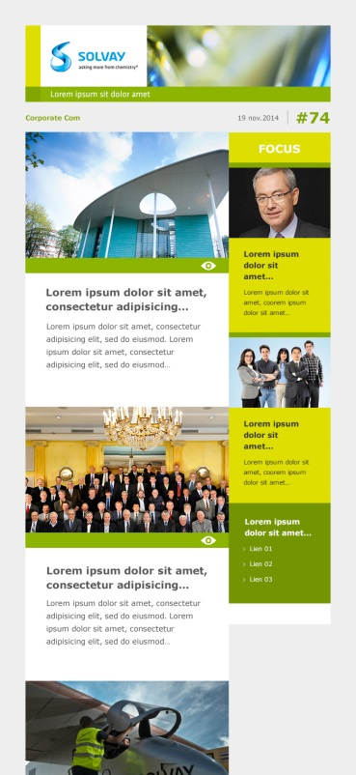
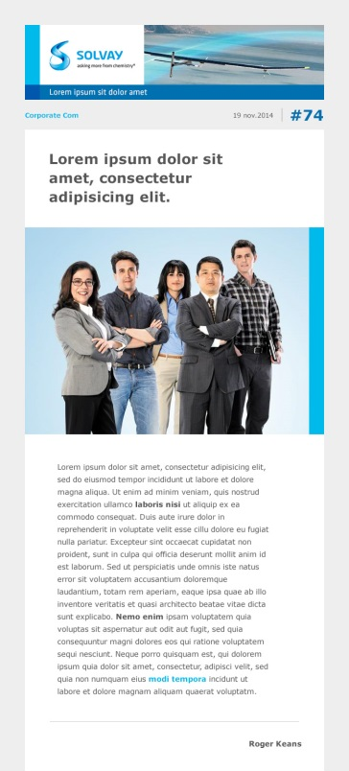
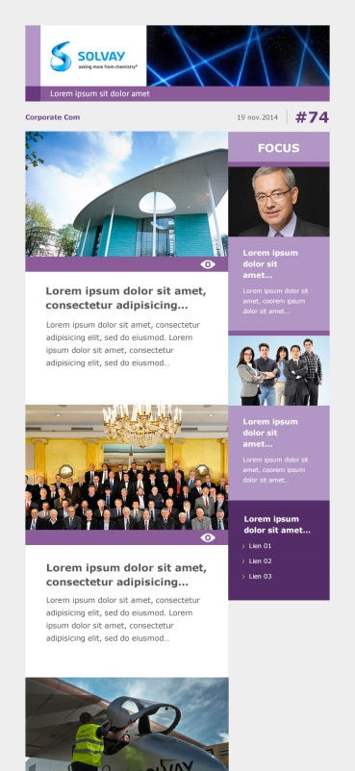
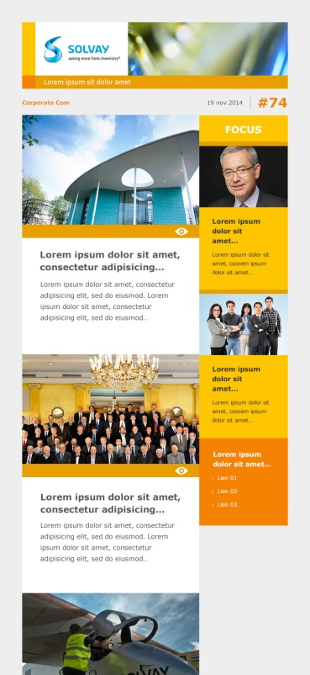
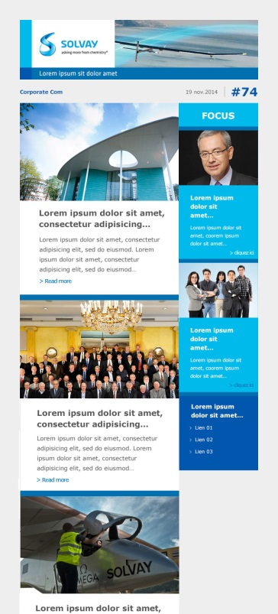

Create a message
Choose a template, among 3 layouts and 5 available colors...
Single article
2 columns, multiple articles
Overview of the available colors
1 column, edito and multiple articles
… then just fill-in a form to build your newsletter!
Solvay.com publisher training – Web support department
Notes:
Ajuster screen shots pour voir le titre
A discuter ensemble cet aprem

Slide 17
Good to know
Your newsletter articles should only contain teasers and links to full articles published in Solvay ONE or any other Solvay web site.
Linked file should be stored into Google drive (internal only).
Some « Personalize » keywords are available under the form.
Use frequently « Preview » and « Send preview ».
Choose your template carrefuly, after creation it cannot be changed anymore.
Solvay.com publisher training – Web support department

Slide 18
External Contacts management in practice
https://solvay.flexmail.eu
Objective: Create your first newsletter
Access to the "Message" section
Create a new message using the template of your choice
(please avoid the too minimalist “Solvay 1 …”)
Fill-in the form to build your newsletter
Preview it
Send a preview to yourself and your trainer
It’s your turn!
Duration: 15 minutes
Solvay.com publisher training – Web support department

Slide 19
AGENDA
Introduction /10 min
Flexmail presentation /10 min
Manage your contacts /30 min
Create a message /30 min
Email campaigns /45 min
Follow up (with the reports) /30 min
Conclusion /10 min
Total duration - 3:00
>>
-------- Break -------- /15 min

Slide 20
AGENDA
Introduction /10 min
Flexmail presentation /10 min
Manage your contacts /30 min
Create a message /30 min
Email campaigns /45 min
Follow up (with the reports) /30 min
Conclusion /10 min
Total duration - 3:00
>>
-------- Break -------- /15 min

Slide 21
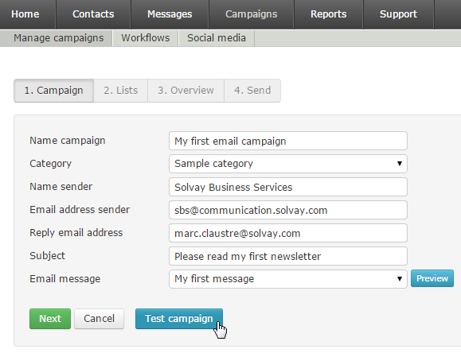
Email campaigns
Campaigns are the way to distribute your newsletter.
Solvay.com publisher training – Web support department

Slide 22
Good to know
Use « Email campaign », just ignore « Opt-in campaign ».
Use « Test campaign ».
Reply email address: can be the email of your choice.
Email address sender: to reduce chances to be considered as SPAM, use only the given email.
(should be ‘YourEntity@communication.solvay.com’)
Use ‘Update this campaign now with the latest version of my message’ if you updated your message after having created your campaign
Solvay.com publisher training – Web support department

Slide 23
External Contacts management in practice
https://solvay.flexmail.eu
Objective: Send your newsletter
Create a new email campaign
Generate a “Test” campaign
Send this test campaign to yourself
It’s your turn!
Duration: 5 minutes
Solvay.com publisher training – Web support department

Slide 24
AGENDA
Introduction /10 min
Flexmail presentation /10 min
Manage your contacts /30 min
Create a message /30 min
Email campaigns /45 min
Follow up (with the reports) /30 min
Conclusion /10 min
Total duration - 3:00
-------- Break -------- /15 min
>>

Slide 25
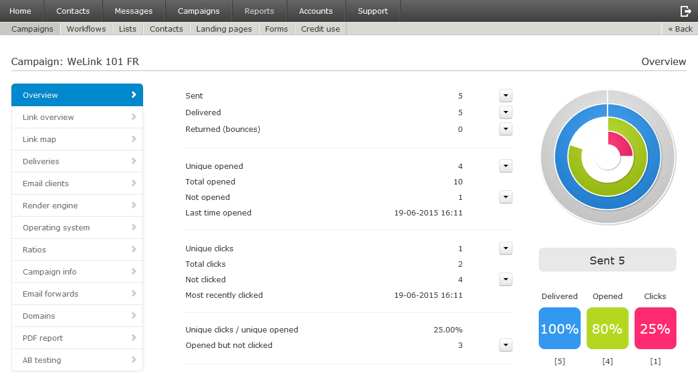
Follow up
Use the reports to follow up your campaigns and contacts.
Campaigns, to get ratio of sending, openind, clicking, etc.
Lists, to the view the sending errors (eg. wrong email address) and unsubscribed from your newsletters.
Solvay.com publisher training – Web support department

Slide 26
Good to know
Use « PDF Report » to archive this information.
To get the unsubscription system properly working, do not create new lists for each of your campaigns.
Solvay.com publisher training – Web support department

Slide 27
AGENDA
Introduction /10 min
Flexmail presentation /10 min
Manage your contacts /30 min
Create a message /30 min
Email campaigns /45 min
Follow up (with the reports) /30 min
Conclusion /10 min
Total duration - 3:00
-------- Break -------- /15 min
>>
Notes:
A décaler

Slide 28
Conclusion
Download this training support from:
https://wiki.solvay.com/display/ISAPPSUP/FLEXMAIL
Solvay.com publisher training – Web support department

Slide 29
Thank you for your attention!

