Slide 1


Shiftconnector®
User Training

Slide 2
Agenda
Organizational
General information about Shiftconnector®
Login to Shiftconnector®
Use of the software

Slide 3
Organizational

Slide 4
Project scope
Copy mind map/customer’s data to this slide.

Slide 5
Training and support concept
Standard User und Key User
Manufacturer support
Users please contact your administrator
You instruct the users (“Train the Trainer”)
eschbach GmbH
support@eschbach.com or phone 07761-559 59-0
Administrator und Shiftconnector Contact person
Interface between you and eschbach
Support +
Training

Slide 6
Goal of the training
Login to Shiftconnector
Function of the Infoboard and Navigation
Creation of an event
Editing Entries
Send events in morning meeting
Search for specific entries
Attach and create tasks
Complete tasks
Working with instructions (publish and sign)

Slide 7
General information about Shiftconnector®

Slide 8
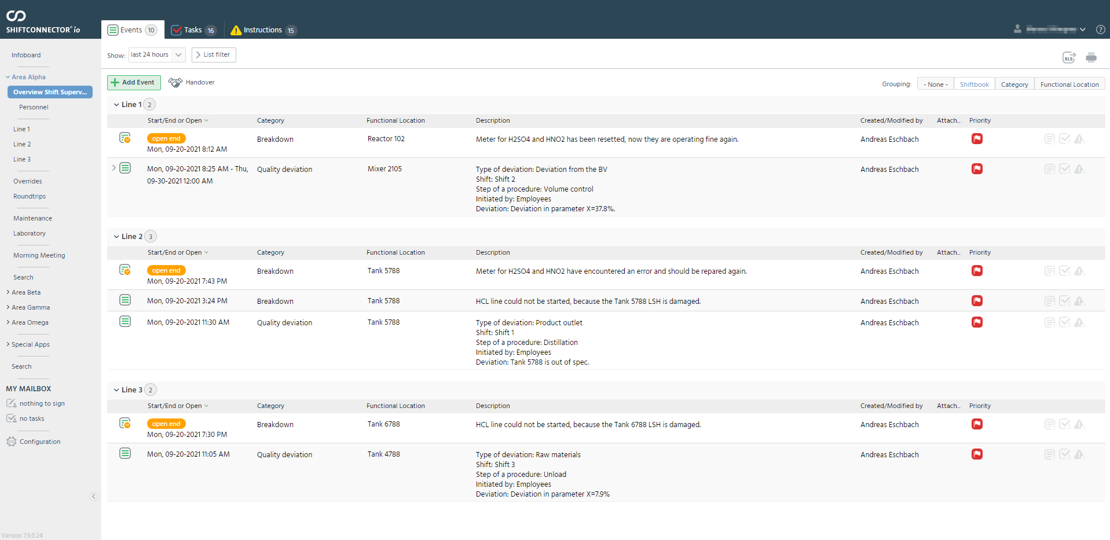
Events, Tasks and Instructions
Instructions
Temporary deviations (different procedures, production trials, security changes etc.) from the standard process.
Events
All incidents listed chronologically.
Tasks
Scheduled action items for shifts or other departments.

Slide 9
Permission
Standard User
  Events (Read, Create, and Modify)
  Tasks (Read, Create, and Modify)
  Instructions (Read)
  Infoboard (Read)
Key User
  All rights of the “Standard User”
  Instructions (Read, Create, and Modify)
  Infoboard (Read, Create, and Modify)
Administrator
  All rights of the “Key User”
  Access to the configuration area
The rights affect the entire work, i.e. all shift books!
Key User must be named
min. one per shift.

Slide 10










Use of Shiftconnector
Shift A
Shift B
Information for
next shift
Morning Meeting
Shift A
Shift B
laboratory, technology, etc.
Task for next shift
or IH
Shift A
or
management
Shift A
Shift B
Shift C
Instructions for all shifts

Slide 11






Procedure for Shift Transfer
8.00 | 9 | 10 | 11 | 12 | 13 | 14 | 15 | 16 | 17 | 18 | 19 | 20.00 | 21 | 22 | 23 | 24 | 1
Shift A
Add “Handover” at end of shift
Shift presence
Safety
event
Break
down
Execution
note
Quality
note
Shift B
Sign “Handover”
Shift presence

Slide 12
Login to Shiftconnector®

Slide 13

Login
URL:
http://servername/shiftconnector
Username: USERNAME
Password: PASSWORD

Slide 14
Use of the Software

Slide 15
A customer audit will take place next week on Wednesday. You want to inform all employees. How do you proceed?
Function of the Infoboard and Navigation
Notes:
Schwarzes Brett, Aktuelle Betriebsvorkommen das nicht mit dem betrieblichen Ablauf zu tun hat

Slide 16
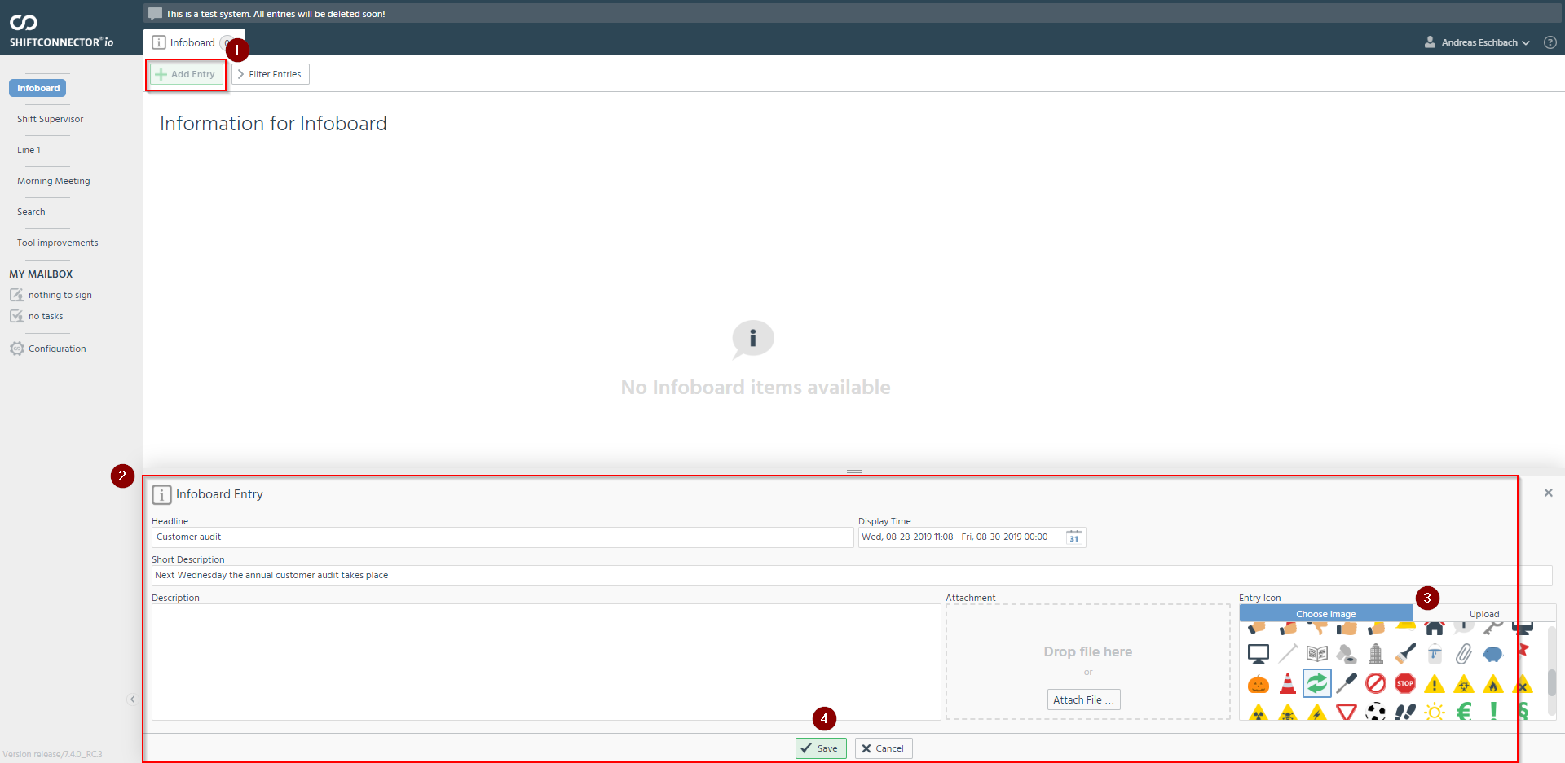
Create Infoboard Entry
Fill in mandatory fields, select icon if necessary and save.

Slide 17
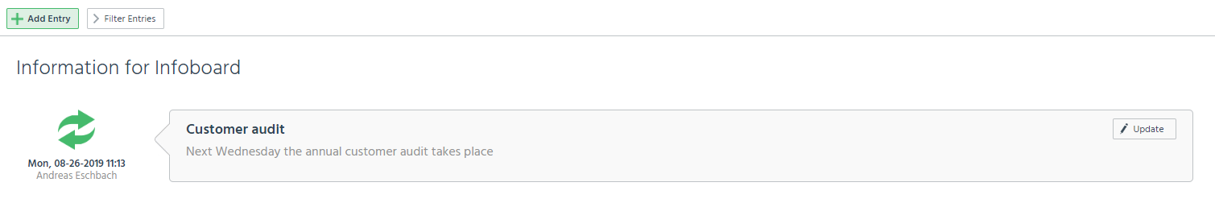
Create Infoboard Entry - Result
This entry disappears automatically from the view after the display time has elapsed.

Slide 18
Exercise
From: | sarah.freier@company.com
To: | stefan.schreiber@company.com
Subject: | Customer audit
Hello Stefan,
next Wednesday a customer audit takes place around 12 o'clock. Could you please make an entry in the Shiftconnector, so that everyone knows about it as soon as possible?
Thank you in advance
Sarah Freier

Slide 19
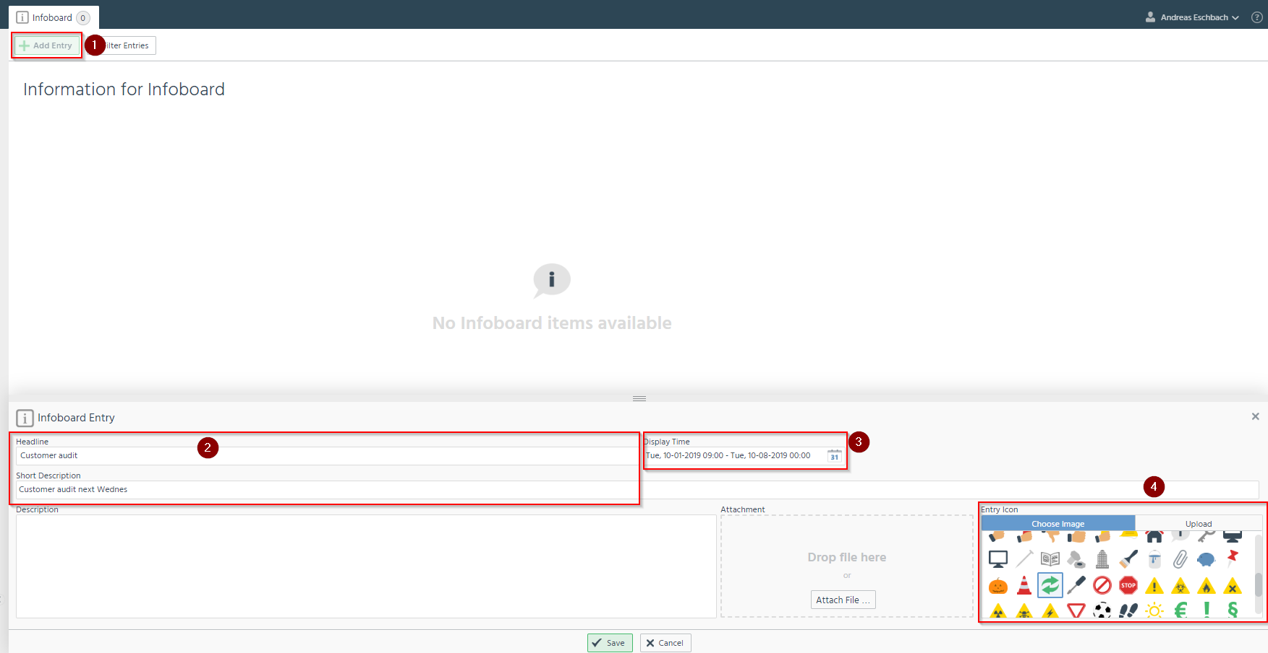
Solution
Create new entry
Describe what has been given or what is pending
Set date when the entry should be visible
Select the appropriate icon to view it

Slide 20
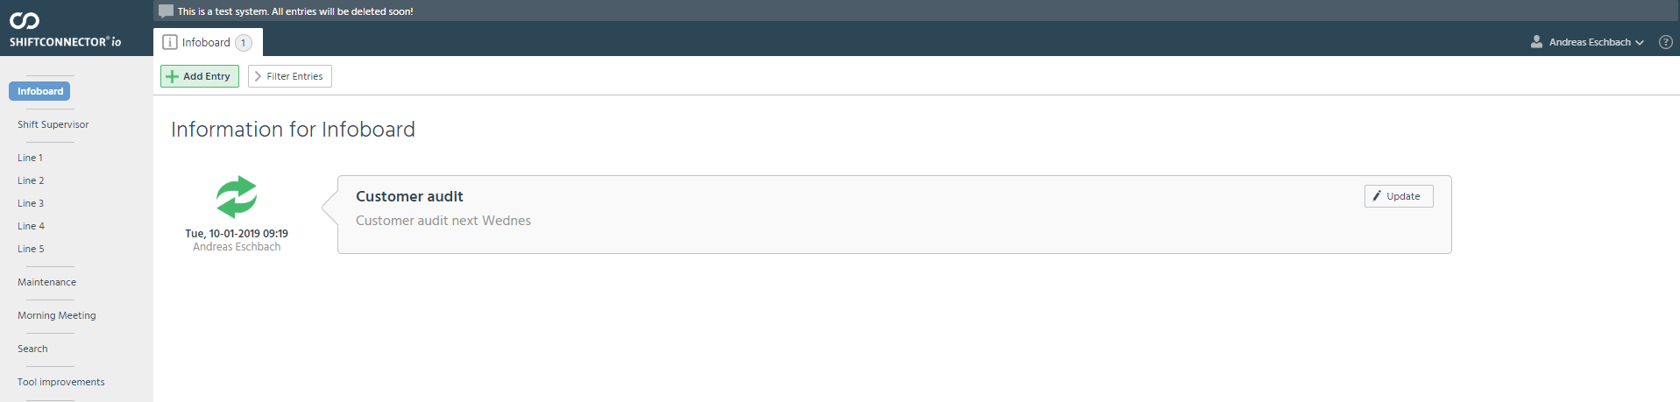
Solution

Slide 21
A pump in your system is defective. What do you have to do to document this?
Creation of a events

Slide 22
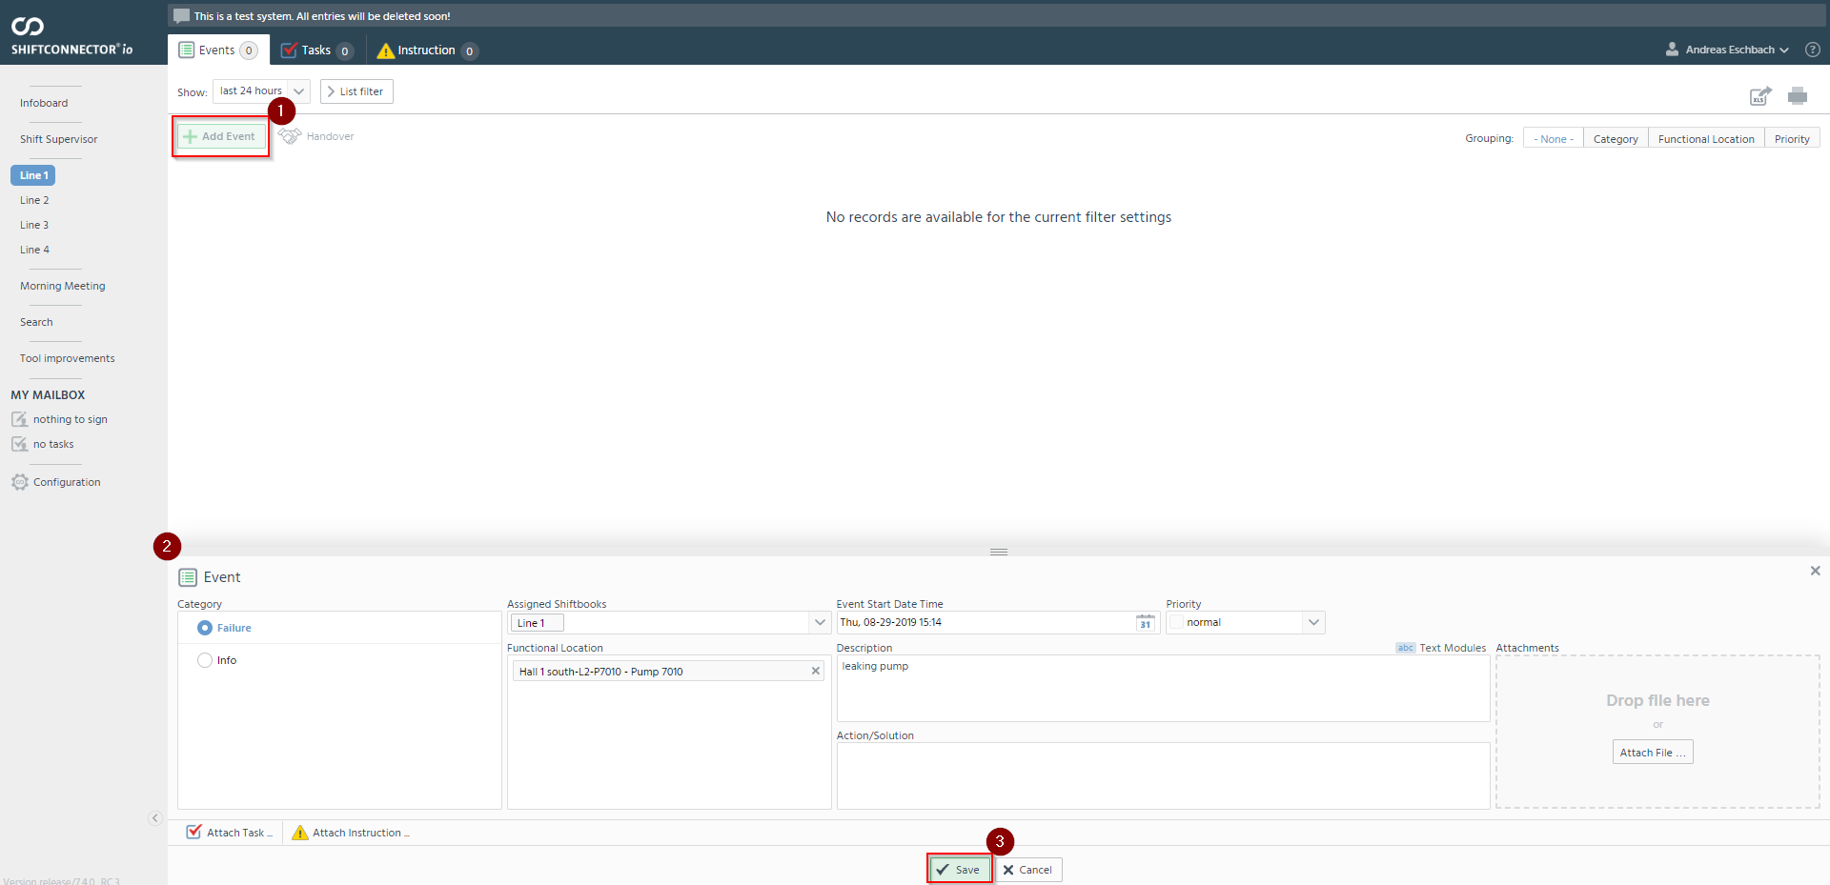
Create events
Selection of the appropriate technical location
Indication of priority and description of the incident

Slide 23
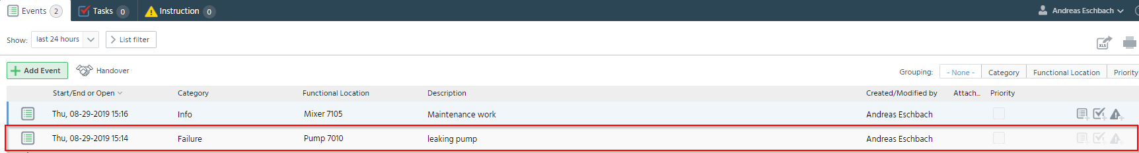
Create events - Result

Slide 24
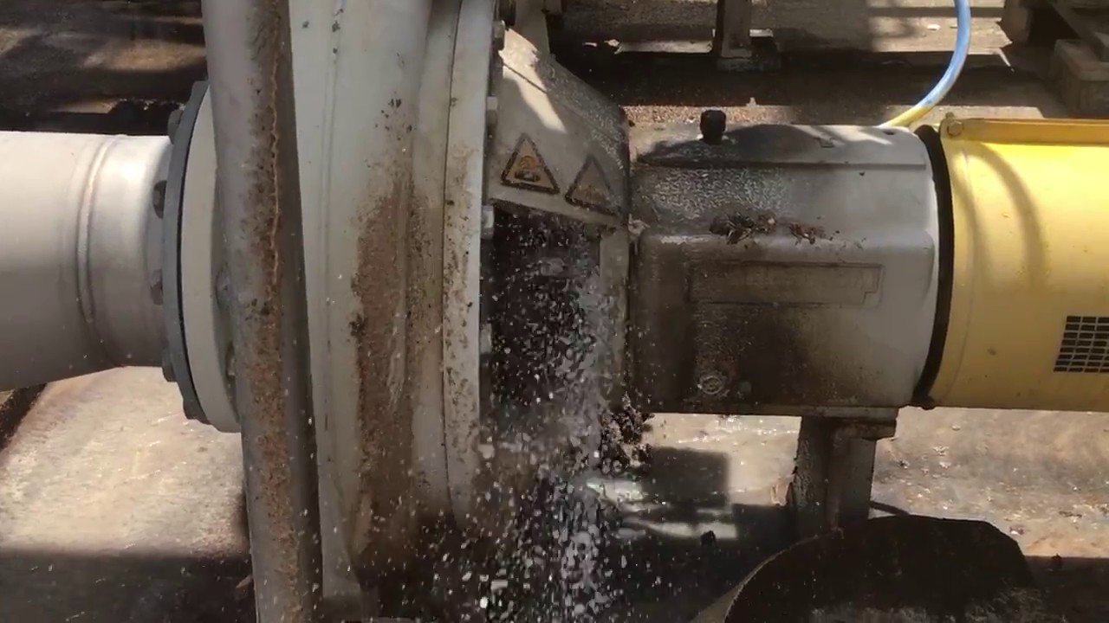
Exercise
During your daily tour you will notice a puddle on the ground next to a line. If you check where the water comes from, you will notice a leak in a pump. You now want to document this event in the Shiftconnector®.

Slide 25
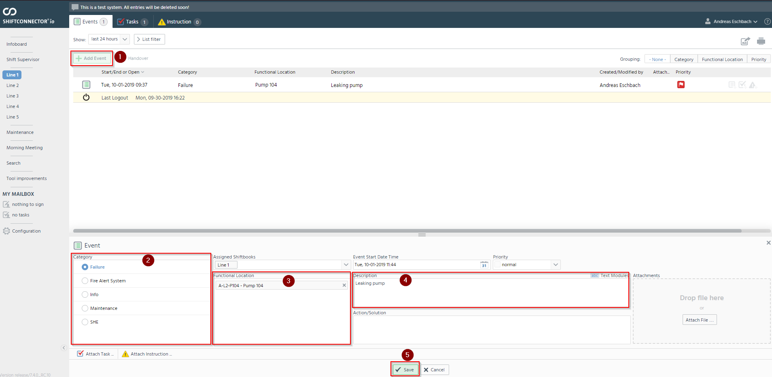
Solution
Select a suitable category
Selection of the affected pump
Describing what happened

Slide 26
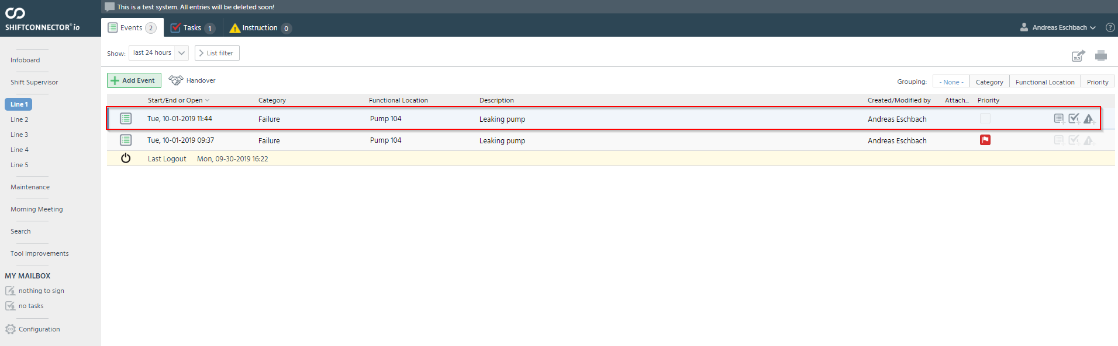
Solution
The entry is then displayed as follows

Slide 27
You have noticed that the entry of the defective pump is not described precisely enough. How do you proceed?
Editing Entries

Slide 28
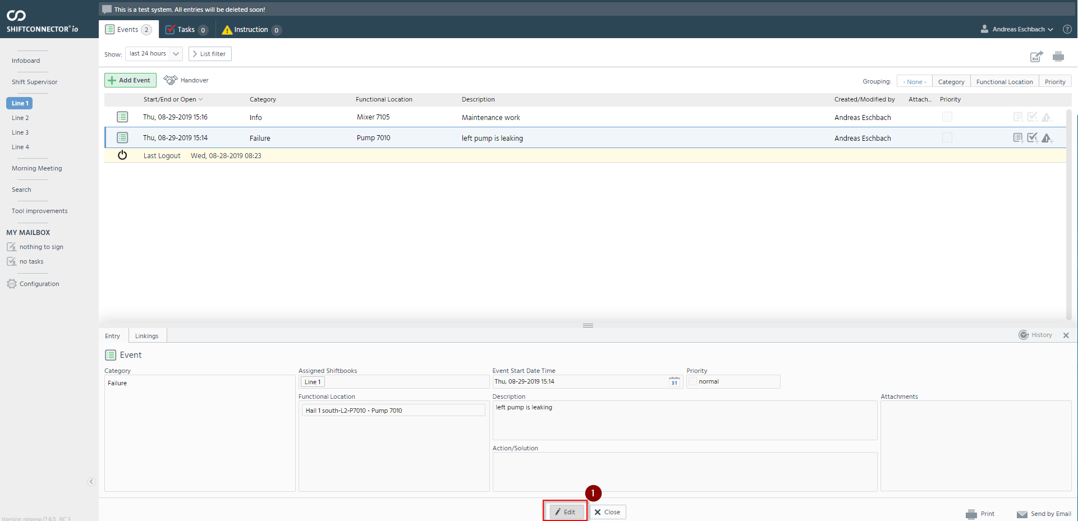
Editing Entries
Perform and save the change.

Slide 29
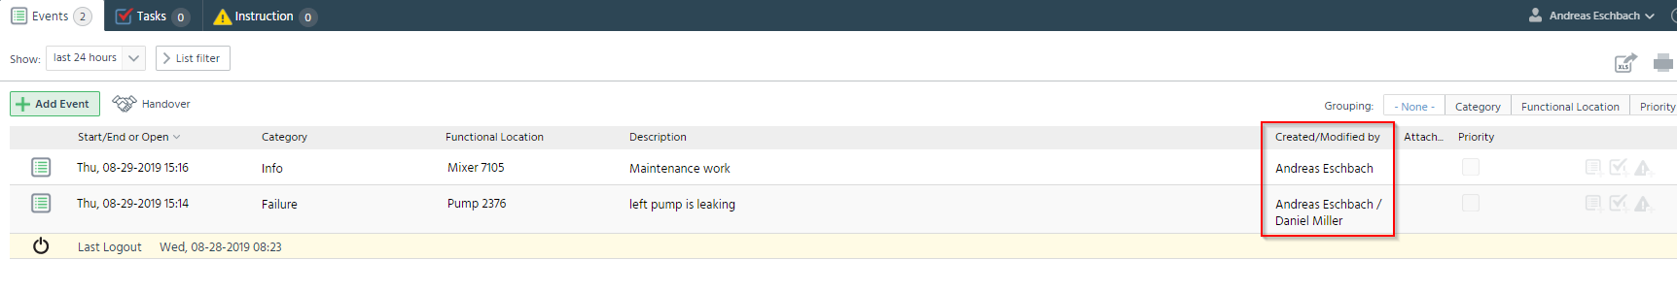
Edit entries - Result
Display who created and/or changed the entry

Slide 30
Exercise
You notice that you have selected an incorrect functional location in your entry. Another pump is affected by the leakage. Please correct your entry.

Slide 31
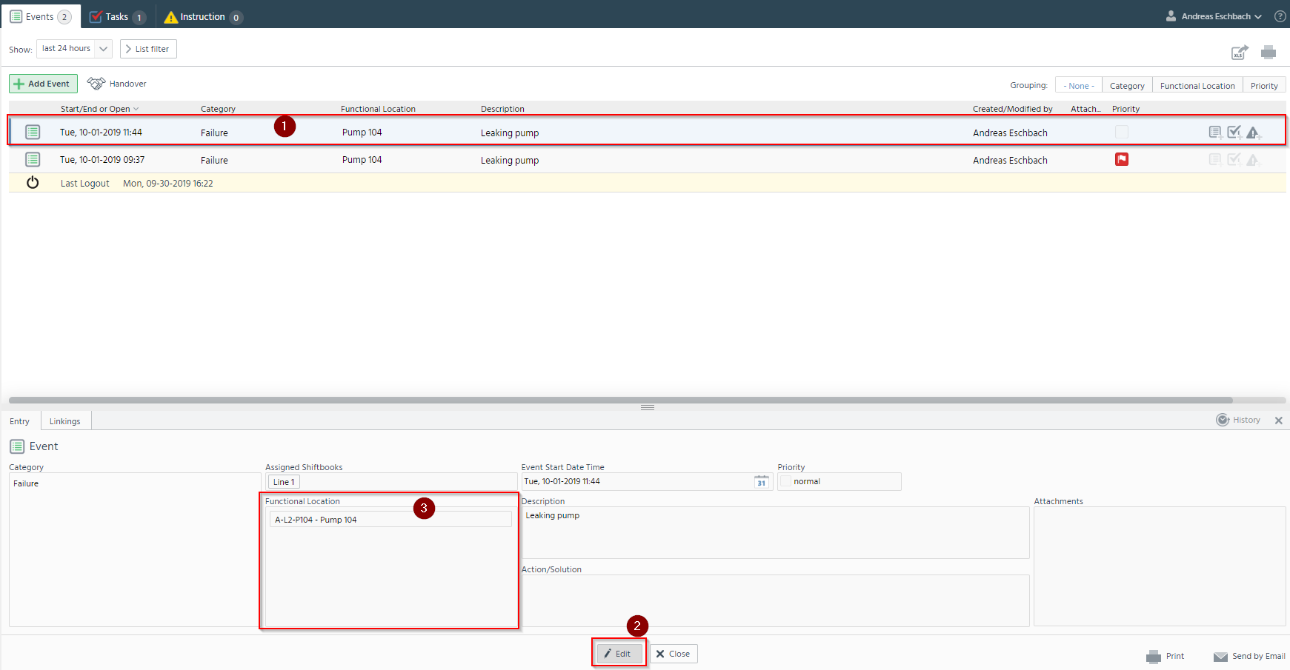
Solution
Click on the corresponding entry
Select another functional location

Slide 32
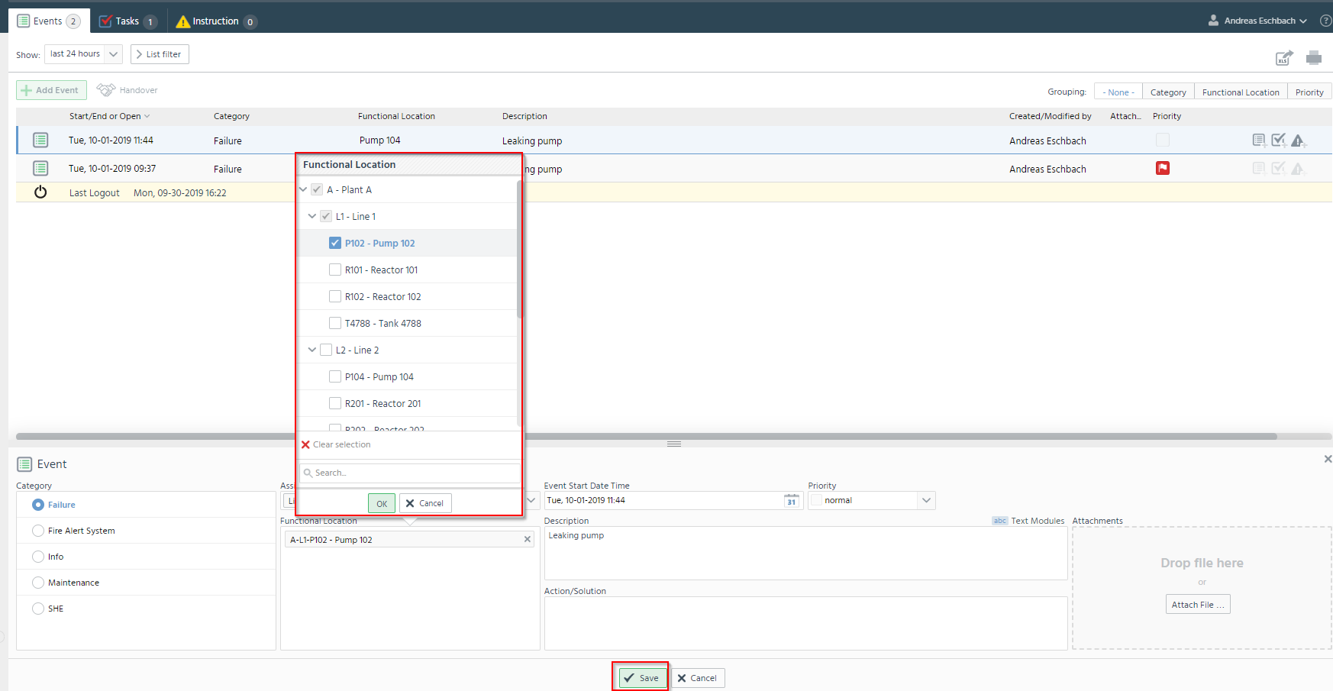
Solution

Slide 33
You would like to report the defective pump to the early meeting. What to do?
Send events in early meeting

Slide 34
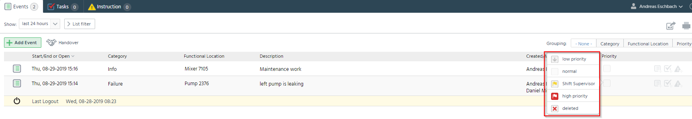
Change priority (list view)
Change the priority to Early Meeting (red)

Slide 35
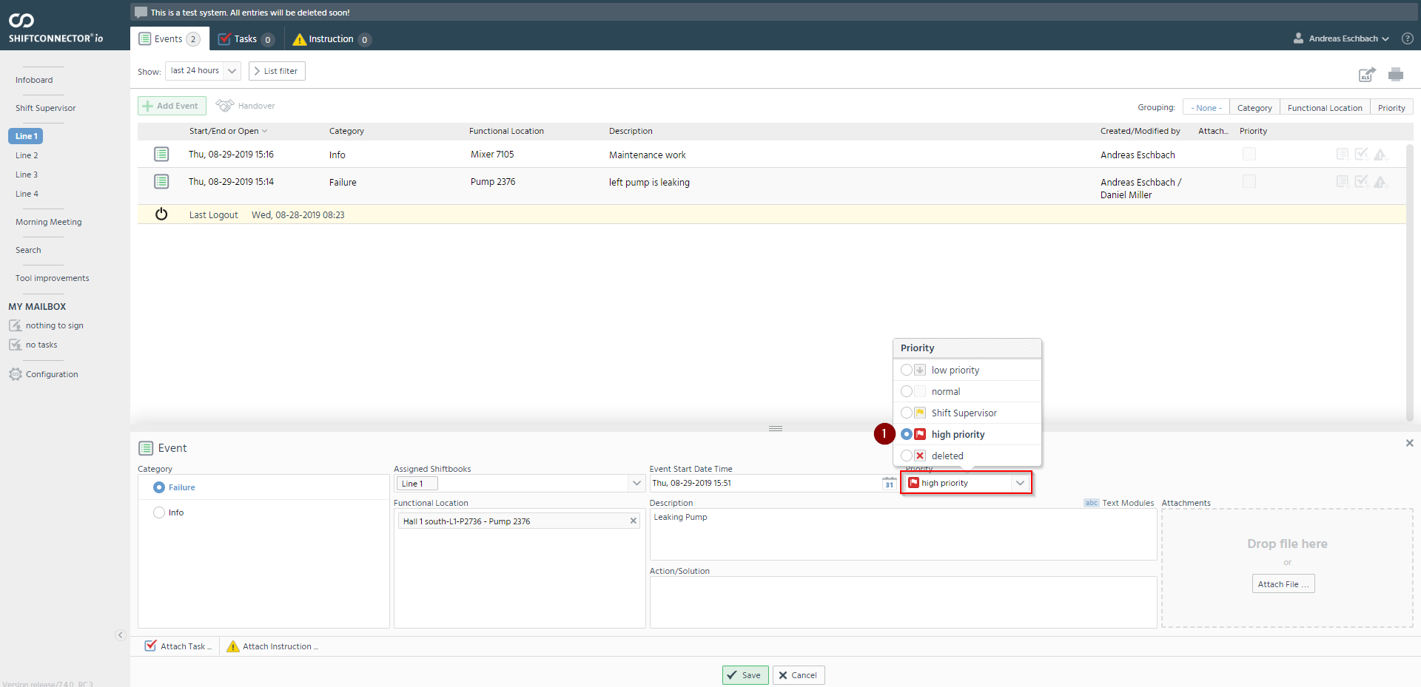
Change priority (detail view)
By changing the priority, this entry is additionally displayed in the navigation point "Early Meeting"

Slide 36

Exercise
During your night shift there was a repeated deviation in quality. Therefore, you would like this topic to be discussed in the early meeting.

Slide 37
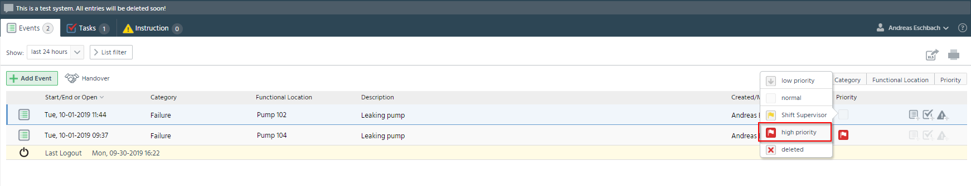
Solution
Selection high priority

Slide 38
You want to search for all entries in the Shiftconnector® that are in the description field "defective". How do you proceed?
Search for specific entries

Slide 39
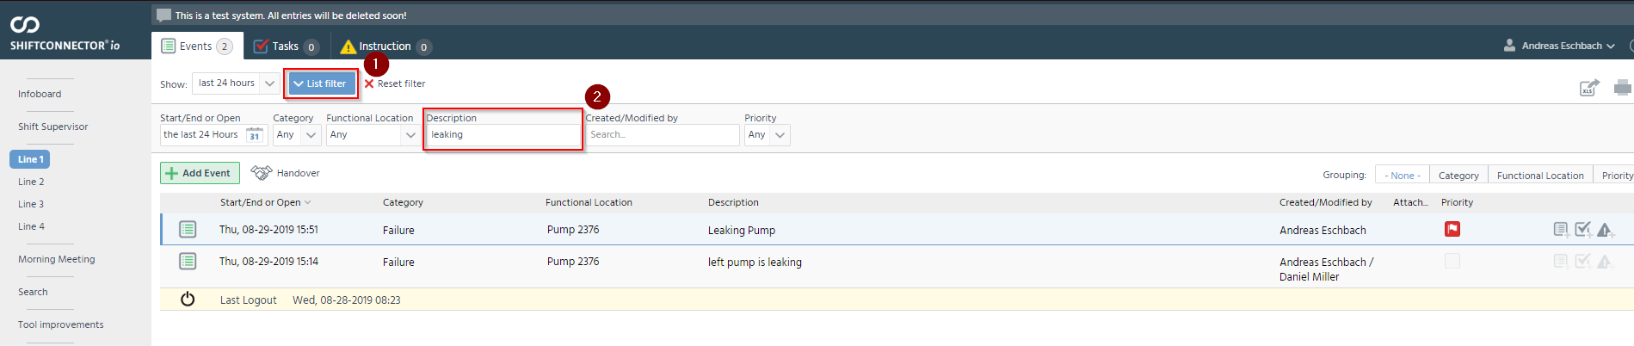
Search for entries
Selection of the search fields in Shiftconnector

Slide 40

Exercise
You want to get an overview of all malfunctions of a certain pump. Therefore, search for all relevant entries that have been created in the last three months.

Slide 41
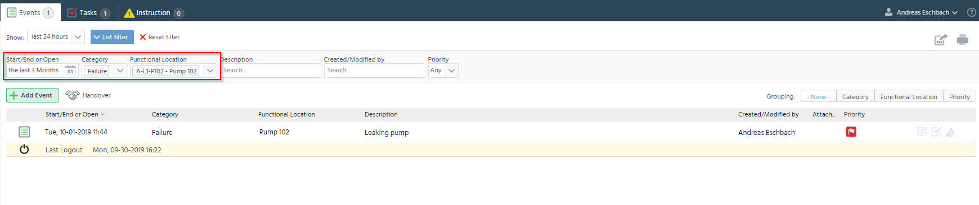
Solution
Search for all entries with the category "Failure", which pump 102 and was created in the last 3 months

Slide 42
The defective pump should be repaired. What should be done?
Attach and create tasks

Slide 43
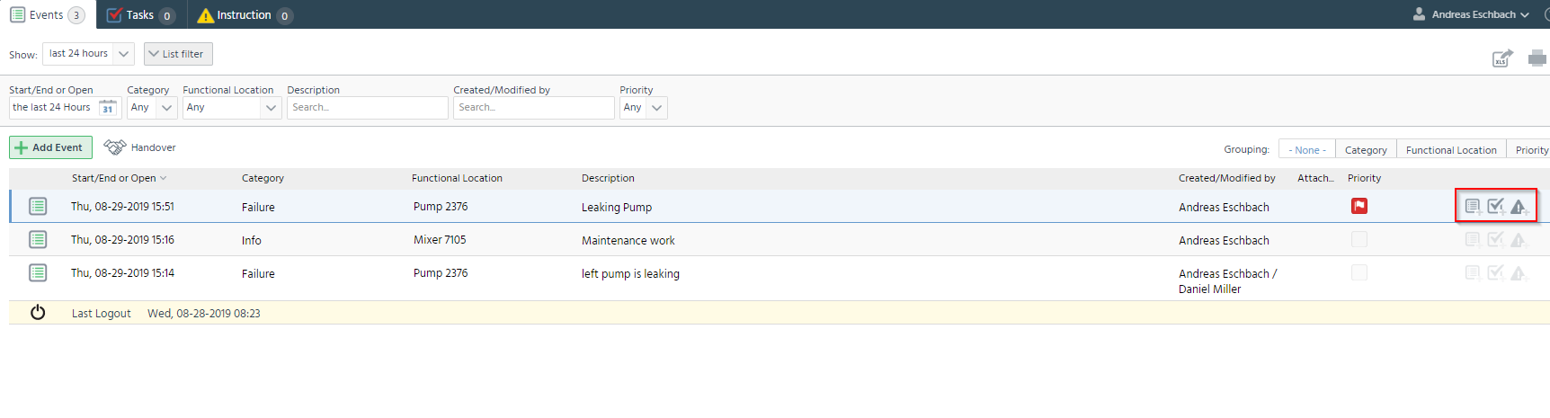
Attach tasks
Attaching notifications, tasks and instructions

Slide 44
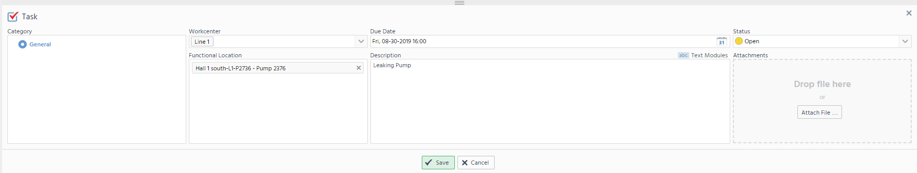
Attach tasks

Slide 45
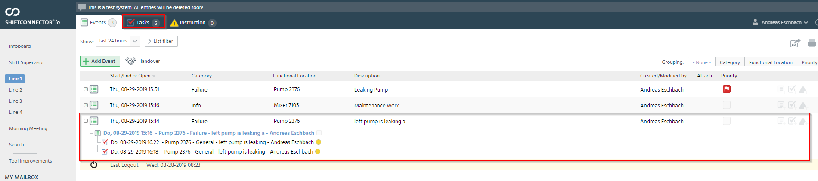
Attach tasks
Appears as a new task in the responsible area

Slide 46

Exercise
The exterior lighting in your factory is defective. A message already exists in the Shiftconnector® for this. Attach a task to the message so that the light bulb can be replaced.

Slide 47
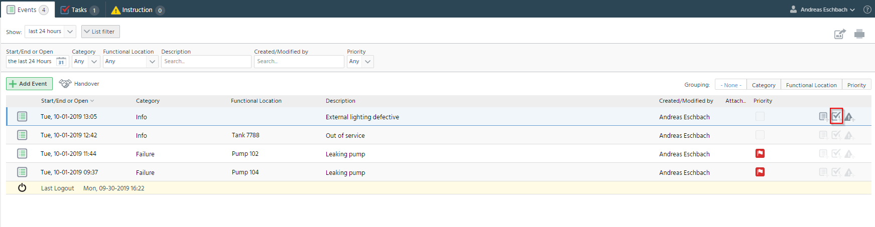
Solution
Attaching a task to the corresponding event

Slide 48
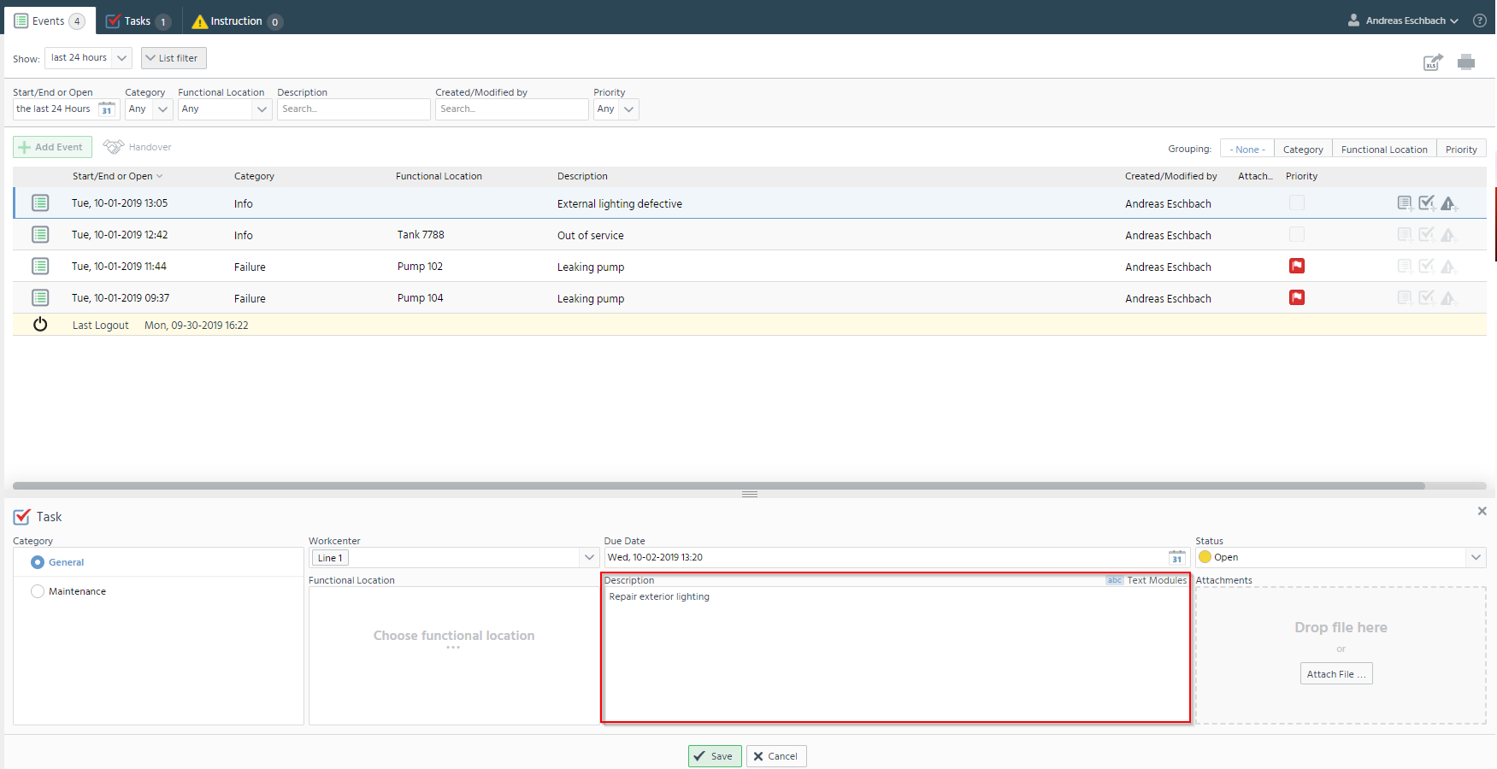
Solution
Describe what to do

Slide 49
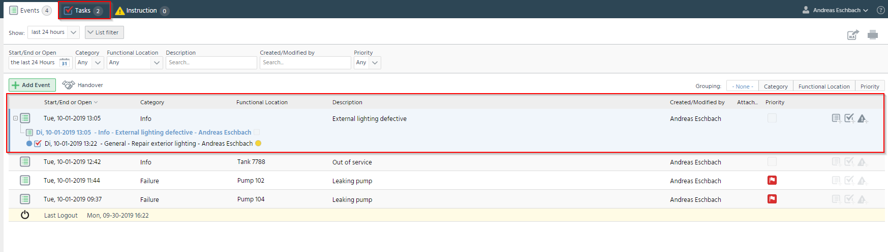
Solution
The attached task is also displayed for the tasks.
The attached task is then displayed under the corresponding message, this message can be expanded with the pulse.

Slide 50
The pump's been repaired. This should now be documented in the Shiftconnector®. How does this work?
Complete tasks

Slide 51
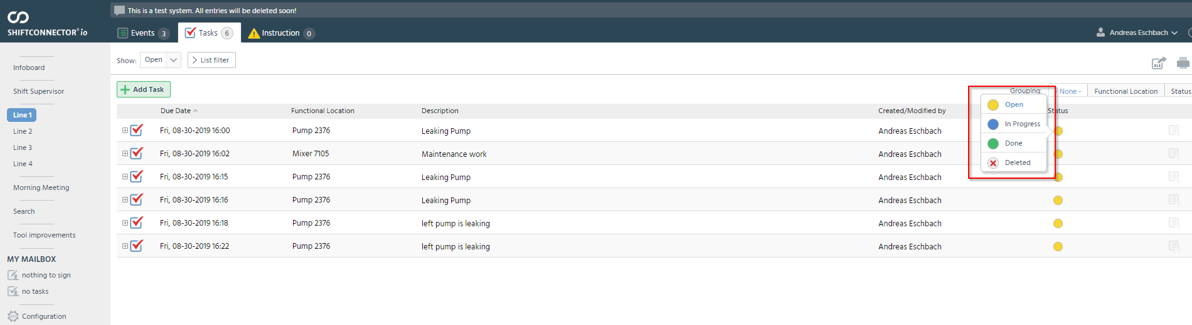
Complete tasks

Slide 52
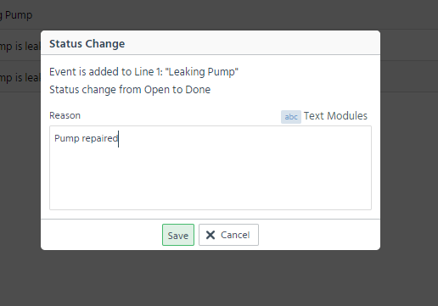
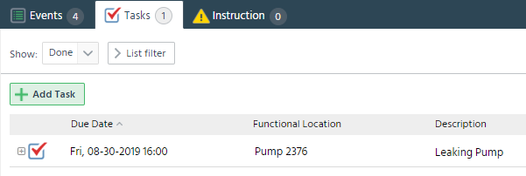
Change status
Indication of what was done
Then "Save"
The entry is then shown in the "Done" display.

Slide 53
Exercise
They changed the light bulb. In the Shiftconnector® you now want to document that you have carried out the maintenance work.

Slide 54
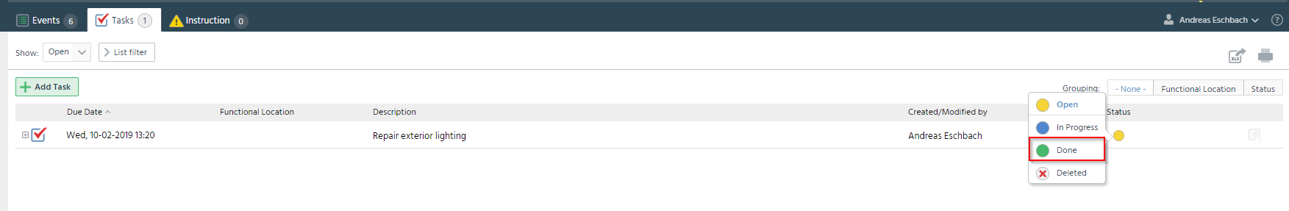
Solution
Change status to done.

Slide 55
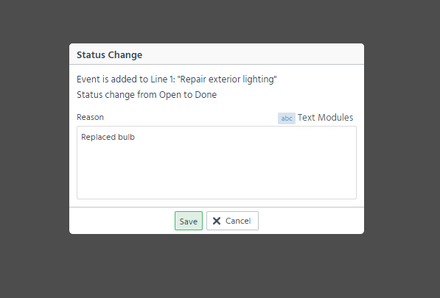
Solution
Enter what was done, save before is not possible.

Slide 56
Your safety showers must be checked weekly. How does that work?
Create recurring tasks

Slide 57
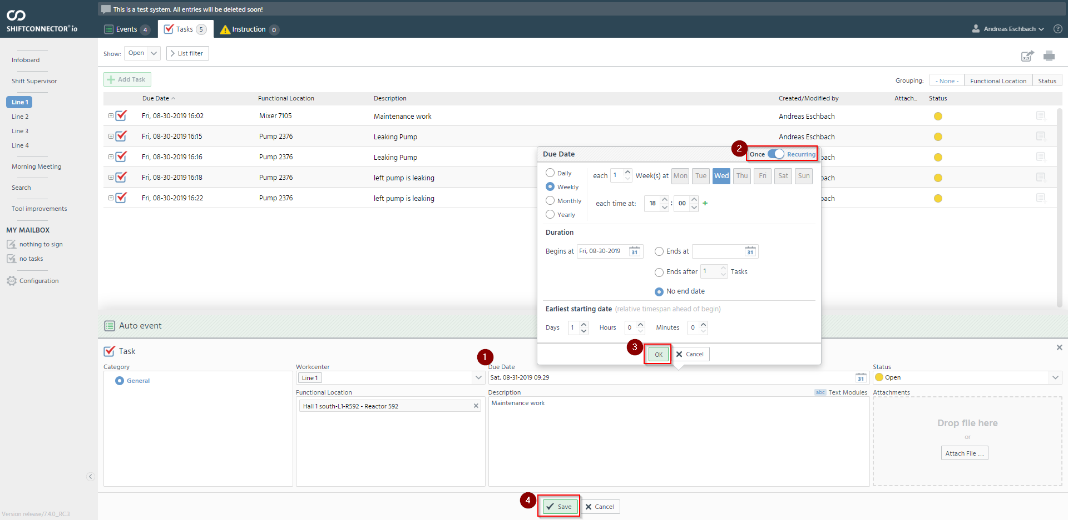
Recurring tasks
Specifies the frequency at which the task is to be completed

Slide 58
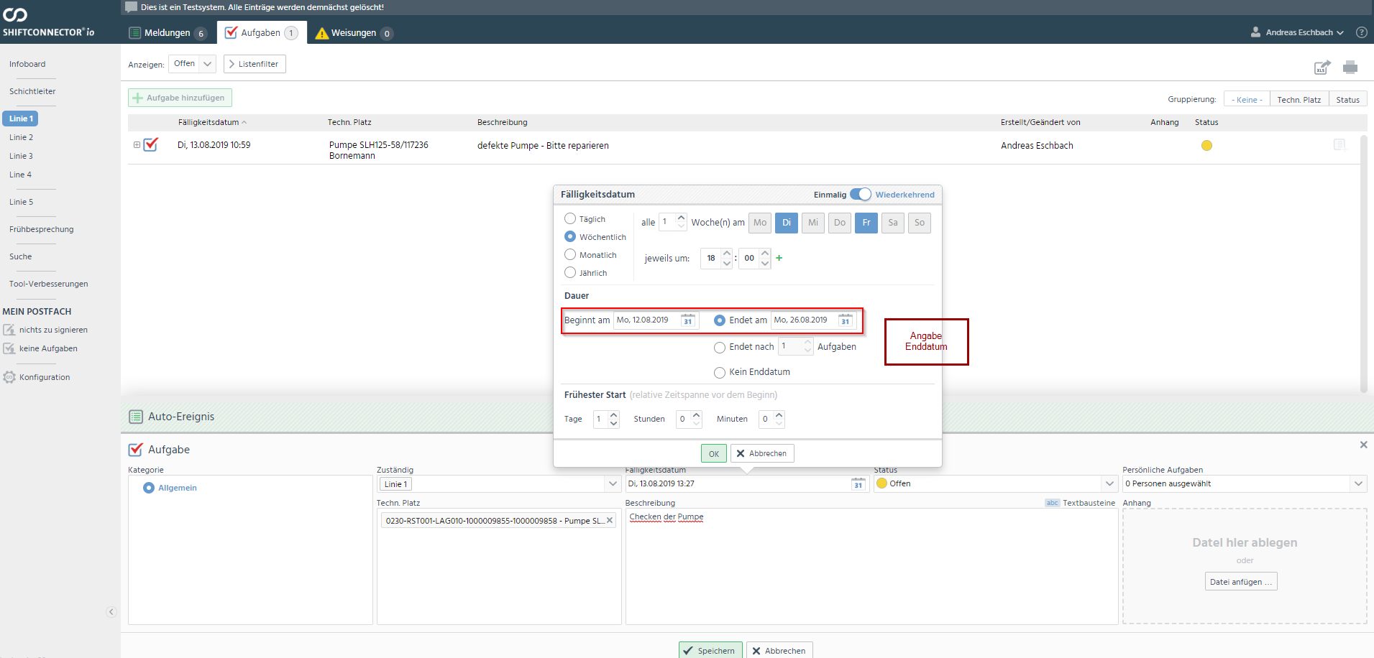
Temporary task

Slide 59

Exercise
You want a weekly security tour to be performed by creating a recurring task.

Slide 60
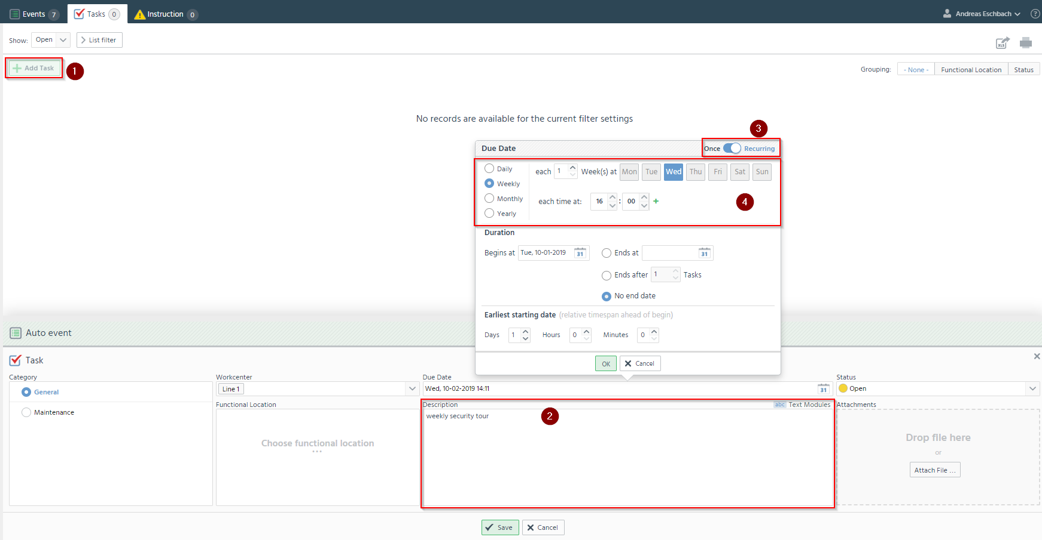
Solution
Create task
Change from once to recurring
Specify when and how often the task should be repeated
Describe what to do in this task

Slide 61
There are new important operational instructions that must be read and signed. How do you do it?
Working with instructions (publish and sign)

Slide 62
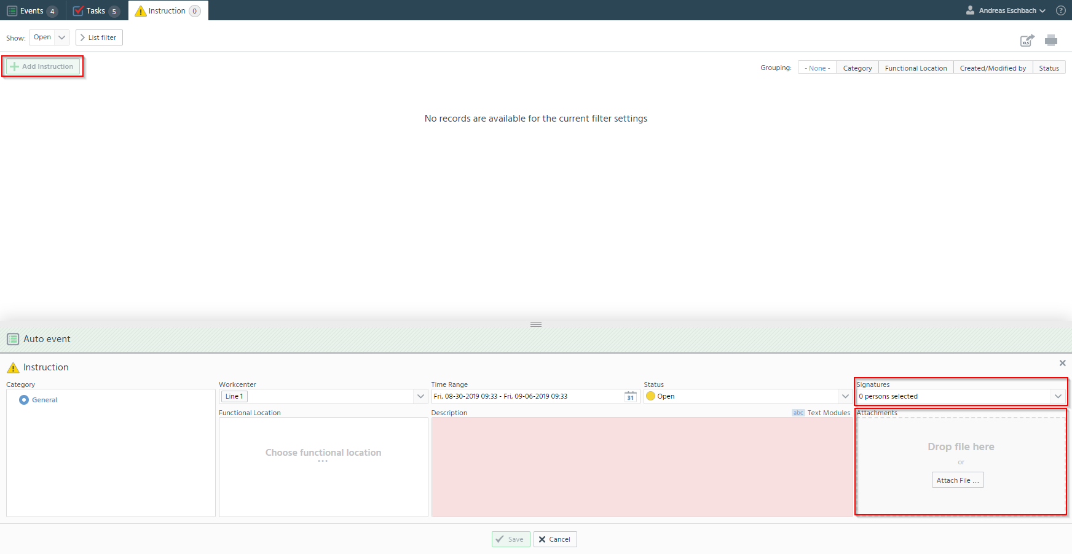
Create operational information (instruction)
Select people who need to sign the information
Attach or link documents

Slide 63
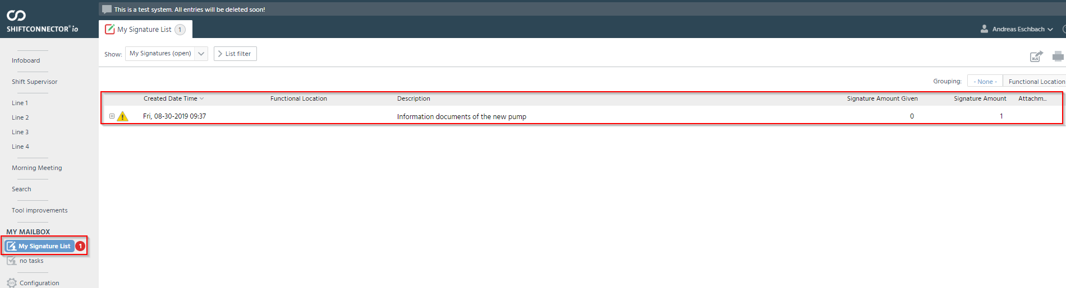
Read instructions

Slide 64
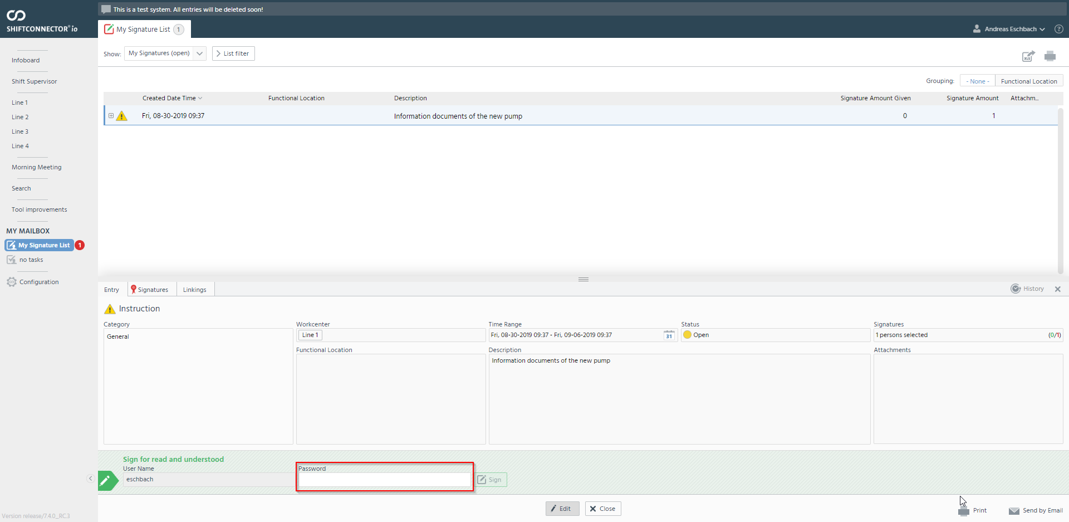
Sign for read and understood
Enter password and click on "Sign"

Slide 65
Exercise for Key User
An updated version of your operating instructions has been developed and you now want to make sure that all employees take note of the new BA and sign it.
Therefore, create a new instruction and send a signature request to all employees.

Slide 66
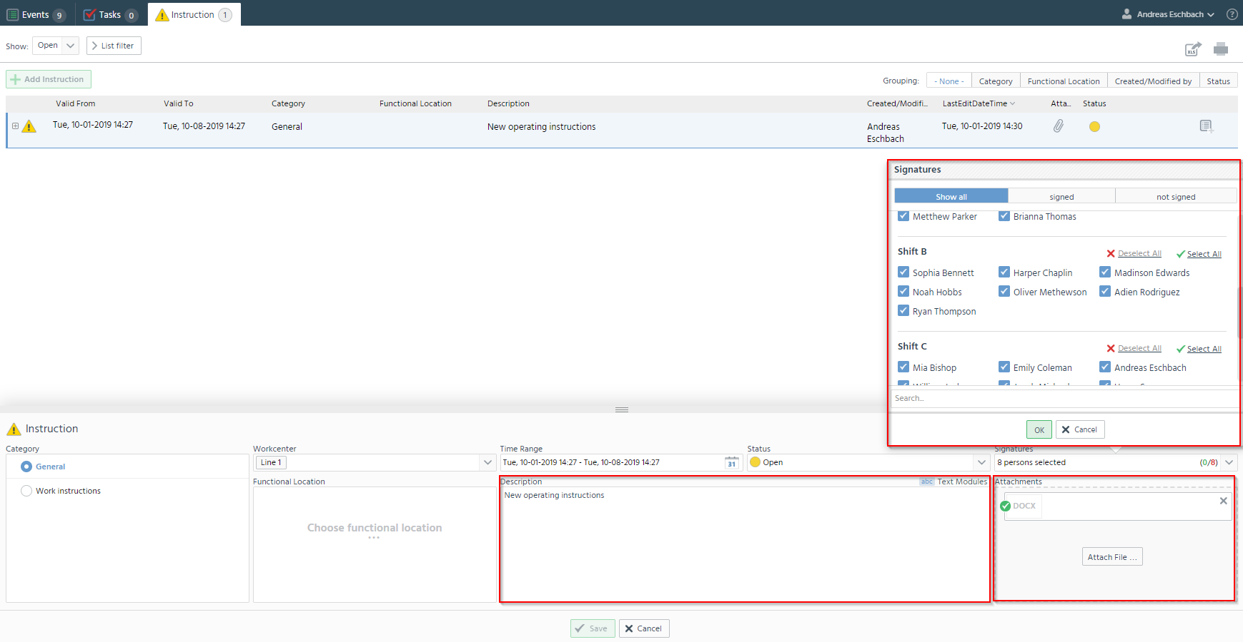
Solution
Select the persons who should read this instruction.
Describe what can be found in this instruction.
Attach documents

Slide 67
Exercise for Standard User
You have received a new signature request in your mailbox.
Please read and sign this instruction.

Slide 68
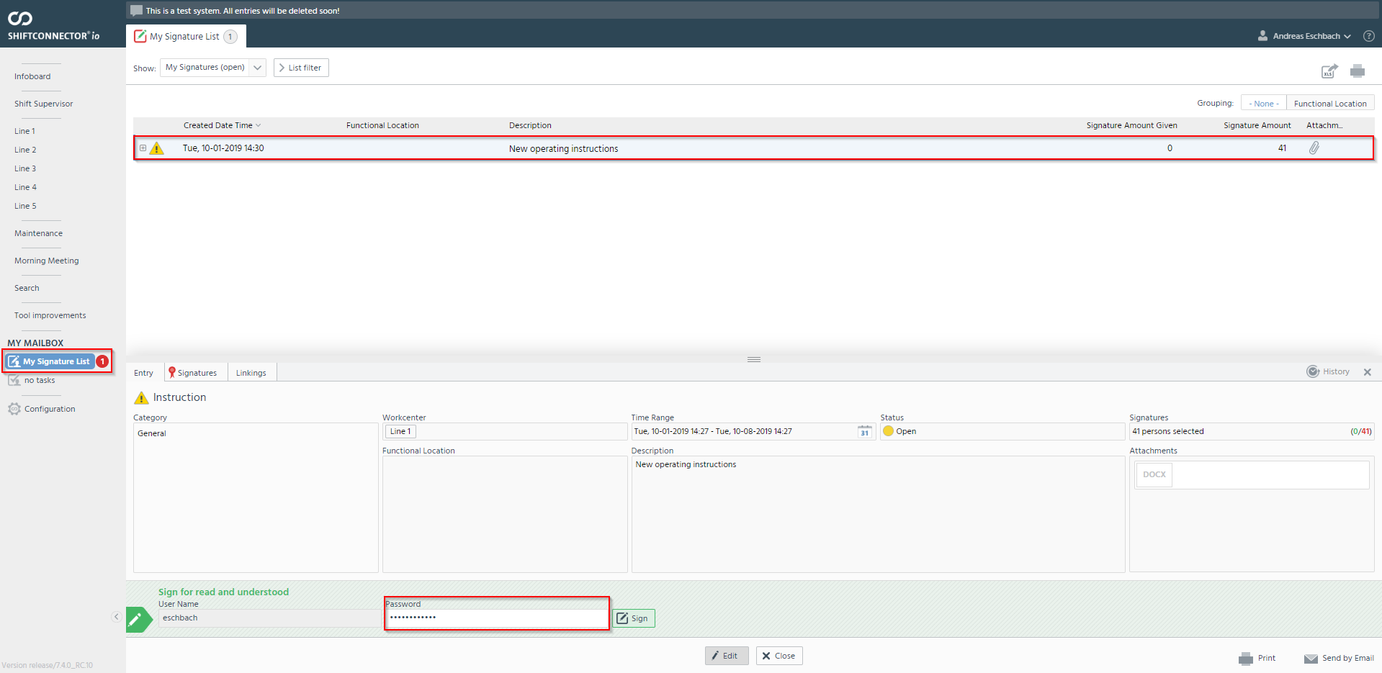
Solution
Check in the mailbox under Signature lists whether there are new messages.
Open entry.
Sign with password.

