Slide 1


io.Performance
User Training

Slide 2
Declare A Loss For OEE

Slide 3

Login
URL:
http://servername/shiftconnector
Username: USERNAME
Password: PASSWORD

Slide 4
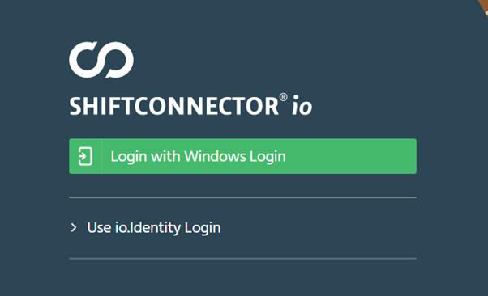
Login
Connect to Shiftconnector (https://eschbach-emea.eua.solvay.com/shiftconnector/Login.aspx?forceFormsLogin=true ) with your solvay email

Slide 5
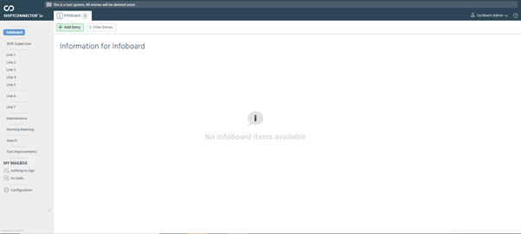
Navigate
Navigate to the structure that requires some OEE indication

Slide 6
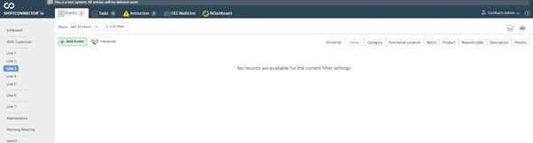
Navigate
3. Select the OEE Single/MultiUnit tab

Slide 7
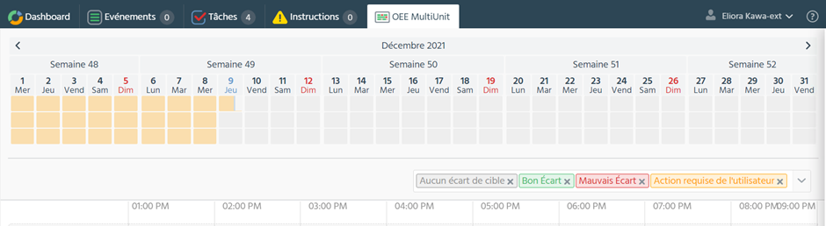
Navigate
You will then arrive on this page :

Slide 8
Navigate
As you see, the legend is showing that the orange rectangles are requiring user action

Slide 9
Enter Information
Click on the shift to have more information of the missing information

Slide 10
Continuous

Slide 11
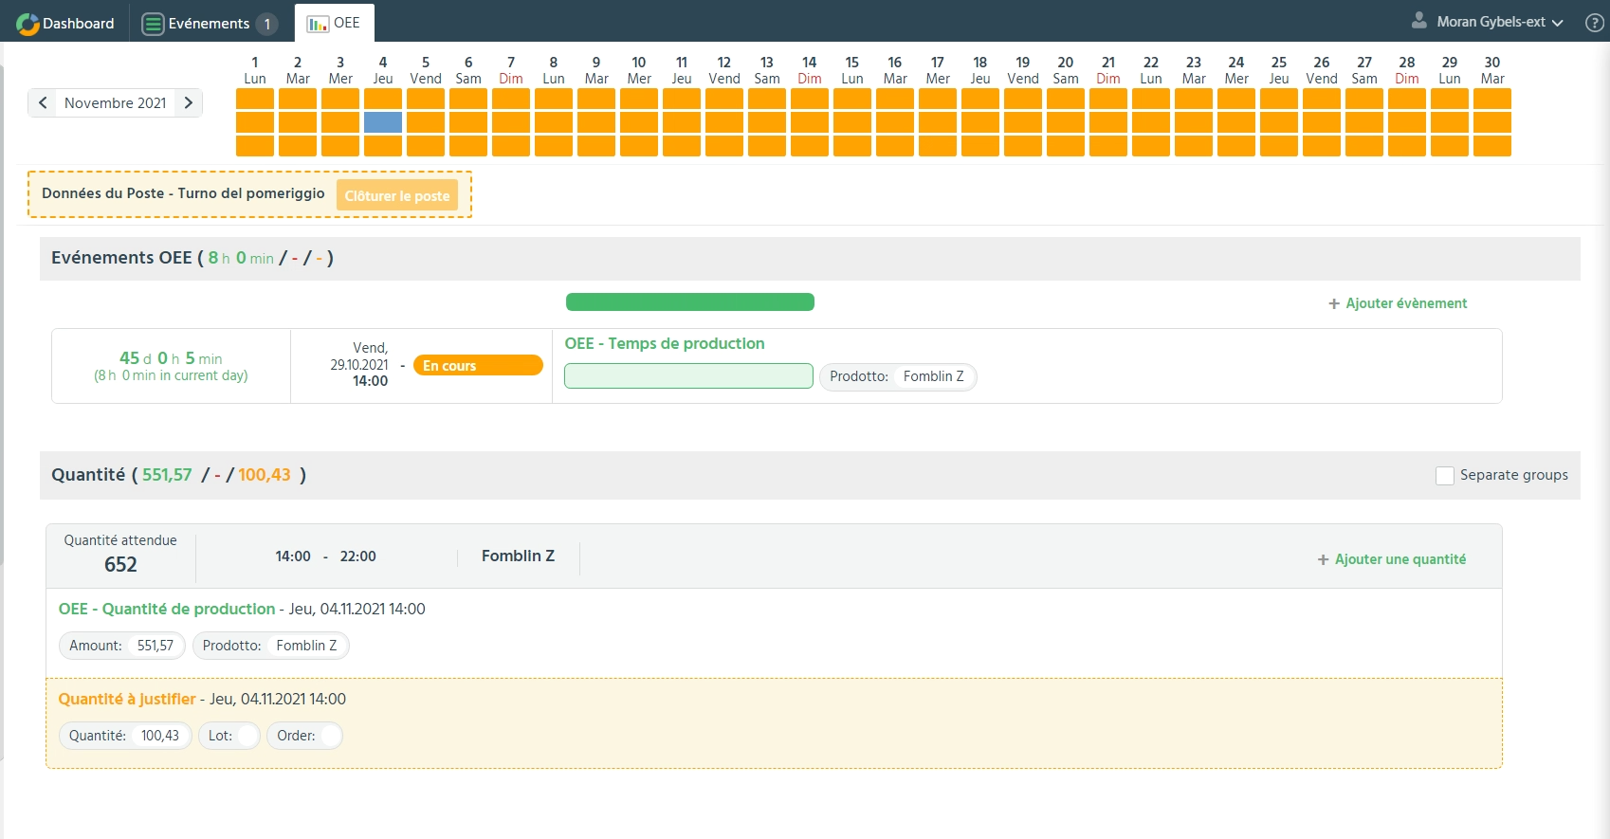
Lost Quantity
Selected Shift
Automatic Data coming from MES
Lost Quantity that needs to be accounted for

Slide 12
Continuous production
Selected Shift
Time Base
Time based section, the data can be coming from MES or can be entered manually
The time events are converted into quantity thanks to the rate of fabrication of the product
Production Base
Notes:
two types, time base and production. the time will directly be converted into production thanks to the rate that was entered. The rate of the product can be found in the product list. downtime (events) and speedloss (amount). You can close the shift as soon as the pruduction amount is reached.

Slide 13
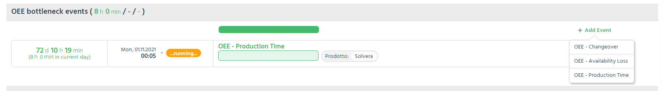
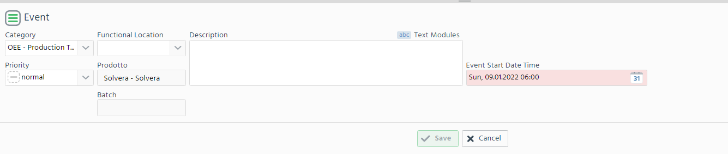
Manually Add Production Time
Will establish what is the expected amount
1
2

Slide 14
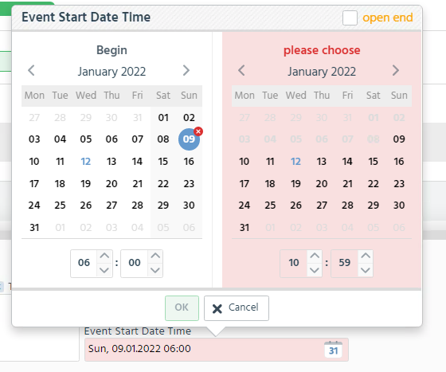
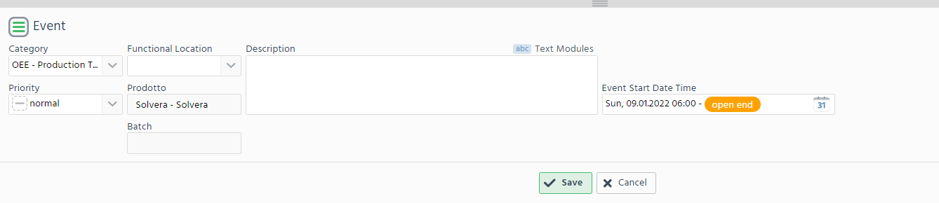
Manually Add Production Time
You can directly define the end date or chose to create a production Event with an Open End

Slide 15
Manually Add Availability Loss
An accounted Downtime will be converted into the Production Amount section and will cut down the expected amount
1
2

Slide 16
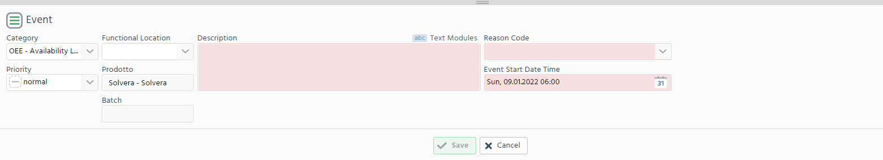
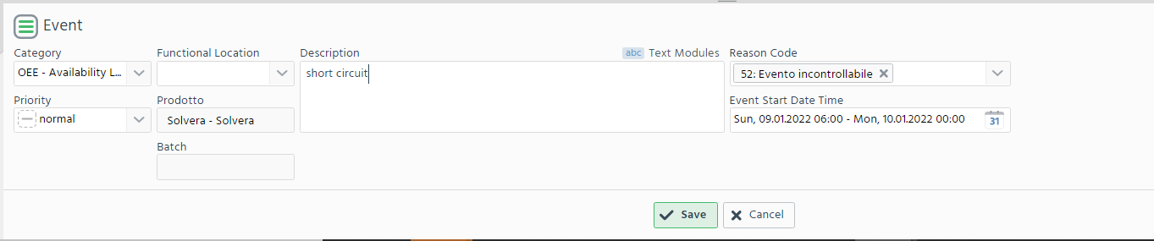
Manually Add Availability Loss
Fill in the fields that are red shaded. Those are mandatory fields

Slide 17
Manually Do a Product Changeover
Switch the product
1
2

Slide 18
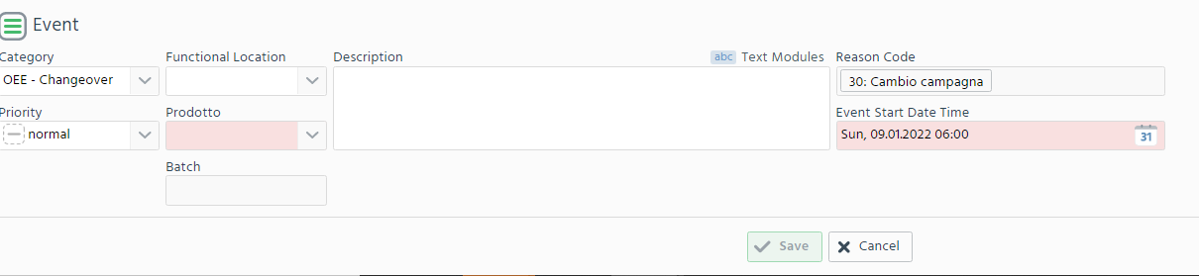
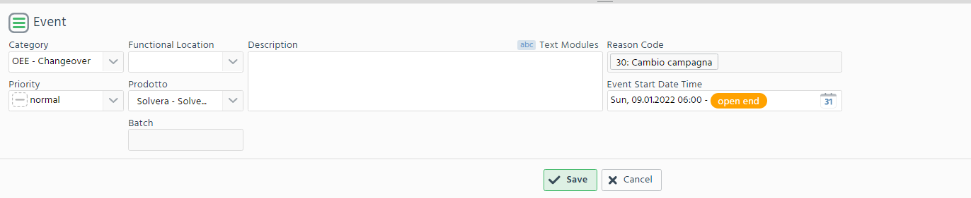
Manually Do a Changeover
Fill the field that are red shaded

Slide 19
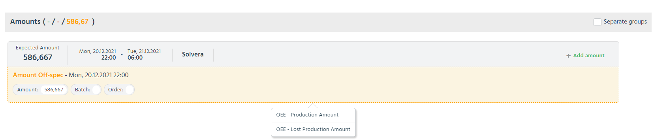
Amount Off-Specification
The amount off-spec will decrease with the extra event.
BUT to close the shift it needs to be zero
The amount is orange → requires more interaction from the Operator
Define the amount as a “Production Amount” or “Lost Amount”

Slide 20
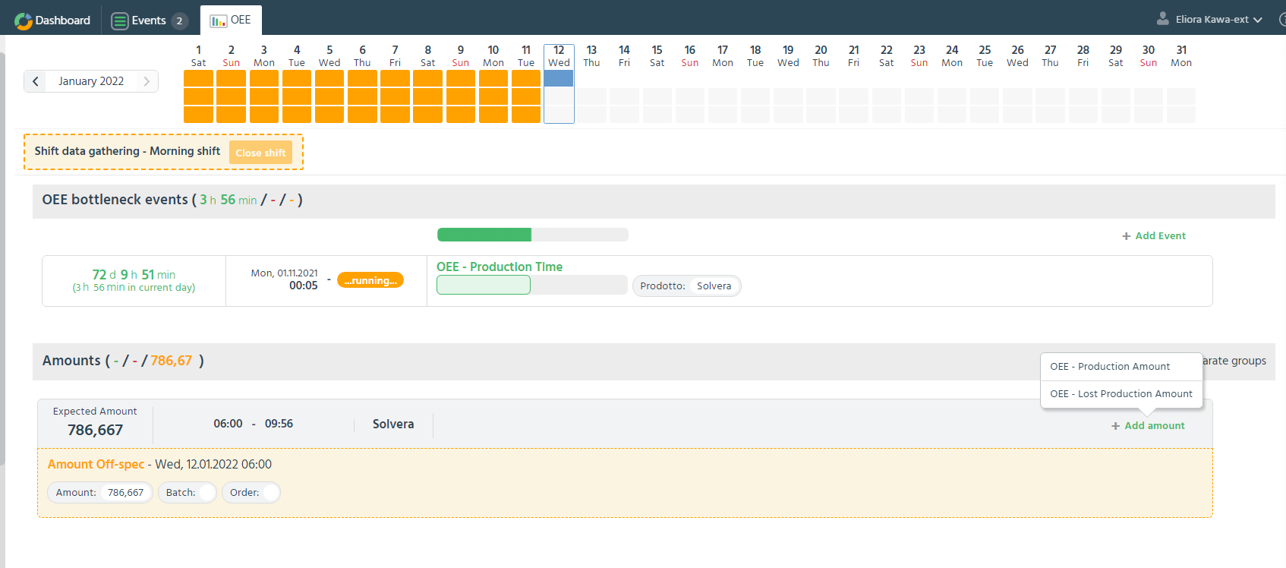
Manually Add Production Amount
2
1
Notes:
The amount section is based on the maximum possible

Slide 21
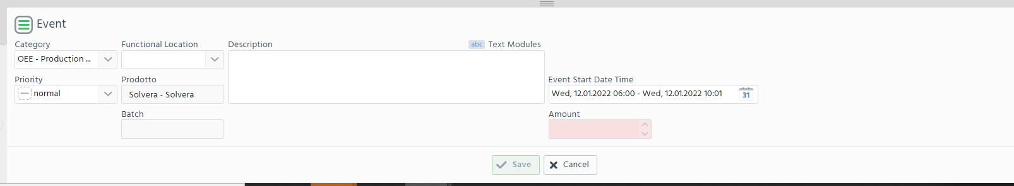
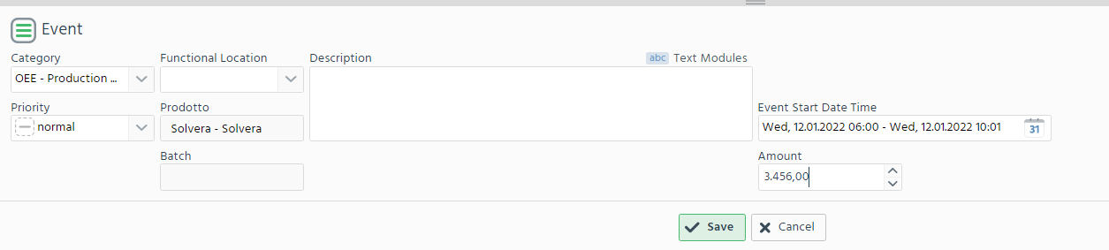
Manually Add Production Amount

Slide 22
Manually Add Lost Quantity
2
1
Notes:
If there was no time down but we just add to reduce the speed of production

Slide 23
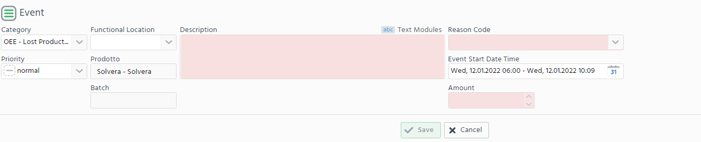
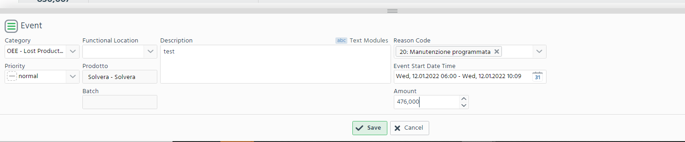
Manually Add Lost Quantity
Fill the field that are red shaded

Slide 24
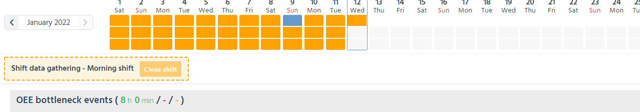
Close Shift
As soon as the expected amount as been reached → the cshift can be close and will become green
Notes:
changeover: is to produce another product. This will change the rate

Slide 25
Batch

Slide 26
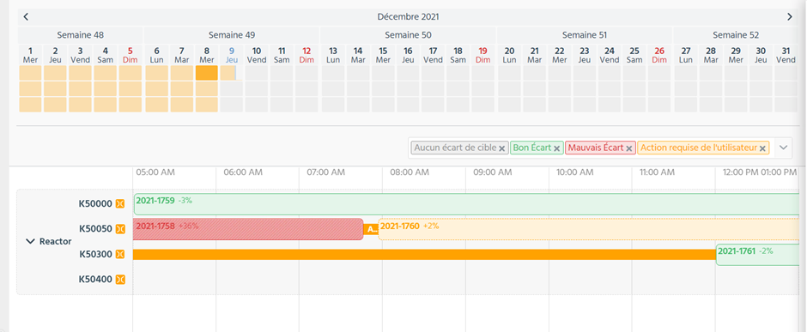
Enter Information
You will arrive on this page:

Slide 27
Enter Information
Select the Batch that you want to complete

Slide 28
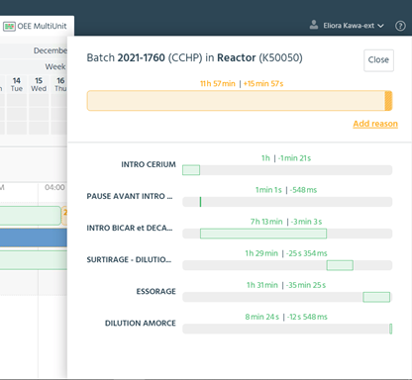
Enter Information
You will arrive on this page:

Slide 29
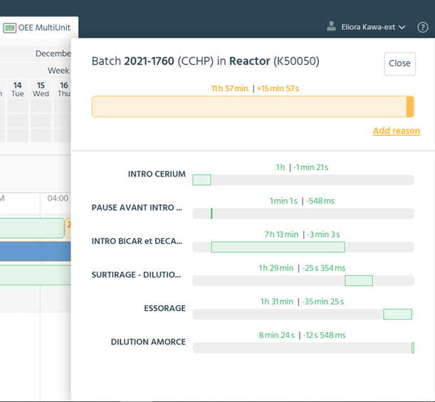
Enter Information
Select add a reason

Slide 30
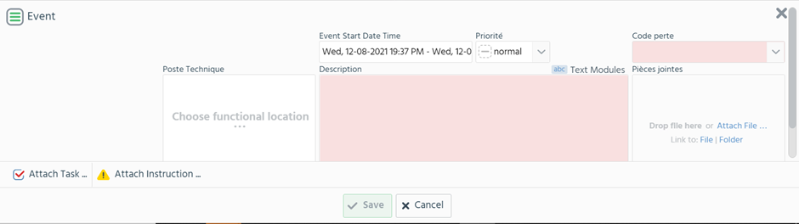
Enter Information
Fill the form. /!\ The description and the reason code are mandatory

Slide 31
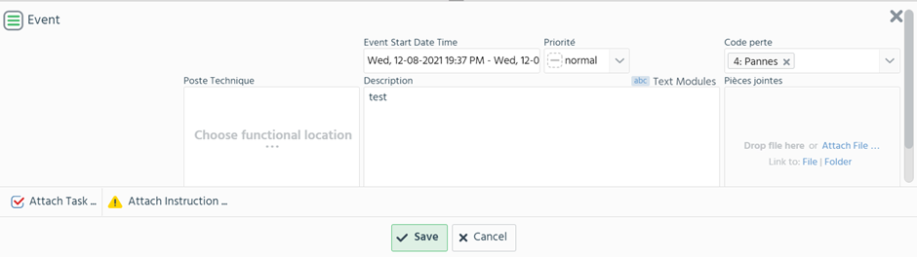
Enter Information
Save

Slide 32
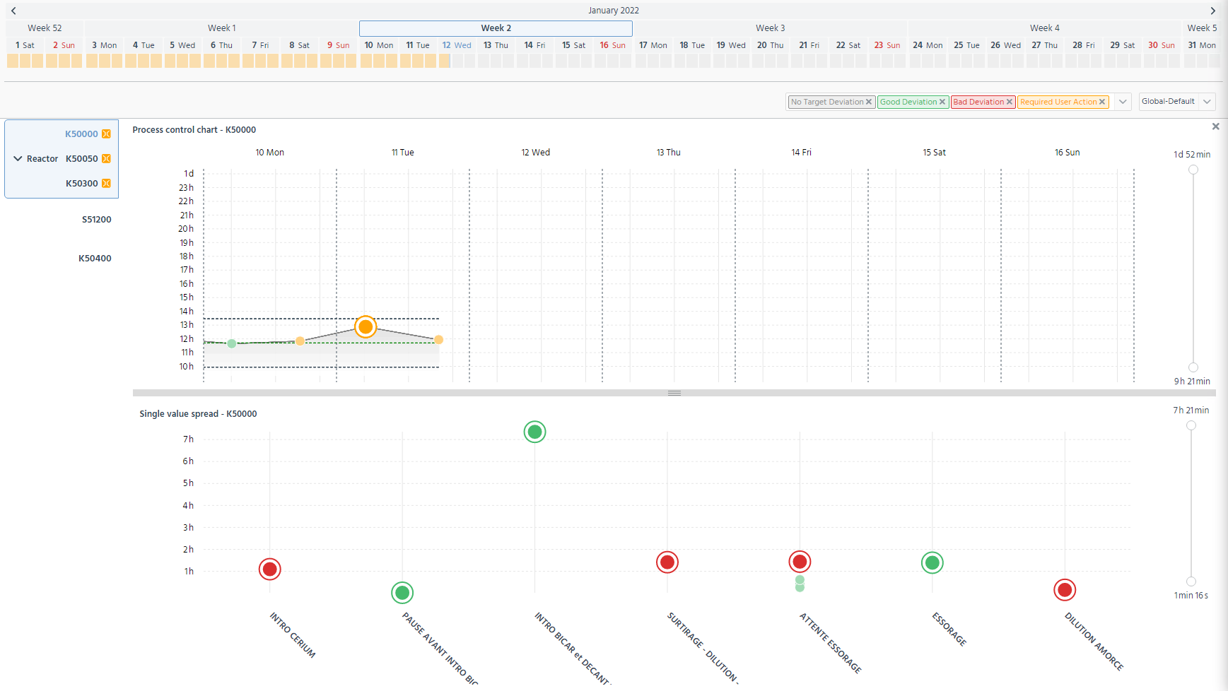
Batch Information
click
Batches Comparaison
Batches Steps Comparaison

Slide 33
Batch Information
Batches Comparaison
Goal to reach

Slide 34
Batch Information
The highlighted point are the one corresponding to the batch selected above

Slide 35
Do that for all the event that required more information

