Slide 1


Solvay Training io.Performance
Florian Lehner
Date: 13.10.2021

Slide 2
Agenda
Part 1 – User Demo
  Single Unit Conti Demo
  Multi Unit Batch Demo
  Standard OEE Dashboard Demo
Part 2 – Admin Training
  Manage Forms / Best practice for OEE forms and category assignments
  Manage Reason codes, mapping to global Waterfall
  Single Unit specific training
  Multi Unit specific training
  Reporting specific training

Slide 3
Agenda - continued
Part 3 – Setup Training
  How to identify the right structure item in Shiftconnector?
  Single Unit
    Runbook
    Historian Data / Interface Requirements
    Setup OEE Tab in Process Cell
  Multi Unit
    Runbook
    Historian Data / Interface Requirements
    Setup OEE Tab in Process Cell
    Initial Import
    Data deletion in multi unit
  How to connect the OEE dashboard
  OEE-specific API endpoints
  How to transfer from QA to Productive

Slide 4
Part 1 – User Demo

Slide 5
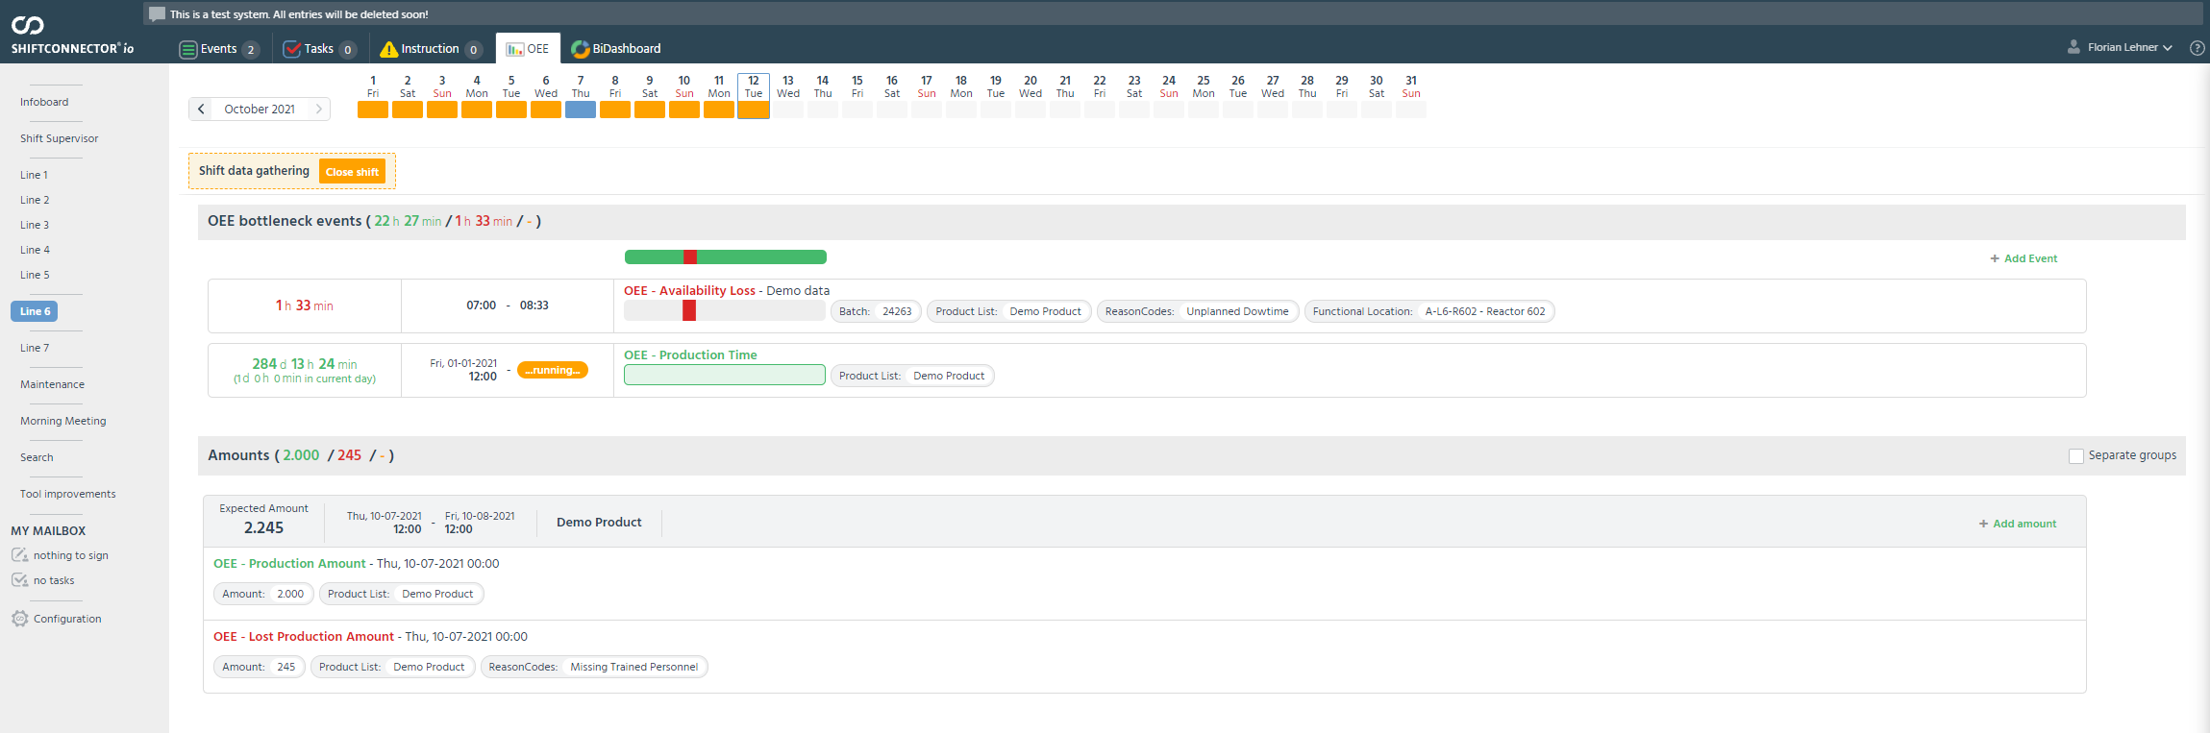
Single Unit Conti Demo

Slide 6
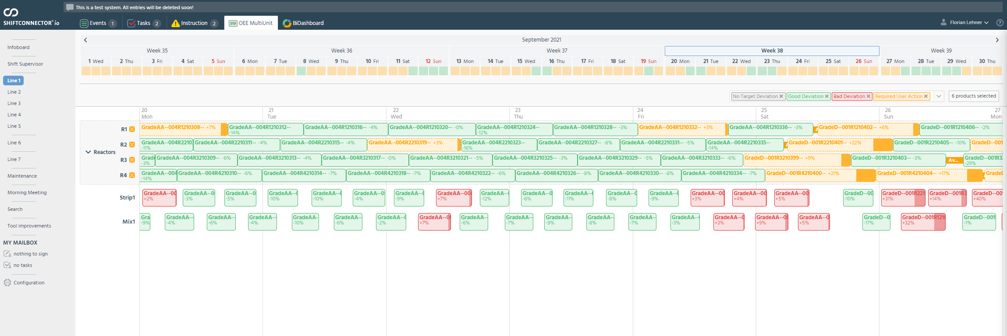
Multi Unit Batch Demo

Slide 7
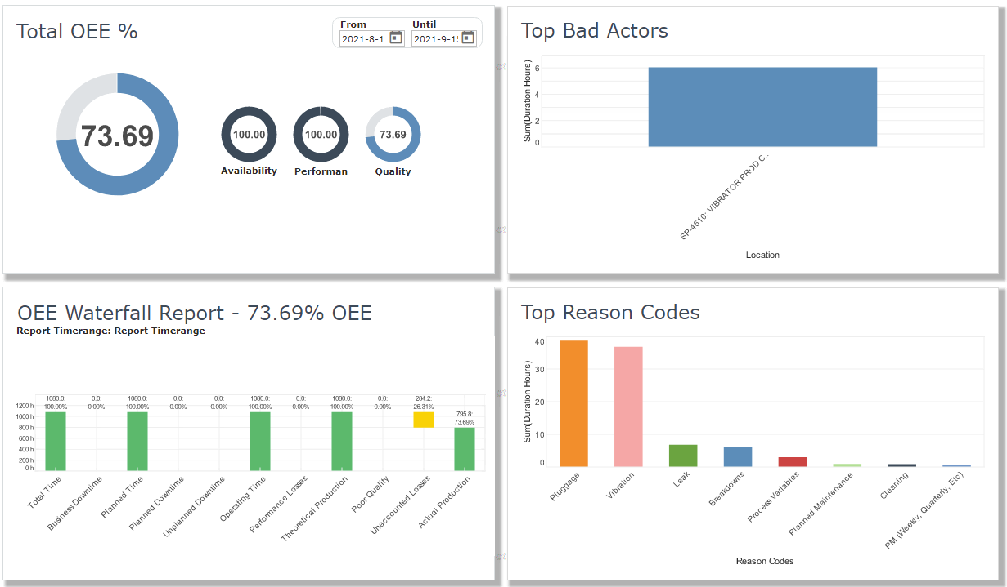
Standard OEE Dashboard Demo

Slide 8
Part 2 – Admin Training

Slide 9
Manage Forms / Best practice for OEE forms and category assignments
Defined in Runbooks → Setup Training
Forms:
  4 Single Unit (Time Production, Time Loss, Amount Production, Amount Loss)
    Important Field: BottleneckStatus (Determines whether it is running or not in Time Events)
  1 Multi Unit (Time Loss Multi Unit)
Categories:
  5 Single Unit (Production Time, Availability Loss, Changeover, Production Amount, Lost Production Amount
  2 Multi Unit (Availability Loss, Performance Loss)

Slide 10
Manage Forms
Typical Business Fields on OEE Categories
Single/Multi Specific OEE Business Fields
AssignedShiftbooks
Attachments
Batch
Category
Description
EventStartDateTime (with mandatory end date time)
EventStatus
FuncLocs
ProductList
{TenantShortName}_ReasonCodes
Multi Unit
  GLOBAL_UnitName
Single Unit
  BottleneckStatus
  GLOBAL_Amount

Slide 11
Manage Reason codes, mapping to global Waterfall
Configure default Treeselect with hierarchy, name it “Reason Codes”
Value should be empty → Will be filled or used for imports
Waterfall bucket naming in “Value1”

Slide 12
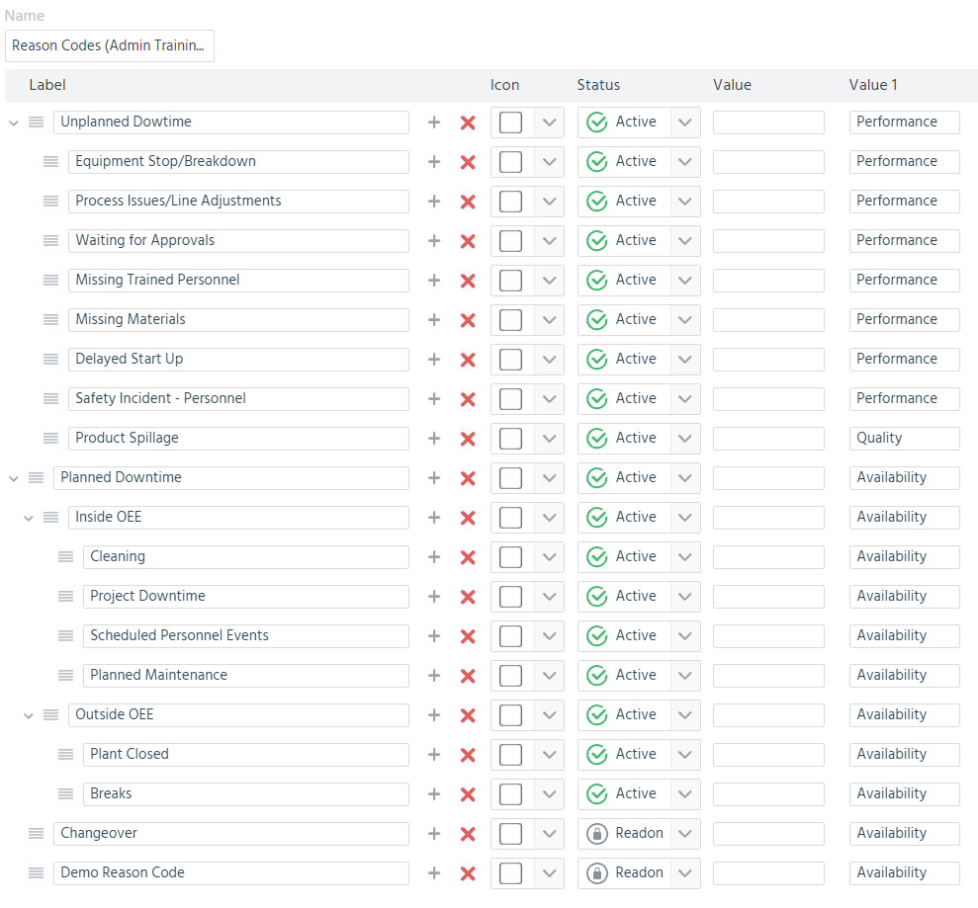
Reason Code Example

Slide 13
Single Unit specific training
Typically, just implement a blueprint configuration
Action Rights (On Tenant level)
  Add-Time-Event
  Add-Amount-Event
  Close Shift
Further options
  Change Amount Loss Threshold
  Add additional categories (e.g. multiple categories of the same type with other forms, other reason trees etc)
  Allow future shifts to be selected or not
  Disable Add-Time-Event button (only fill gaps / yellow entries)

Slide 14
Multi Unit specific training
Everything configurable in admin screen
Action Rights for each Multi-Unit Admin Tab + Creation of new configurations
Important concepts to understand:
  Inheritance
    Global → Tenant → Process Cell / Structure Item (→ Unit)
  Validity of Configurations
    Global / Tenant and Process Cell without “default configuration mode”: Following Settings are only valid from now on:
      Unit Configuration (Popup)
      Targets-Tab

Slide 15
Multi Unit specific training
Procedure to create a new OEE Multi Unit configuration
  Make sure there is a global configuration, if not configure the rights to create one and create it by clicking “Global“ (AD_* Action Rights on Global layer)
  Make sure there is a tenant configuration, if not configure the rights to create one and create it by clicking “{Tenant_Name}” (BR_* Action Rights on Global layer)
  Configure Admin Action Rights for new Structure Item (WC_* Action Rights on structure item layer)
  Create new Configuration by clicking the structure item in OEE Administration

Slide 16
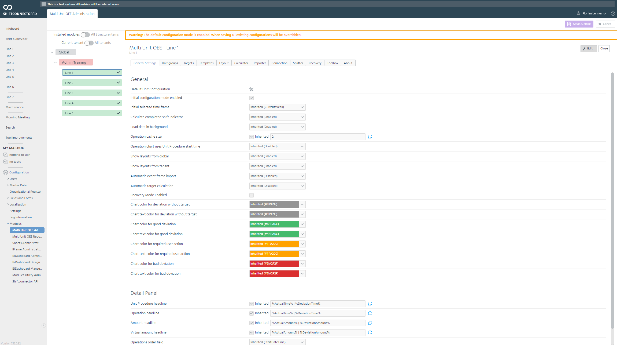
Multi Unit specific training

Slide 17
Multi Unit specific training
“General Settings”
  Overall Module behaviour, e.g. Colors, Detail Panel,
“Unit Groups”
  Configuration of Unit Groups and Units and their Unit Configuration
“Targets”
  Configuration of Target Type and actual targets (per product)
  Configuration of Bottleneck Units (per product)
“Templates”
  Configuration of Mapping of OSI-PI Eventframe template attributes
“Layout”
  Configuration of View modes for the Gantt-Visualization

Slide 18
Multi Unit specific training
“Calculator”
  Defines the time frames of the integrated target calculator. Option to run it manually
“Importer”
  Configuration of the integrated OSI-PI Import. Option to manually run an importer
“Connection”
  Configuration of the integrated OSI-PI Import connection
“Splitter”
  Deprecated, do not use.
“Recovery”
  Provides Recovery functionality for the integrated OSI-PI import
“Toolbox”
  Provides advanced functionality for deleting of data etc
“About”
  Provides information about the installed module version and some relevant IDs for database operation

Slide 19
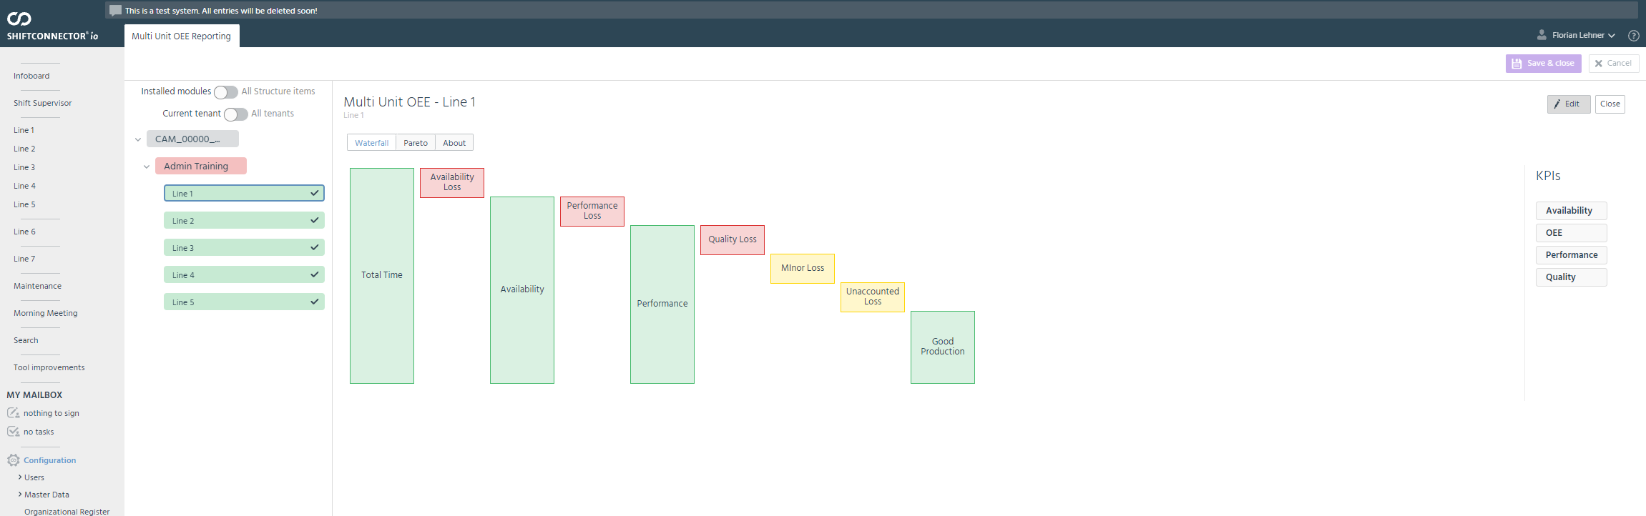
Reporting specific training

Slide 20
Reporting specific training
Available in separate Admin Screen
Requires (currently) Multi Unit to be created, but works then also for Single Unit
Provides Configuration of Waterfall and Pareto Administration
Waterfall Report can be freely configured with:
  Waterfall Bars
  Waterfall KPIs

Slide 21
Reporting specific training
Procedure to create a new Reporting configuration
  Configure Admin Action Rights for new Structure Item (WC_* Action Rights on structure item layer)
  Make sure there is a OEE Multi Unit Configuration in place
  Create new Configuration by clicking the structure item in OEE Reporting Administration

Slide 22
Part 3 – Setup Training

Slide 23
How to identify the right structure item in Shiftconnector?
Questions to ask
  Who is operating the line?
  Which organisational structure is responsible for the line?
  How does it match the ISA-88-Scheme?
Integration Options:
  Add to existing Structure Item
  Add as new Structure Item underneath an existing Structure Item
  Add as new Structure Item beneath the existing structure

Slide 24
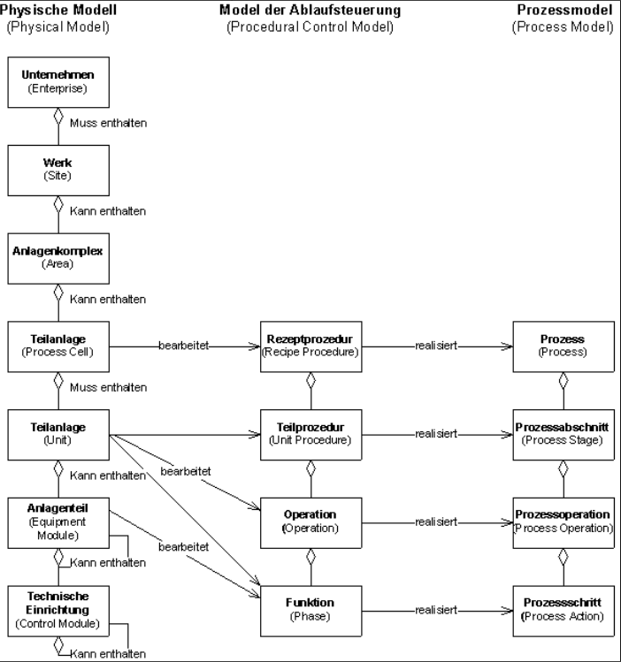
ISA-88 Standard

Slide 25
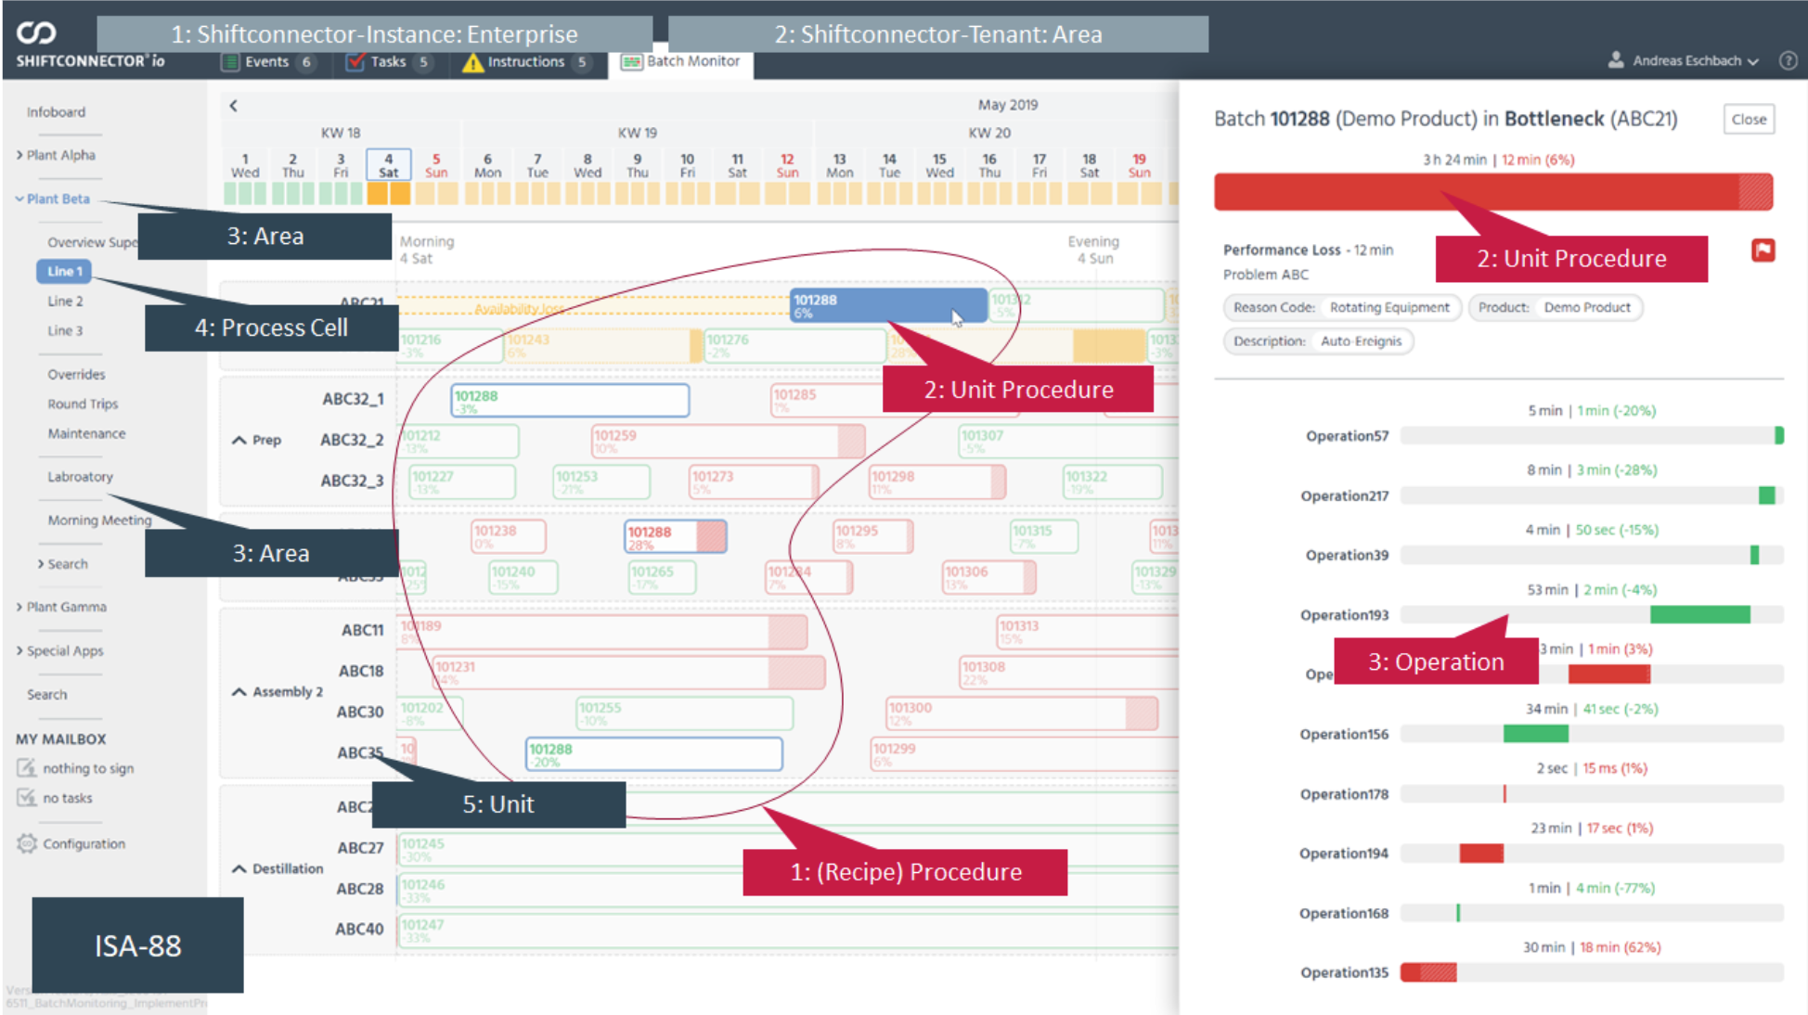
ISA-88 in Shiftconnector

Slide 26
Single Unit – Runbooks
4 Types:
  Conti Line
  Conti Monoline
  Full Conti Line
  Full Conti Monoline
Differences in:
  Implementation scripts
  Required categories
  Finalization steps
  Interface requirements (what types need to be provided)
Typical Runbook:
  Global & Tenant Configuration
    Rights
    Reason Codes
    Business Fields
    Form Templates
    Categories
    List Template Layout Definition
  Process Cell / Structure Item Configuration
    Assign Categories to Structure Item
    Assign List Templates to Structure Item
    Product Creation & Assignment
    OEE Tab Configuration
    Reporting Configuration
  Finalization
    Doing some finalization tasks
  Interface Setup (if required)

Slide 27
Single Unit – Interface Requirements
Event-Driven Data
  Start
  End
  Product
  Type (~Category, 1:1 mapping)
  Additional fields (depending on use case, not always required)
    Produced Amount
    Reason Code (optional)

Slide 28
Single Unit – Setup OEE Tab in Process Cell
Hands on:
  Create new Line 8 with blueprint “Conti Line”
  Follow the Runbook and do all required steps
  Prepare the SQL Script for actual setup

Slide 29
Multi Unit – Runbooks
1 Type currently:
  Batch Multi Unit
Typical Runbook:
  Global & Tenant Configuration
    Rights
    Reason Codes
    Business Fields
    Form Templates
    Categories
    List Template Layout Definition
  Process Cell / Structure Item Configuration
    Assign Categories to Structure Item
    Assign List Templates to Structure Item
    Product Creation & Assignment
    OEE Tab Configuration
    Reporting Configuration
  Finalization
    Doing some finalization tasks
  Interface Setup (if required)

Slide 30
Multi Unit – Interface Requirements
Event-Driven Data → For each Unit
  Start
  End
  Product
  Unit
  Layer (UnitProcedure, Operation)
  UniqueIdentifier
  Additional fields (depending on the layer, not always required)
    Parent UniqueIdentifier (for mapping, must match)
    Operation Name (Only for Operation Layer)

Slide 31
Multi Unit – Initial Import
Typical workflow:
  Import or create Unit Groups / Units
  Import Performance Event Data (Integrated PI-Interface or via API)
  Check if data is coming up
  Start Calculator
  Check if result is coloured
  Define Bottleneck Units
  Define static targets (if required)

Slide 32
Multi Unit – Data deletion / reimport
IMPORTANT: DO THIS ONLY BEFORE USERS START WORKING
Typical workflow:
  Delete data via Toolbox
  Check user app
  Reimport data
  Check user app
  Run Calculator
  Check user app

Slide 33
How to connect the OEE dashboard
OEE Dashboard Multi:
  Datasource 1 (Waterfall Multi Unit)
  Datasource 2 (Loss Events)
OEE Dashboard Single:
  Datasource 1 (Waterfall Single Unit)
  Datasource 2 (Loss Events)

Slide 34
OEE-specific API endpoints
Multi Unit Waterfall:
  <ShiftconnectorUrl>/moduleApi/CM_00000_OEE_MultiUnit/OeeMultiUnitReporting/V1/GetReportAsDataSetGet
  Parameters:
    reportSystemName ("WaterfallReport")
    structureItemGuid
    reportStartDateTime
    reportEndDateTime (optional, if not set the whole month where <reportStartDateTime> lies in will be used
Single Unit Waterfall:
  <ShiftconnectorUrl>/moduleApi/CM_00000_OEE/OeeReporting/V1/GetReportAsDataSetGet
  Parameters:
    reportSystemName (“SingleUnitWaterfallReport")
    structureItemGuid
    reportStartDateTime
    reportEndDateTime (optional, if not set the whole month where <reportStartDateTime> lies in will be used

Slide 35
How to transfer from QA to Productive
Multi Unit
  Re-run Runbook
  Manually transfer any other configuration done in the QA system
  Start productive data import (like in QA)
Single Unit
  Re-run Runbook
  Manually transfer any other configuration done in the QA system
  Start productive data import (like in QA)

Slide 36
Thank you for the attention!

