Slide 1




Slide 2
Agenda
Scope & Plus
How to log into AODocs
Consultation of Report
BO_Labware
How to add a link
LAb Role

Slide 3
Scope
Change how the Reports are managed in Labware,
moving from results stored in a local server to a web link
PLUS
Power search engine
Easy to download and modify
Smart access right

Slide 4
How to log into AODocs?

Slide 5
Opening AODocs using the link
ALL
RoleS
SAVE THE LINK!!!
https://aodocs.altirnao.com/?locale=en_US&aodocs-domain=solvay.com#Menu_listDoc/LibraryId_QWnFUzd0iqz0ZUDSJY/ViewId_SRRFC7h71d4cMU1CUW/Filter_%257B%2522SRREu9HuemL8c6oXCY%2522:%2522SRREG4fu77yKGbaFzV%2522%257D

Slide 6
Consultation of the report

Slide 7
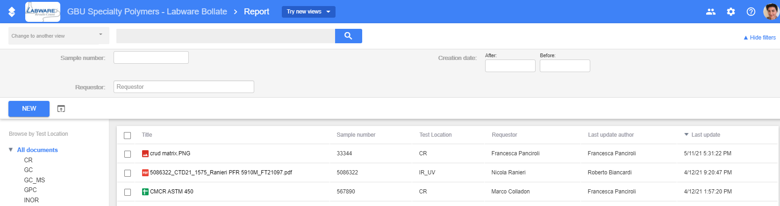
Consultation of the report by AODocs
ALL
RoleS
Many filters available
Lens search for any words in the document
Test location on the left
Sample, Requestor, Doc creator and a period at the top
Sort by latest update

Slide 8
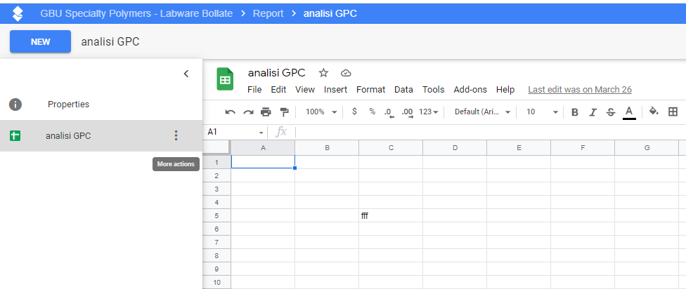
Consultation of the report by AODocs
ALL
RoleS
KEY ADVANTAGES
EASY TO SEARCH
EASY TO DOWNLOAD
-Click on a doc
-Click on More Actions
-Click on download
You can have your copy to modify and store where you prefer

Slide 9
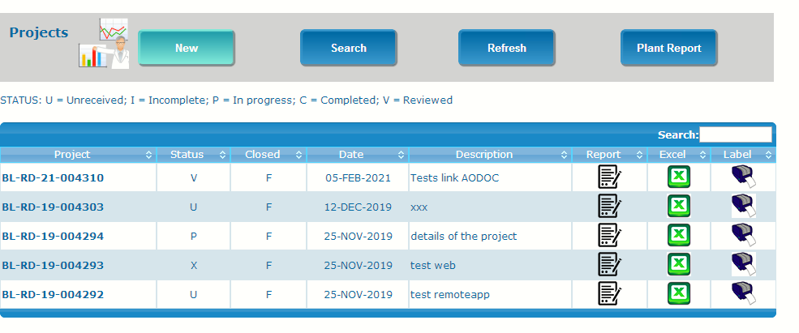
Consultation of the report by Project
REQUESToR Role
Labware allows to consult the aodocs documents in the project form
The link of the document is also included in the Summary Report

Slide 10
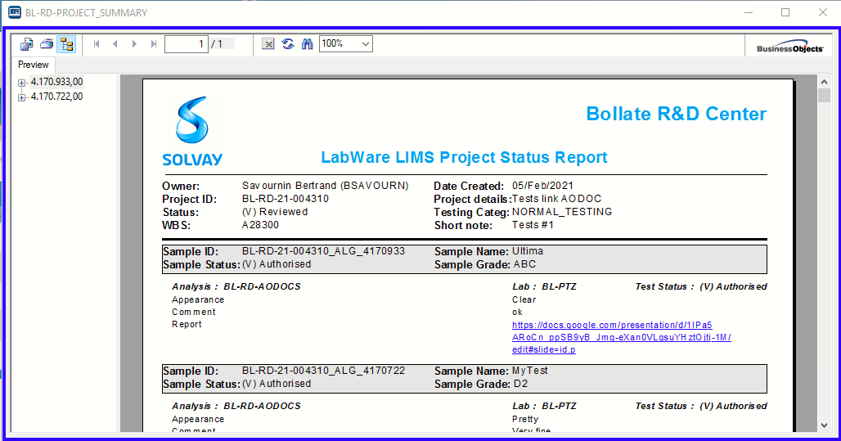
Consultation of the Report by Summary
REQUESToR Role
The link of the document is reachable in the Report as well

Slide 11
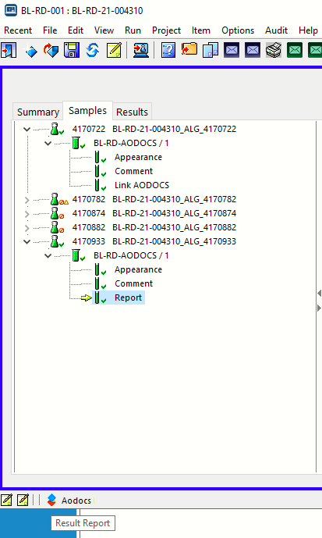
Consultation of the report by Sample
REQUESToR Role
Click on the part of the result named REPORT and the document is reachable by clicking the Aodocs icon

Slide 12
What about BO_Labware?
GOALS
Keeping historical data
Everything in one place
ACTION PLAN
Folder will be put in read only mode
Reports will be migrated in Aodoc Library
TIMELINE: Golive Aodoc week 20 and Migration a month later

Slide 13

Question & Answer

