Slide 1


DataLab for
Mechanical Tests
Roberto Totaro
Luigi Giraldi
Davide Sartori
Paolo Fossati
June 25th, 2024

Slide 2


AGENDA
New Labware codes for tensile and flexural tests
Introduction to DataLab

Slide 3
NEW LABWARE CODES FOR TENSILE AND FLEXURAL TESTS
New unified Labware code have been introduced in Bollate and Alpharetta.
Tensile and flexural tests will be covered by two new codes:
BL-RD-MECH-TENSILE with 10 variations
BL-RD-MECH-FLEX with 2 variations

Slide 4
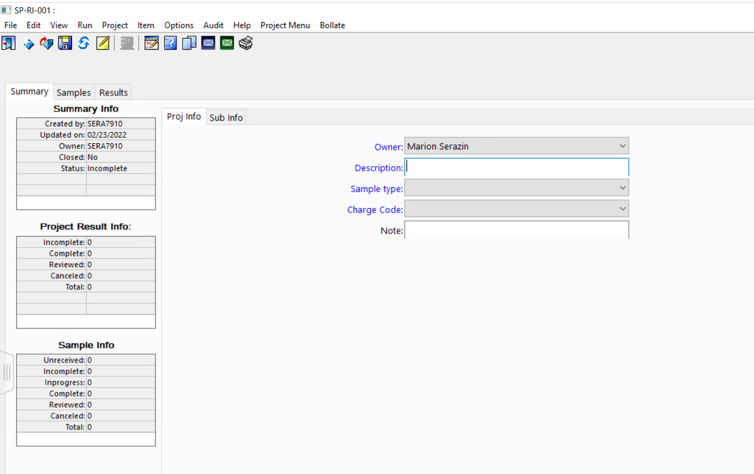
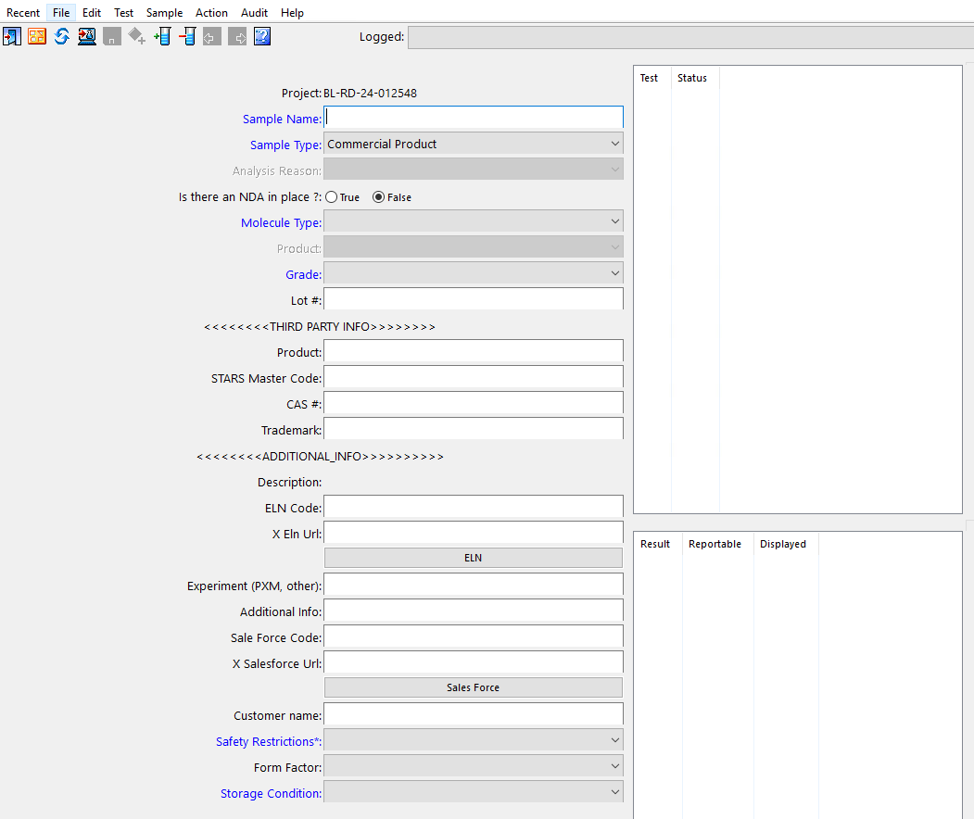
a. CREATION OF THE LABWARE REQUEST
When creating a new request, the user compiles the well known project and sample templates:

Slide 5
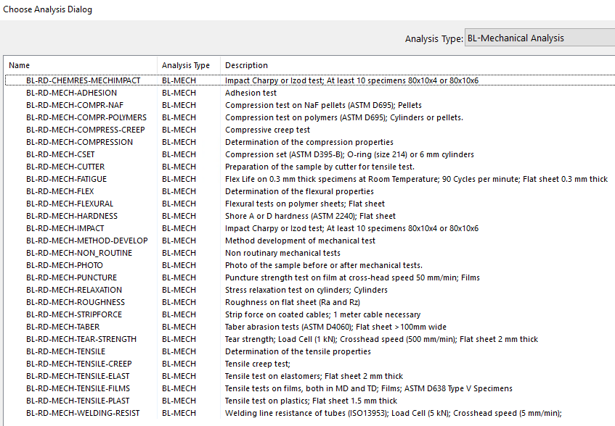
b. ASSIGNMENT OF THE REQUESTED TESTS
Steps for test assignment of tensile and flexural tests:
1. Selection of the new Labware codes BL-RD-MECH-TENSILE or BL-RD-MECH-FLEX
New test codes
Old codes to be deleted

Slide 6
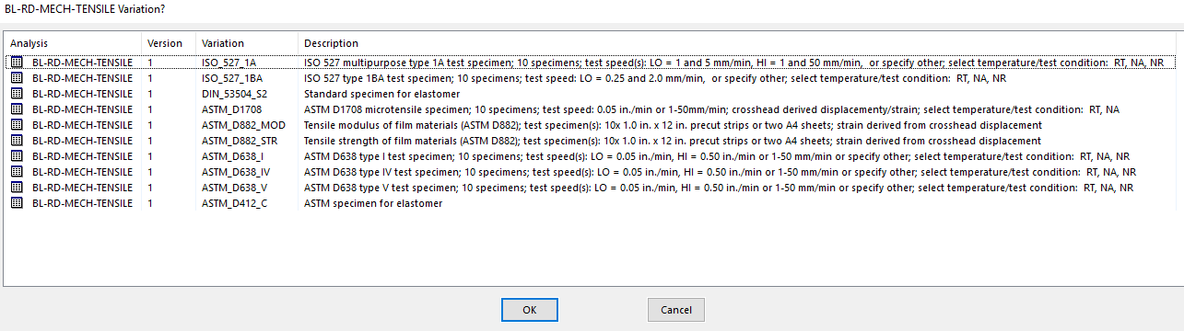
BL-RD-MECH-TENSILE
2. Selection of the test variations to specify the details of tensile test.

Slide 7

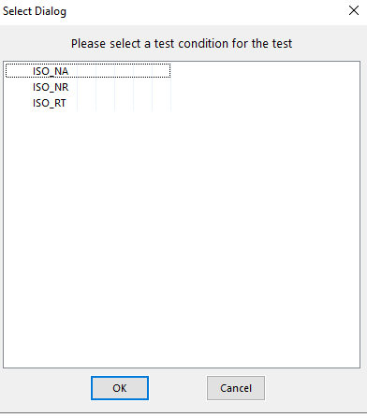

BL-RD-MECH-TENSILE
The list of the test conditions is filtered with the variation selected. If the user selected an ISO variation, the values of testing conditions will be:
ISO_NA (Non-Ambient)
ISO_NR (Non-Routine)
ISO_RT (Room Temperature)
Same kind of filter is applied to DIN and ASTM standards.
3. Selection of the test conditions:
Expected date management:
For RT (Room Temperature):
Expected date: +7 days
For NA (Non-Ambient) or NR (Non-Routine):
Expected date: +14 days

Slide 8
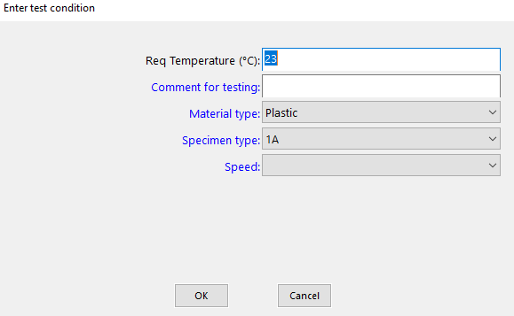
BL-RD-MECH-TENSILE
4. Selection of the test conditions:
Fixed (23°C) for RT
Mandatory for NA
Mandatory for NR
Plastic
Elastomer
Film
HIGH (50 mm/min)
LOW (5 mm/min)
To be defined by the lab

Slide 9
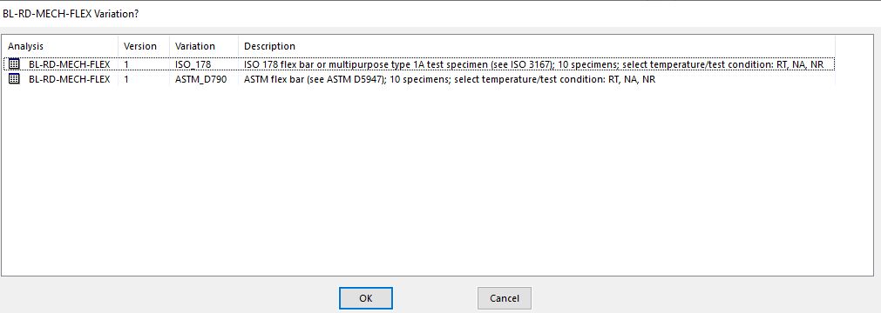
BL-RD-MECH-FLEX
2. Selection of the test variations to specify the details of flexural test.

Slide 10
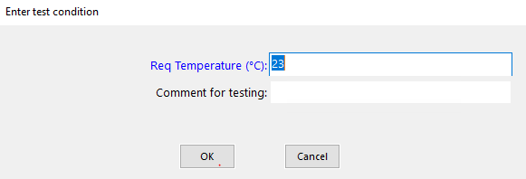
BL-RD-MECH-FLEX
3. Selection of the test conditions:
4. Selection of the test conditions:
Fixed (23°C) for RT
Mandatory for NA
non ambient temperature
non routine tests
room temperature
Mandatory for NR

Slide 11

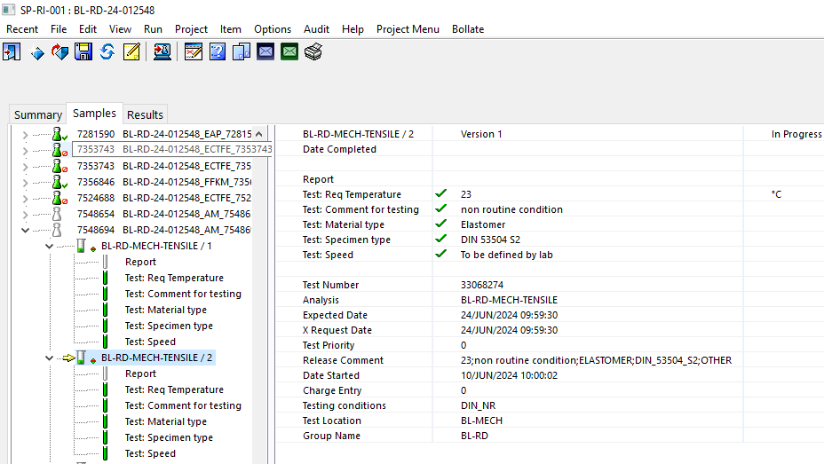
c. SAMPLE LOGIN
Once the sample form is filled out, analysis and variations are assigned and testing conditions are completed, the user can log the sample via the usual icon:
Once sample is logged, sample and tests information are available in the Samples tab of the project:
List of tests linked to the sample
Testing conditions are entered in the component where test tubes are green
Mandatory results are displayed with an empty test tube.

Slide 12
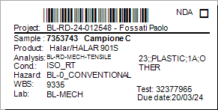
d. SAMPLE LABELS
After the sample login step, the requester can generate and print sample label to physically send the sample(s) to the lab.
The new format of the sample label is the following:
Data displayed
Confidentiality | Sample Number | Analysis | WBS
Project ID | Sample Name | Test conditions | Lab ID
Owner | Product | Hazard | Due Date

Slide 13

AGENDA
New Labware codes for tensile and flexural tests
Introduction to DataLab

Slide 14
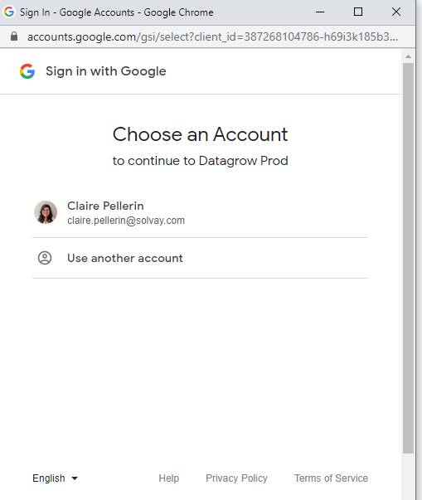
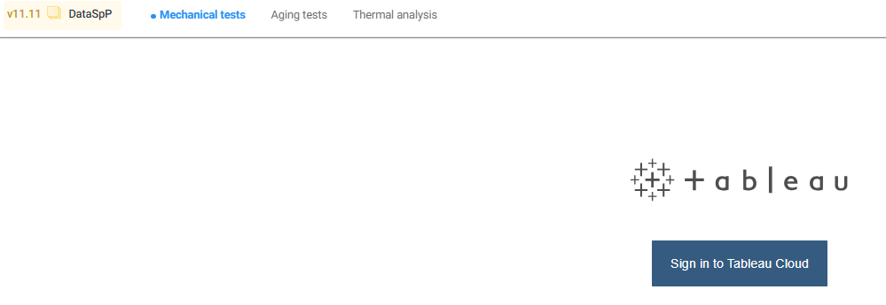
Accessing DataLab
📍You need to be connected to Solvay’s network (on site or using VPN)
1
Go to https://datalab.syensqo.com/
Select “Mechanical tests”
Click on “Sign in with Google”
Sign in using your Solvay account
2
3
4
4
2
3

Slide 15

The Dashboard - User profiles
Two different access profiles were set for users:
Researcher/Lab Analyst Role: having access to all Labware’ Sample Types
CTD Role: having access to all Labware’ Sample Types, except R&I (Internal R&I samples) and Environmental

Slide 16
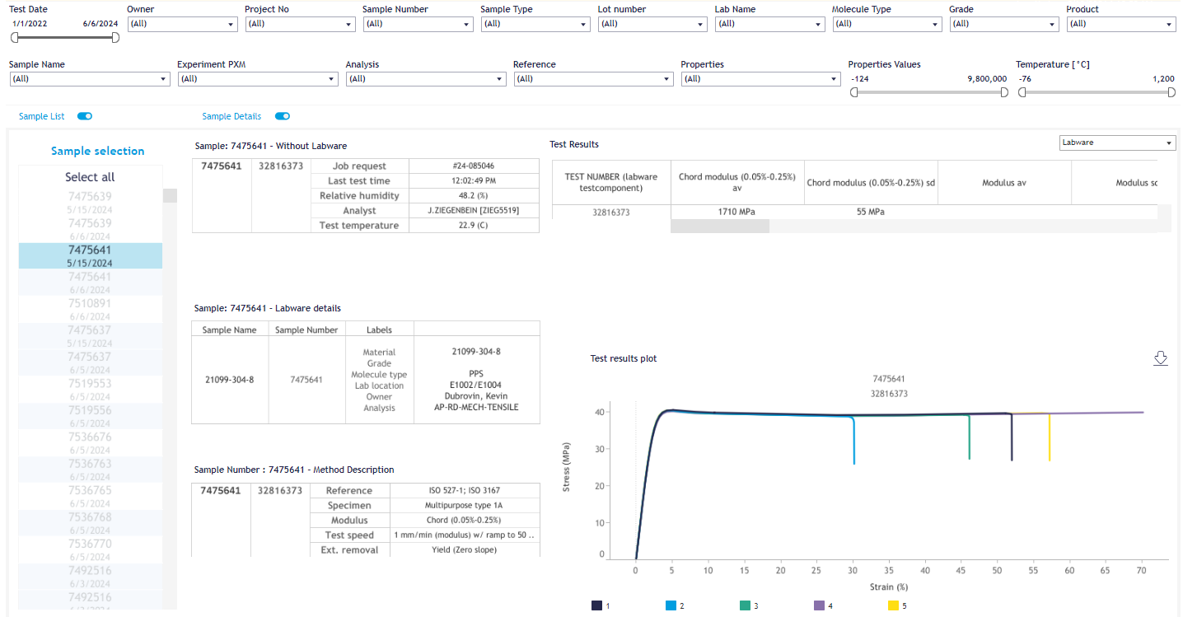
The Dashboard
The dashboard is divided in four parts:
  Filtering section
  Sample list
  Sample details
  Test Results

Slide 17
The Dashboard - How to search?
The filtering section will help you to navigate and refine the list of mechanical tests retrieved through Labware
You can search applying these filters:
  Test Date
  Owner (as defined in Labware’ sample in Owner field)
  Project number
  Sample Number
  Sample Type
  Lot number
  Laboratory name
  Molecule Type
  Grade
  Product
  Sample Name
  Experiment PXM
  Analysis Type
  Mechanical test reference (ASTM, ISO)
  Test Results
  Test Temperature

Slide 18
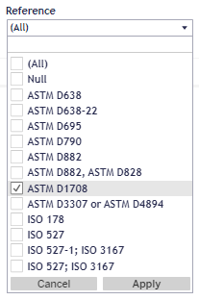

The Dashboard - How to use the filters ?
Checklists
e.g. Owner,Project
Sliders
e.g. Temperature, Test date
Select/unselect all the sample by clicking on the “(All)” option
Select/unselect a specific value by clicking on the checkbox on the left
You can search for a specific text using the search bar
📍Once your choices are done, click on Apply to validate your choices. Otherwise, the filter will not be applied.
Move the two gray placeholders to select the minimum and maximum values you want
You can manually input the min/max value by clicking on the value
💡 Every time a filter is applied, the sample list will be updated automatically.
Notes:
Add a la main

Slide 19
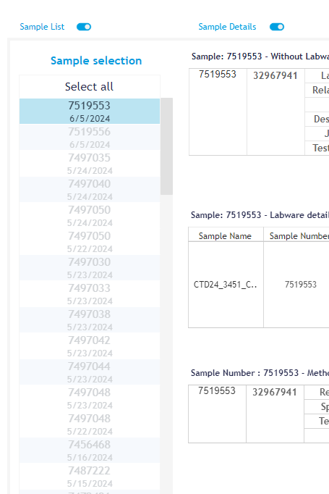
The Dashboard - Sample List
From the sample list, you can pick one mechanical test to further analyze its properties.
Every test is reported with its reference sample number and its login date.
You can select more than one sample at the same time.
  Hold down the “CTRL” button on your keyboard: individually select another sample, or drag the mouse cursor over the samples you would like to select together.
As soon as the selection of the samples is made, you have the option to hide the list. Click on the “Sample List” button on the top of this section in order to hide.

Slide 20
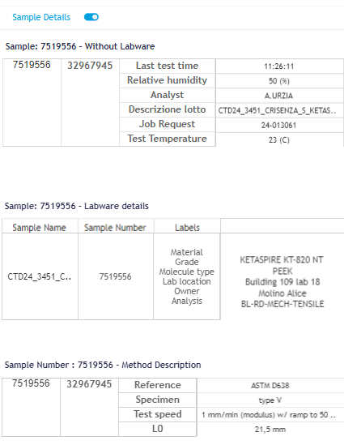
The Dashboard - Sample Details
This section is divided into three sub-sections:
  Properties coming from reports produced by Lab instruments
  Properties coming from Labware
  Details regarding the method used for the mechanical test
In the case of multiple selected samples, the tables will have every sample number/test number reported.
To hide this section, click on the “Sample Details” button at the top of this section.

Slide 21
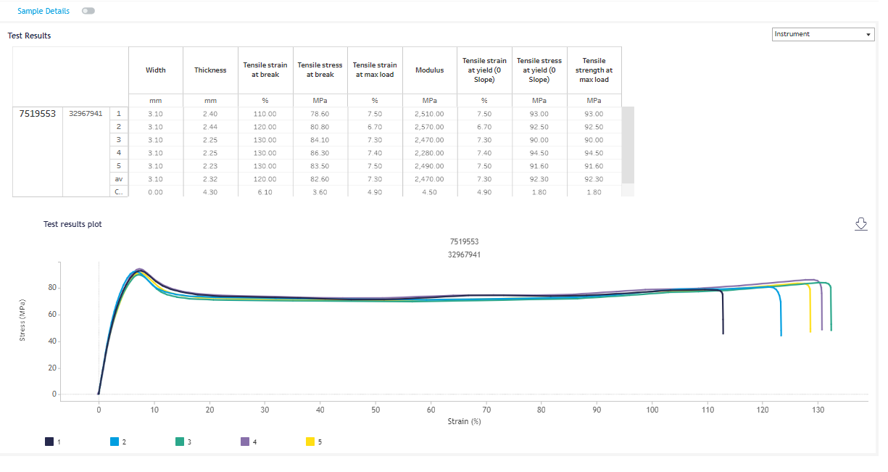
The Dashboard - Test Results
In this section, it’s possible to retrieve the result table coming from the reports generated by lab instruments (information about single specimens) and the stress/strain curves.
To swap between Labware and instrument results table, click on the selector on the top of this section.

Slide 22
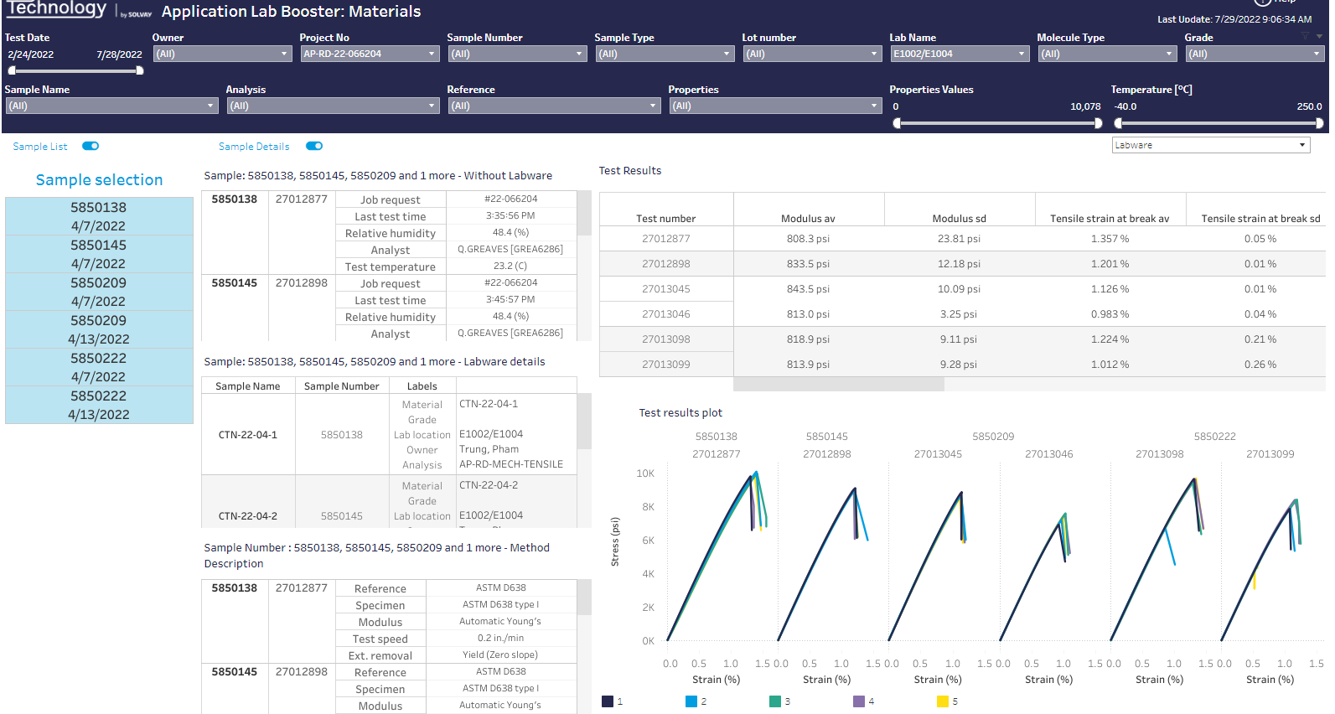
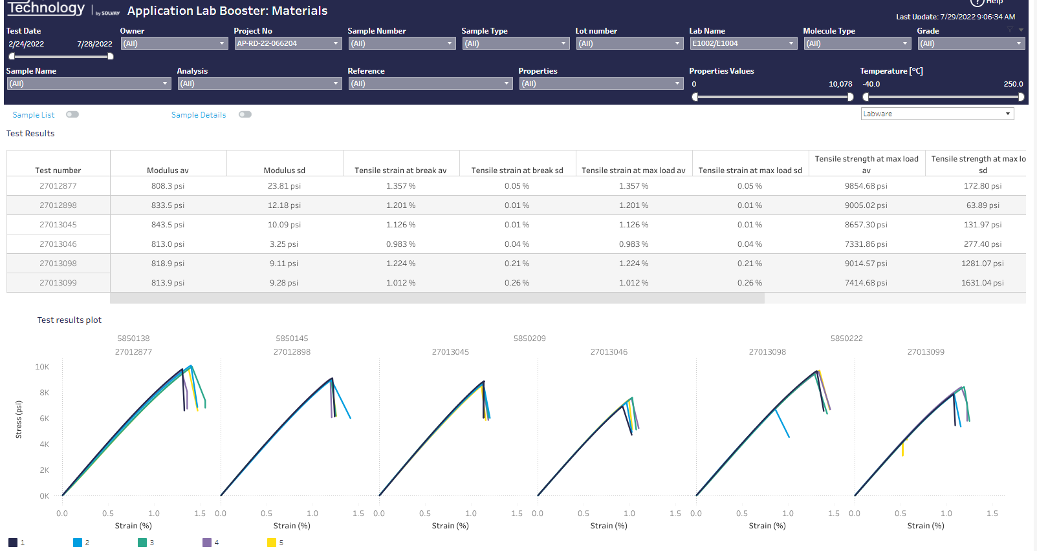
The Dashboard - Test Results
In case multiple samples are selected, it’s possible having a comparison among them.
To focus on the results, it’s possible to hide the sample list and/or the sample details, clicking on the proper buttons.

Slide 23
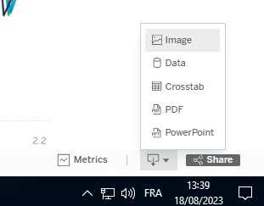
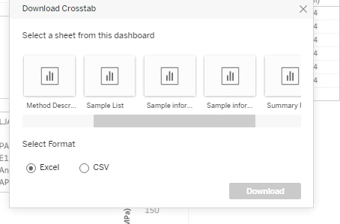
The Dashboard - Export the dashboard data
All the data can be exported:
  Scroll down to the button of the screen
  Click on the “Download” button of Tableau symbol, located on the top down corner of the page.
  Choose among the most convenient format (for Excel/Google Sheets, this can be found under the “Data” section).
  You can choose which data you want to export :
Check next slide to download the instrument raw data

Slide 24
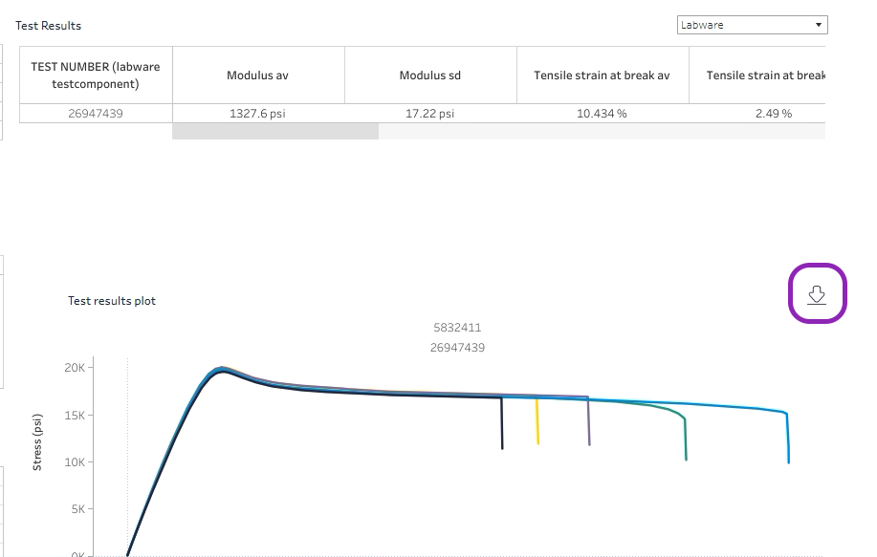
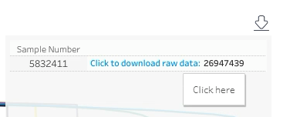
The Dashboard - Export the raw data
In order to export the raw data directly from DataSpP, click on the
Download sign in the graph section.
You can then select the sample/test number you want to export.
A file should be automatically downloaded in your downloading folder in csv format

Slide 25
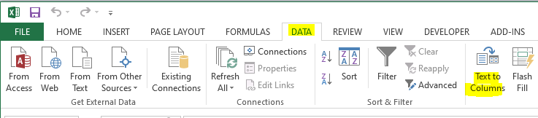
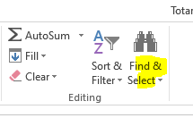
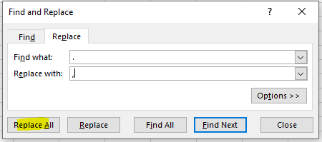
The Dashboard - Export the raw data - Italian format
The data is exported in CSV format, using US number format.
To open it through Excel in Italian format (comma as decimal separator), please follow this procedure:
Select the first Excel column
Click on “Data” → “Text to Columns”
  Set “Delimited” as file data type
  Select “Comma” as separator
Select all the newly created columns
Click on “Home” tab → “Find and select” → “Replace”
Search for “Point”, replace it with “Comma”

Slide 26
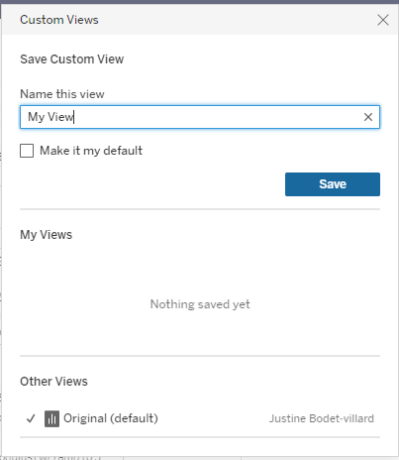
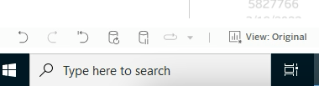
The Dashboard - Save custom view
If you are interested in a set of filters (e.g., only a laboratory, only a molecule type), you can save your view:
  Click on the “View” button
  Select a suitable name for your custom view
  Click on the “Save” button

Slide 27
How to report a bug regarding Lab Booster?
Please check this slide deck : here
Please consider that the official data is still the report in AODocs until the large scale testing is completed

