Slide 1


Electrostatic
Powder
Coating
Roberta Colombo

Slide 2
EPC
Overview
The powder coating process was invented around 1945 by Daniel Gustin and received US Patent 2538562 in 1945.[Gustin, Daniel S; Wainio, Albert W (1945). "Electrostatic coating method and apparatus"]
This process puts a coating on an item electrostatically, which is then cured by heat.
The power coating process is:
Environmetally friendly: no solvent and overspray can be reused
Energy saving: low energy consuption
Safe to process: no harmful solvent
Very economical: low waste

Slide 3
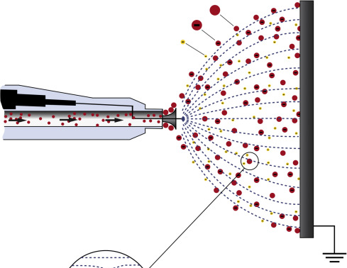

EPC
The basic principle
Powder coating is a type of coating that is applied as a free-flowing, dry powder.
Electrostatic Powder Coating is a spray coating technology based on the physics phenomena according to the parts with opposite electrical charges attracts each other: powder is typically applied electrostatically.
The powder may be a thermoplastic or a thermoset polymer: a curing step is applied to the powder layer to make a continuous film (the coating).
Powder
Powder Spray
Powder Layer
Curing Step
Coating
EPC spray

Slide 4
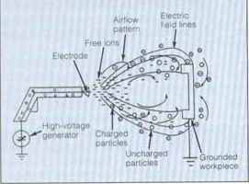
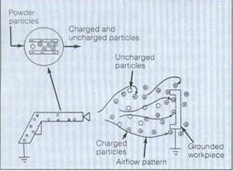
EPC
The Powder charging step
In principle two different powder charging processes are used for powder coating:
The process here in use for our evaluation is the electrostatic charging, called Corona.
ELECTROSTATIC CHARGING
Corona charging of the powder is done by an electric spray gun.
TRIBO CHARGING
Triboelectric guns charge the powder particles using friction when the particle comes in contact with the walls of the gun and feed tube..

Slide 5
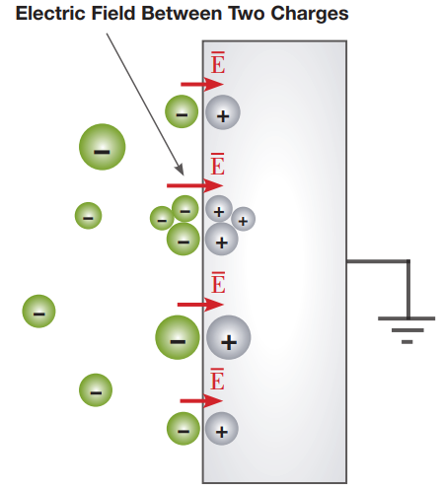
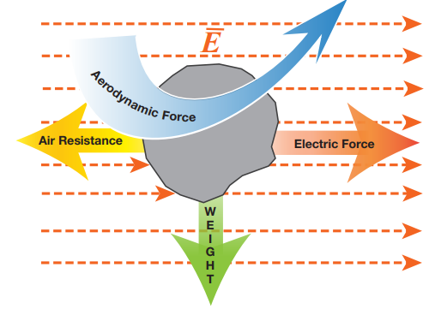
EPC
The Electrostatic Charging Phenomena
The corona discharge is the unimpeded discharge of the free electrons from an electrical conductor. This process is only possible under a high electrical field strength, and increase with the increased voltage. The air stream increases the corona discharge on the electrode, because the electrones are fushed away.
The free electrons seeks the shortest route to the next grounded part. They contact the powder particles and remain adhered to them. The ionised powder particles are attracted all grounded objects like the free electrons. The free electrons that don’t hit powder particles and the ionized air are called space charge and have an influence on the coating quality.
As soon as the ionized powder particles meet the grounded workpiece, a counter-charge is created on the workpiece. Both charges mutually attract one another. Because the powder is not electrically conductive, the charge cannot discharge and the attractive force remain, ensuring the first adhesion. The discharging current, consisting of free electrons, air ions, and the influence current of the counter-charge, flows from the grounded workpiece.
The charged powder is pushed towards the grounded workpiece by only the electric force equal to the charge of the particle.

Slide 6
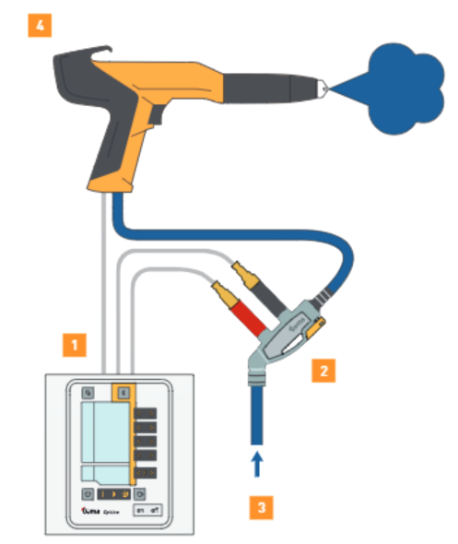
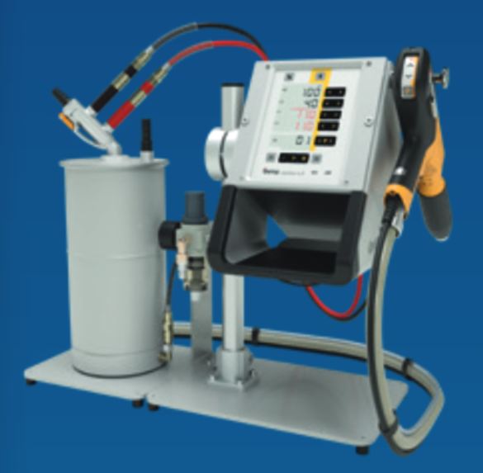
EPC
Electrostatic Spray Process
3
4
The dry coating powder is filled into a powder hopper (1), fluidized (2) and conveyed by means of compressed air to the spray gun (3). One or more electrodes (4) on the front of the powder gun charges the powder to high voltages (tens to hundreds of kV) when sprayed (5 – system controller). An electric field is created between the powder gun and the grounded work-piece. The powder particles follow these electric field lines and remain adhered to the object due to its the residual charge; the curing step induces particles melting to create a continous coating layer.
5
2
1

Slide 7
EPC
Electrostatic Spray Process
3
4
5
2
3
4
5
2
1
1

Slide 8
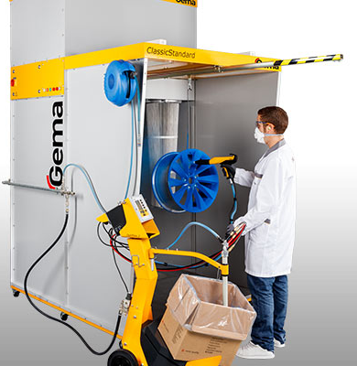
EPC
The coating Plant
PRE-TREATMENT
Before the workpieces can be coated, they must be freed of all contamination such as
grease, oil, dust, etc. In function of type of pre-treatment, suitable capability is needed.
Examples are chemical etching, sandblasting, degreasing…
THE ELECTROSTATIC CHARGING POWDER SPRAY
Standard version of the electrostatic equipment always consist of control unit, a
powder container and a powder gun, that can be fitted with a number of different
nozzles according to the application.
THE POWER CIRCUIT
Even when the powder particles are properly charged, may miss thier target. The
workpiece. Spray booths are operate to confine the extra powder. Cabin with powder
circuit allow to recover and reuse the overspray, for high sustainable process.
THE OVEN
After the spray application, the powder has to be cured into a oven, with no delay to
avoid lose of powder due to discharge phenomena. The final coating finish depends
on the accuracy of the thermal treatment.

Slide 9
Thank you.
Follow us on

