Slide 1
Solvay ONE
Contributor training
Solweb project team
& Web support

Slide 2
AGENDA
>>
Introduction /10 min
Tridion and its user interface /10 min
Create editorial content /30 min
Insert Tridion content in a page /30 min
Manage content from External tools /45 min
Translate and publish in Live /30 min
Conclusion /10 min
Total duration - 3:00
-------- Break -------- /15 min

Slide 3
Solweb, a new web for the new Solvay
The Group is launching a major initiative to strengthen its digital presence and be part of the top league on the web.
The Solweb project covers the overall scope of digital communications:
  Internet/Intranet: promote the Group’s strategy & business offer, federate employees and communications
  Governance: common set of rules & commitments
  Tools, people & processes: single platform and global service offer
This project is not a communications or IS project. All Solvay entities will actively participate to define the strategy and build the tools.

Slide 4
Solweb roadmap & milestones (February 2015)
2013
2014
2015
2016
Internet 
New solvay.com
New corporate web presence
Migration of legacy sector
& country websites
Unified internet presence
GBUs products on the web
Group product catalog
Q1
Q3
Q2
Q3
Q2
New Solvay intranet foundation - WeLink
- Corporate news…
- GBUs & Functions new common content
+ links to legacy intranets
New Solvay intranet portal
Single authentication
Integration with collaboration
Integration with HR e-services
Internet & mobile access
Full integration of legacy content
& country roll-out
Intranet 

Slide 5
A common vision of the intranet
The result of several workshops, interviews, surveys
involving all Solvay stakeholders including employees
Global consensus, common vision, aligned requirements
Lots of expectations and enthusiasm to move forward
Solvay ONE
  Delivering the best user experience, inspired by new digital trends
Driven by
2 main challenges
  Providing the most effective communication & information channel

Slide 6
A common vision: Introducing Solvay ONE
“We want this platform to be a one-stop shop for news, information and the applications people use day to day for work.”
Intranet should not be:
A collection of multiple and unstructured sites
A silo disconnected from information system
A corporate centric communication channel
Solvay ONE
ONE stop shop to access Group information
ONE foundation of new digital Solvay workplace
ONE structured and governed information platform
A user centric communication channel

Slide 7
Solvay ONE – structure
Solvay ONE is composed by Group and Entity Spaces
Group Spaces - global content and services addressed to all Solvay users
Entity Spaces - Entity specific content and services addressed to both internal and external Entity's users
News Center: all corporate and entities news
Employee Services: useful information and services addressed to all employees > access to HR eServices, travel & expenses, local services (facilities)...
Entity and its Departments can own a dedicated Space
Entity Space can be structured according to Entity/Department's needs
Entity Space can contain public or restricted sections
Entity Space can contain editorial content, documents, embedded or links to applications and third-party information repositories, related communities activity streams, external content from internet sources, multimedia content

Slide 8
Space structure
Each Space owner is responsible for its Space structure
Space navigation is flexible and is directly managed by the Space owner
Space navigation can contain a maximum of 3 sub-levels for each main section and a maximum of 15 sections for each level
Space navigation can display public and restricted sections

Slide 9
AGENDA
>>
Introduction /10 min
Tridion and its user interface /10 min
Create editorial content /30 min
Insert Tridion content in a page /30 min
Manage content from External tools /45 min
Translate and publish in Live /30 min
Conclusion /10 min
Total duration - 3:00
-------- Break -------- /15 min
Notes:
A décaler

Slide 10
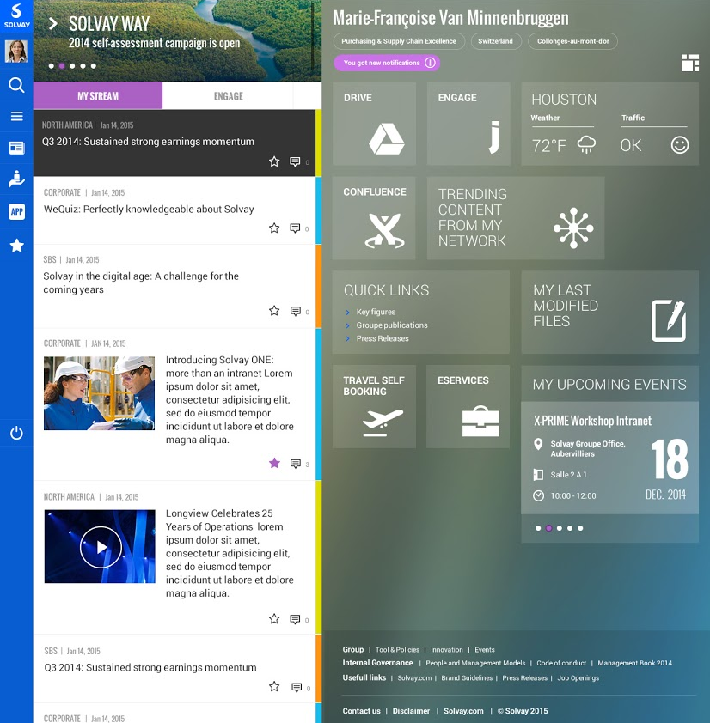
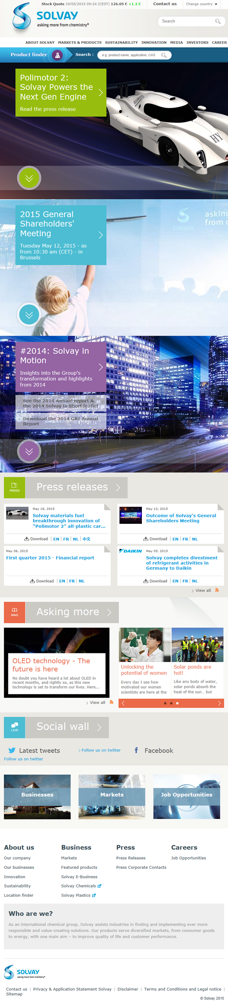
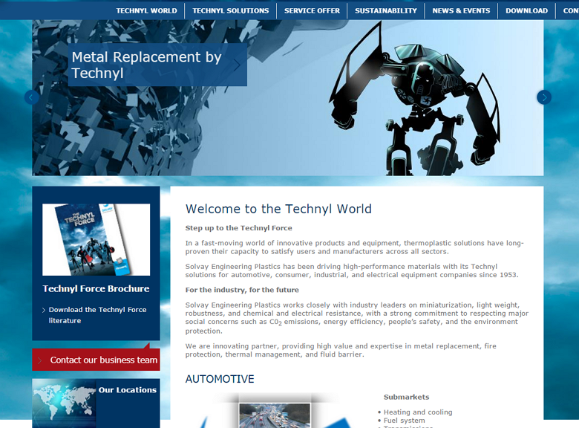
Introduction to Tridion CMS
Tridion is the Content Management System (CMS) actually used at Solvay to manage:
Solvay ONE
Solvay corporate website
5 “standard” country sites
37 “light” country sites,
translated in 21 languages
A panel of external & internal
dedicated websites (focus
on a brand, an event, etc.)

Slide 11
ONE website, three environments
Edit mode
2
What for?
Content update
Staging
3
What for?
Edit mode access
& Content validation
Live
What for?
Public website
Who?
Tridion contributors
Who?
All people connected to Solvay network
Who?
All visitors
Access
from Staging, activate SDL Tridion.
Access
https://staging.solvay.com/one/en
Access
Solvay ONE will be Live soon
1
Solvay.com publisher training – Web support department

Slide 12






User interface 1/2
From Staging, activate Tridion with
Welcome to the Edit mode
  to save all changes on the page and (re)publish it in Staging
  to discard all unsaved changes on the page
To inactivate Tridion, swich to tab, then
Welcome back to Staging environment
Solvay.com publisher training – Web support department

Slide 13
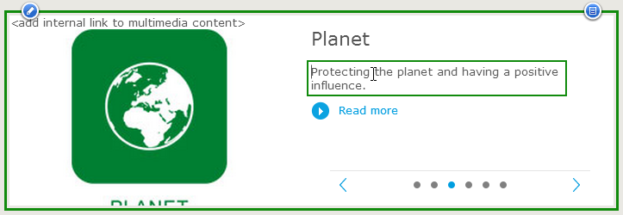
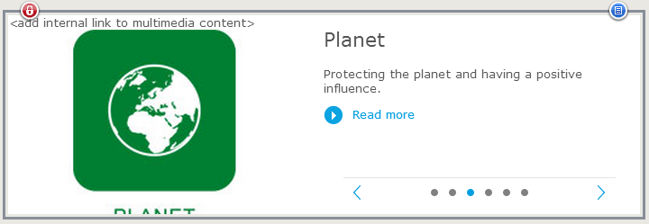

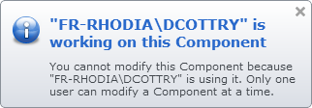
User interface 2/2
Click on a component to select it.
Click a place to edit its content (enter plain or formatted text,
pick a date, browse for a component or a media to link).
  - Blue borders: you can edit
  - Green borders: pending changes to validate or discard
  - Grey borders: you cannot (currently) edit. Click to know why
Solvay.com publisher training – Web support department
Notes:
Changer les captures d’écran, on n’aura pas ce type d’affichage sur ONE

Slide 14



Good to know
Never leave a page having green bordered components:
Always finish or cancel editing.
Recommended browser:
Google Chrome is also supported.
Solvay.com publisher training – Web support department

Slide 15
AGENDA
Introduction /10 min
Tridion and its user interface /10 min
Create editorial content /30 min
Insert Tridion content in a page /30 min
Manage content from External tools /45 min
Translate and publish in Live /30 min
Conclusion /10 min
Total duration - 3:00
>>
-------- Break -------- /15 min

Slide 16
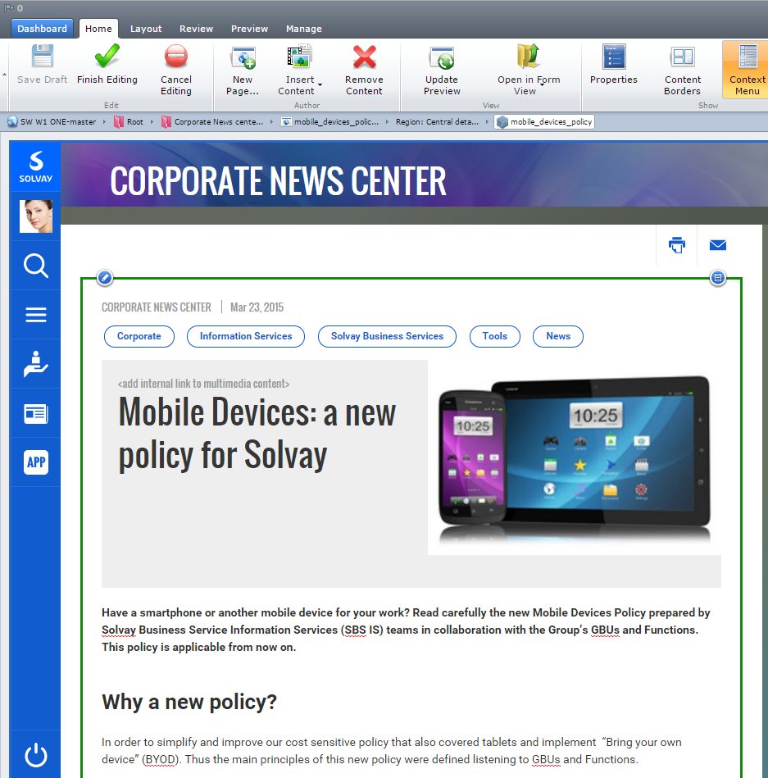

Create editorial content
Editorial content is the generic « page based » content of Solvay ONE.
Create it at your current page location with this button:
Qualified by tagging:
Information type
(eg.: News, Event, Appointement)
Concerned Business, Function, Location, Zone or Country
Etc.
Solvay.com publisher training – Web support department
Notes:
Ajuster screen shots pour voir le titre
A discuter ensemble cet aprem

Slide 17
Good to know
Use the same value for « Page title » and « File name ».
It must:
  be unique, short and meaningful
  use no special characters
  (only ‘a’ to ‘z’ letters, numbers and ‘-’ to avoid any spaces)
Tags might be updated.
Date must be updated.
Solvay.com publisher training – Web support department

Slide 18


Editorial content in practice
https://staging.solvay.com/one/trainingmaster/index.html
It’s your turn!
Objective: Create your first Editorial. Customize its content.
Reach your session in the "Training space"
Create an Editorial
Update the Date and Tags
Play with the rich text editor
Save all changes and publish in Staging
Duration: 10 minutes
Solvay.com publisher training – Web support department

Slide 19
AGENDA
Introduction /10 min
Tridion and its user interface /10 min
Create editorial content /30 min
Insert Tridion content in a page /30 min
Manage content from External tools /45 min
Translate and publish in Live /30 min
Conclusion /10 min
Total duration - 3:00
>>
-------- Break -------- /15 min

Slide 20
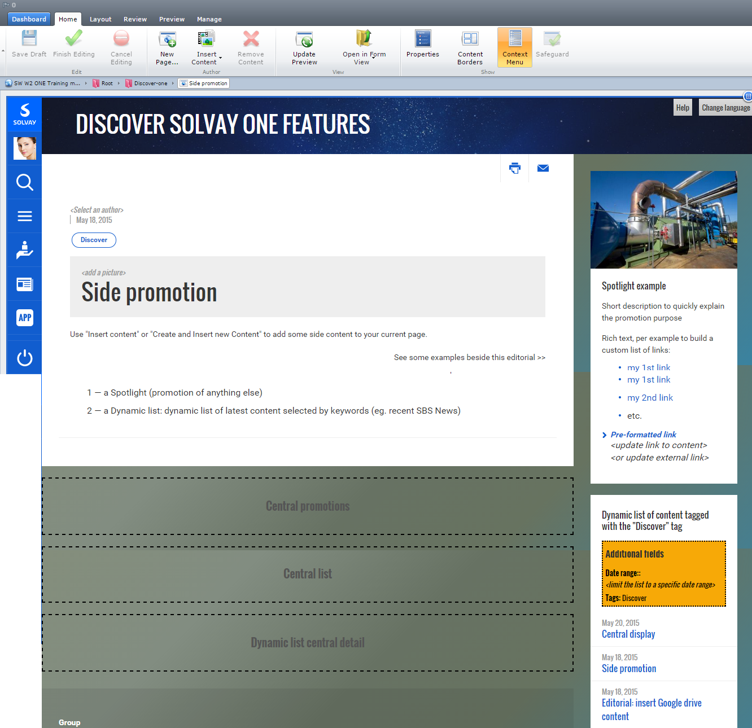
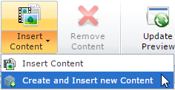
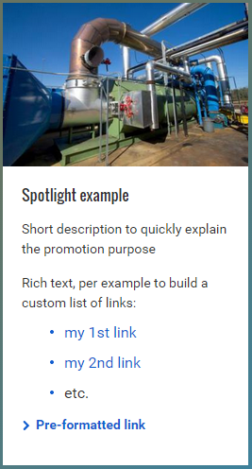
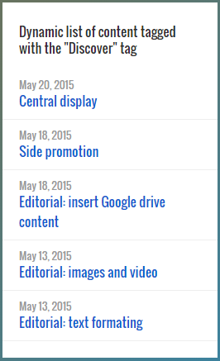
Create and insert new content
Insert some content beside and under your Editorials
Create and insert it in the current page with this button:
Spotlights
To promote any content.
Dynamic lists
To display the latest
Editorials selected by tag.
(eg. recent SBS News)
Solvay.com publisher training – Web support department
Notes:
Ajuster screen shots pour voir le titre

Slide 21
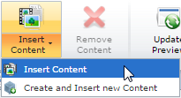

Good to know
The « Content title » is only a reference (not displayed).
It must be unique, short and meaningful
You can also insert existing content:
Prefer using drag’n drop than the button.
To move content: « Layout » tab then « Move »
To remove content: Right click on it, then « Remove »
Never remove the main Editorial in a page.
Solvay.com publisher training – Web support department

Slide 22
Insert Tridion content in practice
https://staging.solvay.com/one/trainingmaster/index.html
It’s your turn!
Objective: Enrich your Editorial with some Tridion content.
Drag'n drop a new Spotlight to your Editorial page
Update its content
Drag'n drop a new Dynamic list and customize it
Insert a content from another trainee to your page
Save all changes and publish in Staging
Duration: 10 minutes
Solvay.com publisher training – Web support department

Slide 23
AGENDA
Introduction /10 min
Tridion and its user interface /10 min
Create editorial content /30 min
Insert Tridion content in a page /30 min
Manage content from External tools /45 min
Translate and publish in Live /30 min
Conclusion /10 min
Total duration - 3:00
>>
-------- Break -------- /15 min

Slide 24
AGENDA
Introduction /10 min
Tridion and its user interface /10 min
Create editorial content /30 min
Insert Tridion content in a page /30 min
Manage content from External tools /45 min
Translate and publish in Live /30 min
Conclusion /10 min
Total duration - 3:00
>>
-------- Break -------- /15 min

Slide 25
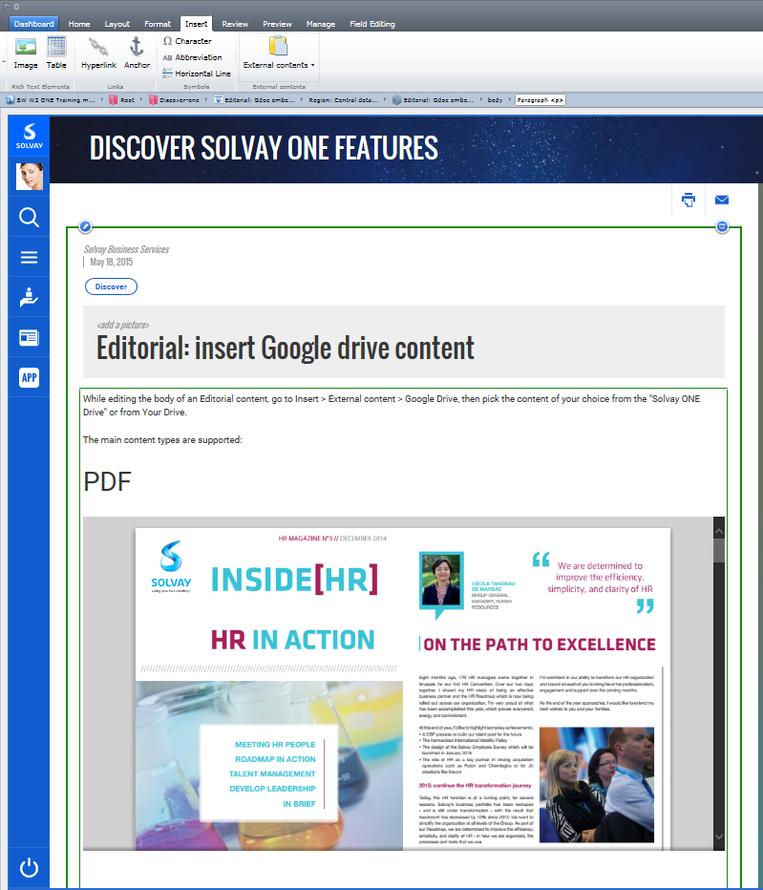







Insert Google drive content
In your Editorial body, you can insert some elements of Google drive.
Insert it with this button:
Pick it from the dedicated ONE Drive folder or « My Drive »
Any Drive content:
Except images and video…
PDFs
Drive folders
Presentations
Docs
Spread sheets
Forms
Solvay.com publisher training – Web support department
Notes:
Ajuster screen shots pour voir le titre

Slide 26
Good to know about Google Drive for ONE
You are in charge of your Entity part of the « Solvay ONE » folder (giving authorisations, manage sub-folders, etc.)
The images and video stored in Google Drive are not usable in ONE. Use Keepeek for this (next chapter).
The Google Drive content must be shared with your visitors
Solvay.com publisher training – Web support department

Slide 27
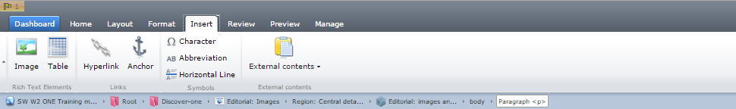
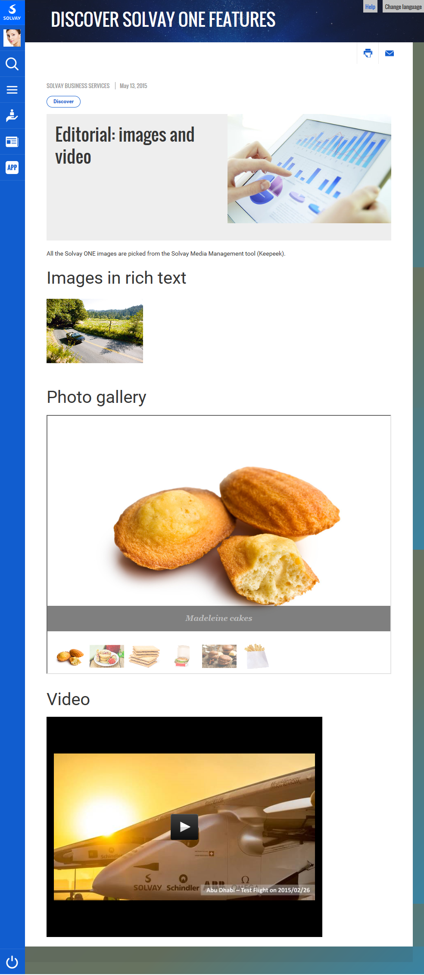

Insert images and video
The Solvay ONE media are all managed from Keepeek.
Several way to use the media:
Main Editorial image
(click on )
Images within the rich text
(‘insert’ toolbar tab, then )
Photo galleries and video player generated from Keepeek
Solvay.com publisher training – Web support department
Notes:
Ajuster screen shots pour voir le titre

Slide 28
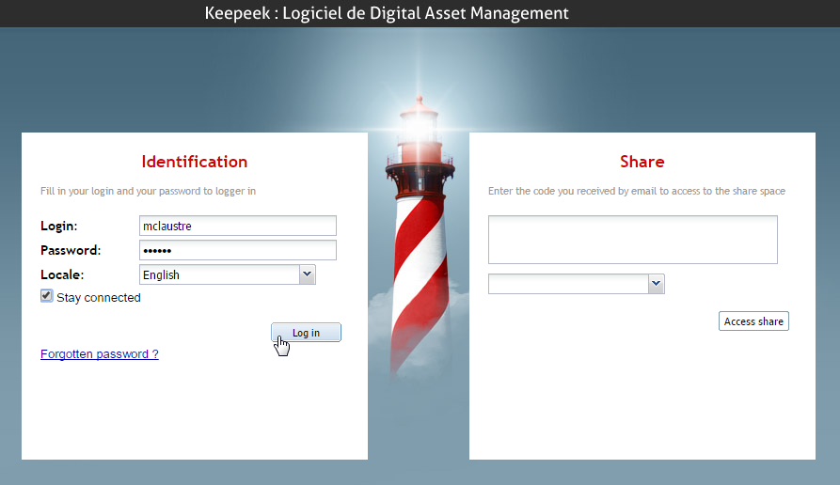
Insert media in Keepeek (1/3 - Connect)
http://solvay.keepeek.com
Your login is your Windows ID
Use “Forgotten password ?” to retrieve your Password AND Login
Solvay.com publisher training – Web support department

Slide 29
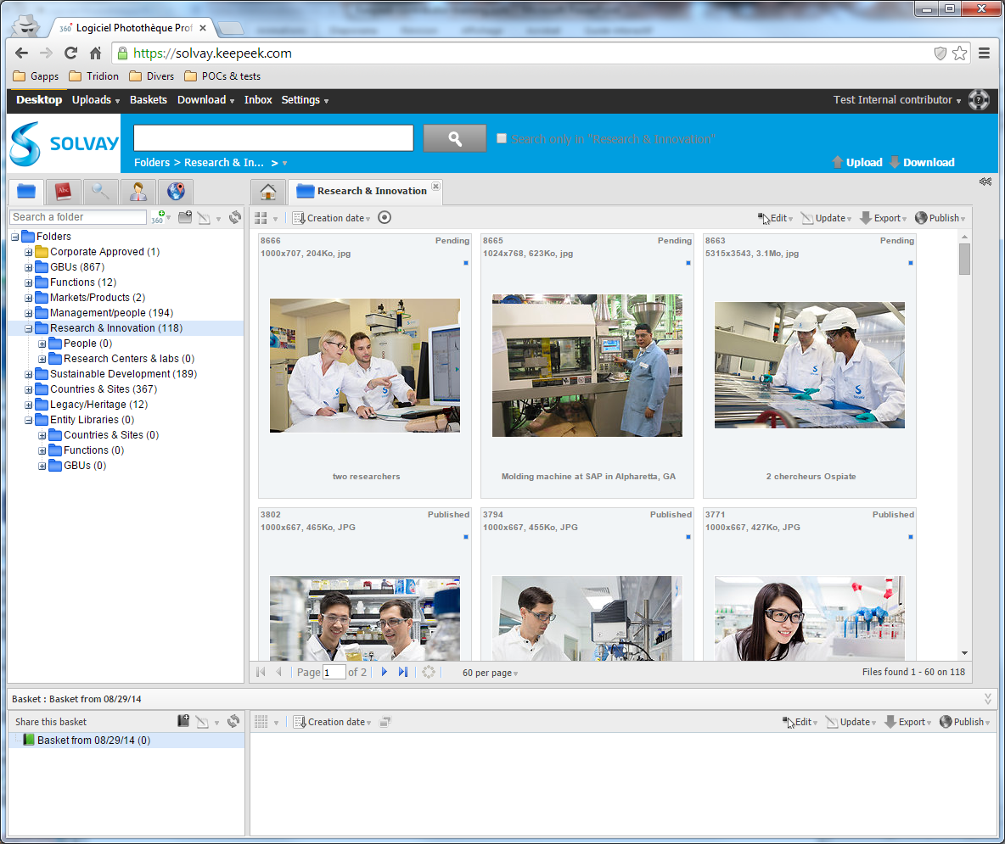

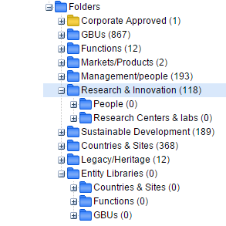
Insert media in Keepeek (2/3 - Folders)
‘Entity Libraries’ folder:
contains your entity folder
to store media having no value in the Group photolibrary
‘Corporate approved’ is read only (published on solvay.com)
All other folders are only opened to the Photolibrary contributors
(blue colored if authorized).
Solvay.com publisher training – Web support department

Slide 30
Insert media in Keepeek (3/3 - Process)
1. Upload
2. Index
Describe your media in one or several languages.
3. Publish
Send your media to Keepeek.
Place your media in a folder and publish it.
a. Upload menu
b. Multiple files (flash)
c. Double click a media
d. Fill-in at least the * fields
e. Press
f. Select then indexed media
g. Press
h. Check 1 or more folder(s)
Solvay.com publisher training – Web support department

Slide 31
Good to know about Keepeek for ONE
Only the indexed images can be published
Only the published images are usable in Solvay ONE
Use ‘Entity libraries’ to store media without publishing it to the Group photolibrary
If you think a media or its description should be updated, please contact the owner.
Solvay.com publisher training – Web support department

Slide 32
Manage Content from External tools in practice
https://staging.solvay.com/one/trainingmaster/index.html
Objective: Enrich your Editorial with some External content.
Insert a Google Drive content into your Editorial
Attach a 'Main image' to your Editorial
Store a new image in Keepeek
Insert this image in your Editorial rich text
Save all changes and publish in Staging
It’s your turn!
Duration: 10 minutes
Solvay.com publisher training – Web support department

Slide 33
AGENDA
Introduction /10 min
Tridion and its user interface /10 min
Create editorial content /30 min
Insert Tridion content in a page /30 min
Manage content from External tools /45 min
Translate and publish in Live /30 min
Conclusion /10 min
Total duration - 3:00
-------- Break -------- /15 min
>>

Slide 34
Solvay ONE language management
Manage several language versions of your content.
English
Any language can be a Master language: pushed to all if no translation available.
Other languages are considered as ‘Child languages’.
Process:
Create a content in English
Publish it in Child languages (Staging)
Switch to a language to translate in
Select the Editorial component
Localize it
Translate the content
Repeat 3, 4, 5, 6 for other languages
Editorial title
French
Portuguese
Editorial title
Editorial title
Titre d’Editorial
Título do Editorial
Solvay.com publisher training – Web support department
Notes:
Ajuster screen shots pour voir le titre

Slide 35
Good to know about Translation & publishing
It is recommended to create global content in English.
Publish Master + Child languages with ‘Advanced’ tab, then ‘Also publish in child publications’.
While publishing, right click in the page, out of any component, to apply the whole page
Use ‘Localize’ to unlock a child version.
‘Edit this component everywhere’ would update the English version
Solvay.com publisher training – Web support department

Slide 36
Translate & publish in practice
https://staging.solvay.com/one/trainingmaster/index.html
Objective: Translate your content and publish it
Reach the previously created article and switch to the language you want to translate the page into
Select the content
Localize it from the locker icon menu
Translate the content
Finish editing to save changes and publish in staging
It’s your turn!
Duration: 10 minutes
Solvay.com publisher training – Web support department

Slide 37
AGENDA
Introduction /10 min
Tridion and its user interface /10 min
Create editorial content /30 min
Insert Tridion content in a page /30 min
Manage content from External tools /45 min
Translate and publish in Live /30 min
Conclusion /10 min
Total duration - 3:00
-------- Break -------- /15 min
>>
Notes:
A décaler

Slide 38
Conclusion
Download this training support from the « Help » button
Solvay.com publisher training – Web support department

Slide 39
Thank you for your attention!

