Slide 1

Syensqo | October 2023
Customs control Tower
GLOBAL TRADE CONTROL

Slide 2


Agenda
1
Introduction
2
Functioning of the Control Tower
3
Implementation of the Control Tower
4
Why implementing a Control Tower?
5
FAQ
Customs control Tower

Slide 3
1
Introduction

Slide 4
Customs Compliance: The Backbone of International Trade
Risks of Non-Compliance in Global Trade
Customs is an essential chain of any business involved in international trade. In today's globalized world, businesses need to understand and comply with a complex array of customs laws and regulations. Failure to do so can result in significant financial penalties, reputational damage, and even criminal charges.
Accessibility to different sources
To create a customs declaration, information about the goods needs to be accessible from different sources, suppliers, importers, exporters, carriers, customs agents, etc...
Streamlining the Supply Chain
This complexity and multiple sources and ways of communication can lead to mistakes in the declaration and extra delays in the supply chain, with a non-compliance risk.
Enhancing Compliance with a Customs Control Tower
A one-source truth solution would mitigate the compliance risks to a lower level found in a “Customs Control tower”.
Customs control Tower

Slide 5
What is a Customs Control Tower?
Digital tool facilitating the tracking, reporting, collection, and consolidation of data from various systems and data sources
Examination of responses processed by the tool and delivery of information in a user-friendly format constantly updated
Enables monitoring of the import and export procedures of goods
Insight into the progress of your shipments
Allows a company to track its products, check their status and take decisions based on data consolidated by the control tower
Notification of delays or any other issues regarding customs processes affecting your goods
Establishment by a customs broker. This CT will seamlessly connect with various systems, such as logistics services, shippers, etc. It will consistently interact with these systems to track and determine the whereabouts and condition of your products
Boost visibility among trade partners, enhancing data collection and distribution on a consistent format, Real-time analytics enable logistics providers to optimize operations, meet evolving consumer demands, ands enhance overall supply chain visibility
Customs control Tower

Slide 6
Scope of the Control Tower
Tracking and reporting of export and import movement of goods
Managing of special data schemes such as ERPand GTS data systems
Special procedures
Information gathered within the Customs Tower:
Quantity, type and value of goods imported / exported
Regulations, licenses, permits applicable to the export / import of goods
Supply chain parties
Foreign trade documents
Customs control Tower

Slide 7
2
Functioning of
the Control Tower

Slide 8
Functioning of the Control Tower
How will the Control Tower function?
Information gathered by the Control Tower
The tool will interact with diverse sources through different integrations. Common data sources include:
Control towers and customs brokerages may request
different information, which can encompass:
Data from Syensqo’s systems regarding imports and exports movement of goods (ie. ERP and GTS)
Type, classification, origin, quantity, value, etc. of imported or exported goods
Exporter’s information from their foreign country
Regulations, licenses, or permits that are mandatory
Data from supply chain partners including suppliers and manufacturers
Countries and ports involved in the import or export process
Freight forwarders, carriers and customs brokerage businesses
Information about supply chain partners, including suppliers or manufacturers
Enrich the data with information predefined in the control tower
Foreign trade documents and necessary fillings
Customs control Tower

Slide 9
3
Implementation of the Control Tower

Slide 10



Customs Control Tower Implementation
Example of a control tower
Freight forwarders information
Customs Broker System
Customs Control Tower
BE (STREAM)
Lead Broker
Operations Dpt
SAP
GTS
Data XML
Webservice
Customs
Douane
Status responses
Customs
SAP
ECC
PDF
email
FR (CONEX)
Lead Broker
Operations Dpt
Customs
Douane
Customs doc – declaration status
Customs
Customs Declaration completion and sending to Lead Broker
Customs control Tower

Slide 11
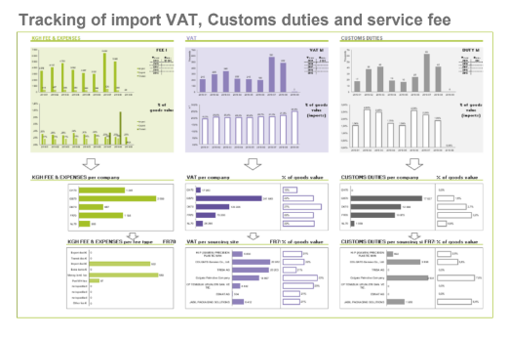
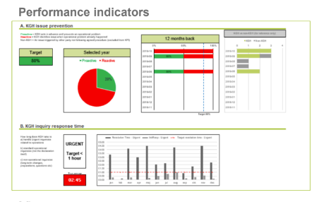
Customs Control Tower dashboards
Customs control tower enables overviews of key facts tailored to Syensqo’s needs, e.g.:
Issues prevention ratio
Continuous improvement implementation
Audit completion ratio
Customs dispute rate
Customs delays
Invoice verification ratio
Customs control Tower

Slide 12
4
Why implementing a Control Tower?

Slide 13
Why implementing a Control Tower?
Objective of Syensqo
The objective Syensqo seeks with the setup of this Control Tower is to:
Simply, streamline, digitize and better manage Syensqo customs clearance process and activities
Zero non-compliance
Bring visibility into Syensqo’s trade flows and related metrics
Import duty and cost optimizations
Create a robust partnership with the regional lead broker through clear SLA and reported KPI’s in order to reach together four key objectives
Turn export/import processes into a seamless experience for our business and external stakeholders (management by exception)
Become a highly agile and resilient global trade organization against external disruptions and internal evolutions
Customs control Tower

Slide 14
Why implementing a Control Tower?
Benefits of the tower for Syensqo?
Improvement of Syensqo’s supply chain operations
Visibility and Control
Cost control
Compliance
Optimize goods flow and track customs progress efficiently
Gain real-time visibility into the location of your products, allowing you to promptly determine their whereabouts.
Optimization of administrative costs for the control process
Ensure compliance with customs regulations and proactively identify any potential breaches before they escalate.
One centralized data access and contact point for the entire supply chain.
Insight on the complete journey of goods across your entire import or export supply chain.
Streamline the customs process and minimize costs and delays by submitting the appropriate documentation.
Mitigate the impact of inspections and audits, minimizing their disruptions.
Serve as a centralized source of information for all customs-related procedures.
Accurately calculate and understand the tariffs and fees you are required to pay.
Identify and mitigate potential risks that could result in delays during the customs clearance process.
Allows flexible implementation and changes for the future
Customs control Tower

Slide 15
5
FAQ

Slide 16
FAQ
1. What is SAP GTS Broker control tower?
5. Does SAP GTS Broker Interface control tower integrate with other SAP modules?
SAP Global Trade Services (GTS) Broker Interface Trader-Centric is a module within SAP GTS designed to facilitate trade compliance and manage import and export operations. It allows traders, brokers, and customs authorities to interact with the SAP GTS system seamlessly.
Yes, it can integrate with other SAP modules, such as SAP ERP, to provide a comprehensive solution for managing global trade operations. This integration ensures data consistency and efficiency.
6. How can SAP GTS Broker Interface Trader-Centric help in auditing and reporting?
2. What are the key features of SAP GTS Broker Interface Trader-Centric?
Streamlined document submission for imports and exports.
Enhanced communication with customs authorities and brokers.
Real-time tracking of trade compliance and documentation.
Simplified compliance reporting and auditing.
It offers robust reporting capabilities, allowing organizations to generate compliance reports, audit trails, and documentation history. This is crucial for demonstrating compliance and addressing regulatory requirements.
7. How does the process work with the Customs and brokers system?
3. How does SAP GTS Broker control tower enhance trade compliance?
Data is exchanged between SAP GTS and the customs broker in the following way:
First of all, SAP GTS transfers data to the customs broker.
The customs broker validates data then transfers this to the authorities.
The customs broker receives all answers from Customs.
The customs broker to send the Customs reply to SAP GTS.
It provides a central platform for managing all trade-related documents, allowing for consistent and accurate documentation. Real-time compliance checks help prevent costly delays and errors in import and export processes.
4. What types of documents can be managed using SAP GTS Broker Interface?
It can handle a wide range of documents, including invoices, bills of lading, certificates of origin, customs declarations, and more. These documents are essential for trade compliance and customs clearance.
Customs control Tower

Slide 17
Thank you!

