Slide 1
COLMAR
Training Material
Industrial Function /SBS

Slide 2
AGENDA
Principles
Reminder:
    Capspend vs Capex
    Investment Type
    Capex01 requirements
Aggregated Forecasts – Bundles
Project States
COLMAR main menu
Project Creation
  First characteristics
  General Attributes
  Comments & Documents
  Advanced Attributes
  Authorized amounts
  Forecasts
Select, Update, Copy
Forecast Entry Excel Sheet
Mass upload
BW Reports (Analysis)
Envelopes

Slide 3
COLMAR
Groupwide application which
Supports the application of CAPEX01
Holds the list of all capital budget from idea to execution
Lets the GBUs, functions and stakeholders
  Characterize, document the capital budget (including some engineering information)
  Have them approved and created
  Follow quarterly figures (Capspend/Capex)
  Update quarterly forecasts (Capspend/Capex)
Provides reports at all levels, in all currencies
  Group (consolidated)
  GBU (consolidated)
  Plant
In an integrated and auditable system
Capex
Overall Lifecycle
Management
Approvals and
Reporting
Where are the levers for adapting the project list to the cash available?
Detailed specs written with NoveCare, Speciatly Polymers, Acetow, Soda Ash!
Notes:
Current situation and needs to be achieved descriptions should be done in business language, not in technical language.
The Business Managers are the target when doing a Business Case. They are familiar with Operational and Financial concepts and want to know the benefits expected from the project.
Acronyms and technical terms not of common knowledge should be avoided. If this can’t be avoided, they should be carefully explained, but without technical details.

Slide 4
Principles /1
All (future, present, past, major, medium, current) budgets are registered with
  General properties (description, plant, GBU, BFC activities …)
  Authorized amounts (to be requested for or already obtained)
  Approval status
  Advanced information for budgets > 1 MEUR (challenges, MIRR, NPV, Payback, …)
  Approval reference is in COLMAR
  1 project in COLMAR ⬄ 1 project in SAP-PS
But, as to quarterly forecasts, projects can be either
  Forecasted individually (compulsory over 1 MEUR)
  Gathered in ‘Bundles’ and forecasted at this aggregated level
The consolidated total should converge to BFC
  Axes used in Colmar are those of BFC (GBU, Act1, Act2)
  Currencies are those managed in BFC
  Consolidation rules are those used in BFC

Slide 5
Principles /2
Any project is approved in COLMAR before it is created in PS (by SBS)
Users only see budget items and values of their perimeter (only my plant(s), only my GBU(s), the whole Group)
Documents and web links can be attached to a budget item
Most information is in Business Warehouse (BW) cubes
  Reporting available in BW queries and worksheets
A Qlikview dashboard is being built

Slide 6
Target process for a given project
Quarterly CapSpend and Capex forecasts updated every quarter
Project ID
Description
Plant, Value Stream
Reason of investment
First idea of the amount
Challenges
Finance calculations (MIRR, NPV, PayBack)
Documents
Amount to authorize
Forecasted Authorization Date
CapSpend and Capex Actual (from PS)
reapproval
reapproval
The idea is logged
The project is planned
The basic study is
Authorized
Project Execution is
Authorized
Project is executed
Project Execution is
Complete
GBU
Creation of the project in PS
Creation/
updated of the project in PS
WBS closure
Transfer to Assets
Captitalization
SBS
At any time of the year
But most next year budget are created from June to September
At any time of the year, as a proposal ; decision to include in the plan typically taken in October
Many current investments authorized in January (at once) ; others released during the year
Large projects need a formal Basic study before the execution can be approved ; Other projects can be approved withouth formal basic approval

Slide 7
Reminder: CAPSPEND vs CAPEX
At goods receipt, the amount corresponding to purchase order is booked => CAPSPEND
After the payment term, the amount is actually paid to the provider => CAPEX
Example:
30 k€ equipment, received on July, 1st 2014
Payment term : 1 month
 | 05-14 | 06-14 | 07-14 | 08-14 | 09-14 | 10-14 | 11-14 | 12-14 | 01—15 | 02-15
CAPSPEND |  |  | 30
CAPEX |  |  |  | 30

Slide 8
Reminder: Investment type
Capitalized investments
Type | Amount Range | Authorization
Current | < 1 MEUR | GBU
Medium | ≥ 1 MEUR < 10 MEUR | GBU
Major | ≥ 10 MEUR | COMEX (after Investment committee validation)
But also, not capitalized investments
Type | Amount Range | Authorization
Demolition | any | GBU

Slide 9
Reminder - Capex01 requirements

Slide 10
Typical Tasks – typical calendar
Task | Actor | J | F | M | A | M | J | J | A | S | O | N | D
Create projects | Site Capex Correspondent | … | … | … | … | █ | █ | ██ | ███ | █ | … | … | …
Complete project information (challenges, scope) | Site Capex Correspondent | … | … | … | … | … | … | … | … | … | … | … | …
Pre-approve/reject projects (Budget decision meetings) | GBU coordinator, GBU manager |  |  |  |  |  |  |  |  | █ | ███
Update forecasts for BFR/BSR (and lists of projects) | Forecasters |  | █ | █ |  | █ | █ |  | █ | █ |  | █ | █
Project approval | Submission by Capex correspondents Approvers | ███ | ██ | █ | █ | █ | █ | █ | █ | █ | █ | █ | █

Slide 11
Budget Forecast at different levels
Usual case: one project in PS = one project in BW
Compulsory for Normal and Strategic projects
Possible for Current projects
Creation in BW of the project idea
PS
COLMAR
Project Bundle
Past Capspend
Forecast
Project Current A
Actual capspend updated in COLMAR
Past Capspend
WBS element – lvl 1 .
Creation by SBS after approval in COLMAR
Project Attributes among which quarterly/yearly approved amounts
WBS element - lvl 2
Project itself
…
(manual) creation in PS at project approval based
on attributes and amounts defined in BW

Slide 12
Bundles: forecast at an aggregated level
Creation in BW of the project ideas
PS
BW
Project Bundle : “aggreg1”
Past Capspend
Forecast
Actual capspend
Project A
Project Current A
Past Capspend
WBS element – lvl 1 .
Project Attributes among which - quarterly/yearly approved amounts
- Reference to forecast line ‘aggreg1’
WBS element - lvl 2
Project N
…
Actual capspend
Project B
Project Current B
Past Capspend
WBS element – lvl 1 .
Project Attributes among which - quarterly/yearly approved amounts
- Reference to forecast line ‘aggreg1’
WBS element - lvl 2
Project N
…
Actual capspend
Project N
Project Current N
Past Capspend
WBS element – lvl 1 .
Project Attributes among which - quarterly/yearly approved amounts
- Reference to forecast line ‘aggreg1’
WBS element - lvl 2
Project N
…

Slide 13
Project statuses
Three notions are managed:
PLANNED
No
Yes
STAGE
Idea
Approach
Preliminary
Basic
Execution
Startup
Started
STATUS
Created
Pre-approved
Approved for basic
Reapproval needed
Fully approved
Reapproval needed
Technically complete
When total forecast > 110 % of approved amount
The forecast amounts are taken into account in the GBU totals
Closed
engineering phases
Authorizations
Capex Cycle Management
Steering Committee #2

Slide 14
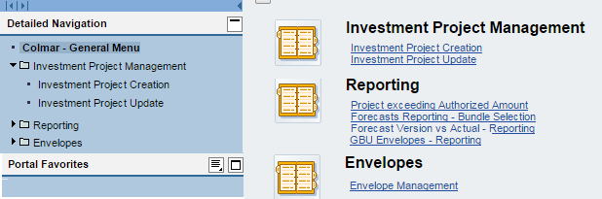
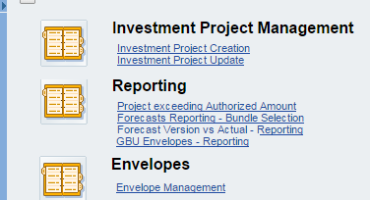
COLMAR – how to start
COLMAR project edition is made accessible through a web browser
Internet Explorer supported ; Chrome works unsupported (with some tiny limitations)
Single Sign-On (SSO). This link logs you directly into COLMAR, with no need of typing in a password
Available Menus depend on the user’s profile
Fields with a red star * are mandatory (no way of exiting the form if they are not filled in)
Menu
Hide the menu
Show the menu
Increase/ Decrease Menu Width

Slide 15
COLMAR – how to start
Menus used by most users
Investment Project Creation: create a project from scratch
Investment Project Update:
  Search the database for projects using filters and select one
  Change project attributes
  Change project authorized amounts / forecasts
  Simply display projects / access attached documents
  Create another project on the base of the current one (“copy”)

Slide 16
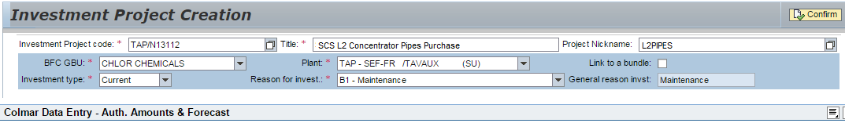
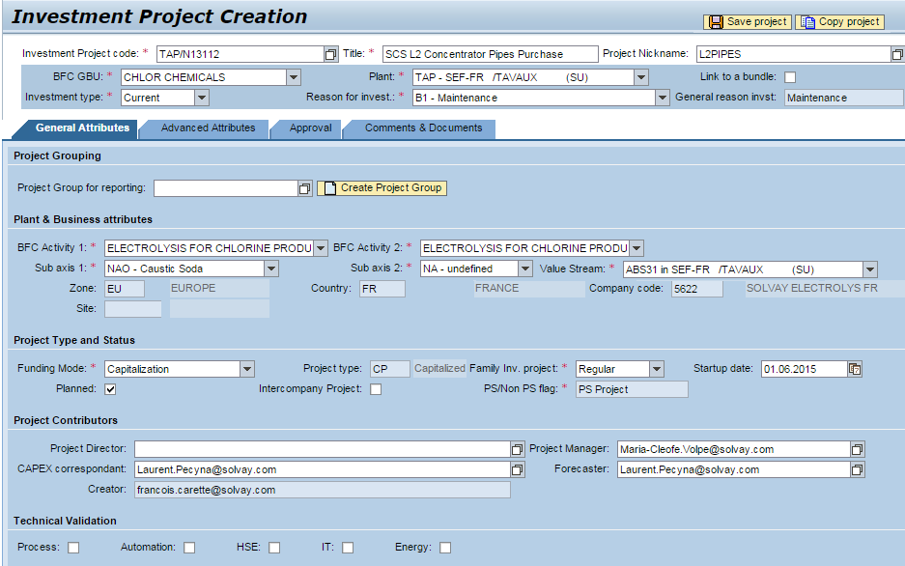
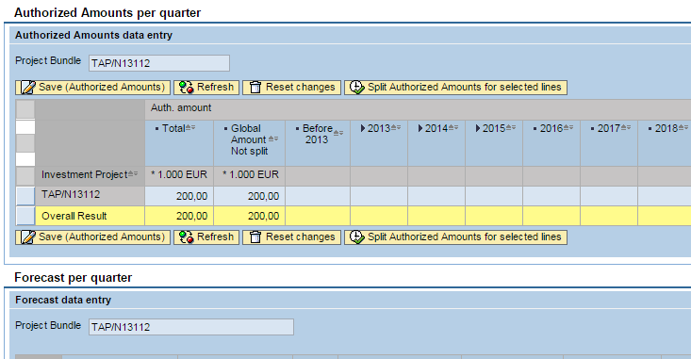


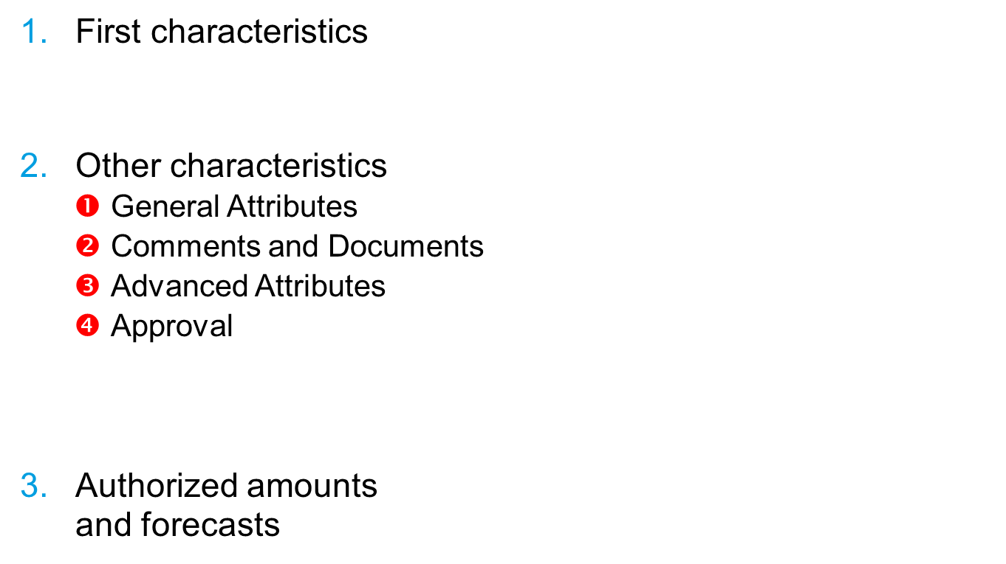


Project creation: 3 steps
First characteristics
Other characteristics
  $❶$ General Attributes
  $❷$ Comments and Documents
  $❸$ Advanced Attributes
  $❹$ Approval
Authorized amounts
and forecasts
$$❶$$
$$❸$$
$$❹$$
$$❷$$

Slide 17
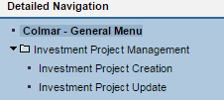
Project Creation: first characteristics (1)
Field | Usage
Investment Project Code | ID of the project (unique in COLMAR) Identical to PS project ID will be used to create the project in PS at approval Will be used to extract actual expenses from PS thereafter Older projects (created before Colmar startup) have been created with their existing PS project ID name New projects to be created with common syntax: PPP/TYYNNN With PPP = the 3-letter alias of the plant T = C (Current), M (Medium), J (Major), D (Demol), P (Preliminary/Approach/Test), YY = the current year NNN = any number Example: RBA/J14005 Should not change in the future Type the project code (future version will suggest the code)
What is my plant’s
3-letter code?
- In the plant field (Solvay)
In the Plant List
  See correspondance PF1-RCS for RCS plants
In the PRS system
Hints
  when you are prompted for a password, just press [ESC], then [F5])
  Company and Plant Number may differ from RCS

Slide 18
Project Creation: first characteristics (2)
Field | Usage
Title | What the investment is about. Anyone who has access should be able to understand Preferably in English Not an alias or nickname (not “HPPO3” or “ROSA”) : there’s a special field for that
Nickname | Alias of the project (known in the GBU or the engineering department). Examples from the past: ANTARES, BAMBOO, CANEPAR, CAPLA, COLEOP-TERRE, DAPHNE, DAWN, DRAGON, EAGLE, EMPIRE, FLAVOR, FLEX21, FORCE, GREEN FOREST, HPPO, HPPO2, IKRA, JESSIE, MERLION, MINIBUS, MIRE, OSCAR, PVC2007, RENFORCE, ROSA, SAMPO, SBT, SILVIA, SUNNY, WINDMILL, YELLOW & GREEN, ...
BFC GBU | Name of the GBU. (BFC to remind that this notion matches the BFC* definition) To be selected in the drop down list. Values in the list depend on the user profile (only the GBU the user has access appear) => in most cases already set to the appropriate value
* BFC= Business Financial Consolidation, the Group Reporting and Consolidation Application

Slide 19
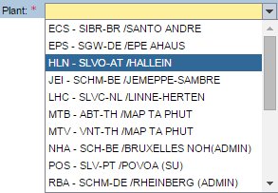
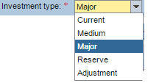
Project Creation: first characteristics (3)
Field | Usage
Plant French: “établissement” | Combination of the company and the location (site) Example: [Solvay Electrolyse France – Tavaux] Should be the plant where the investment will be capitalized (the cost centers concerned by the amortization of the investment belong to that plant). The list of possible plants depend On the GBU (only the plants where the GBU is active appear) On the user rights (only the plants the user can access appear) Local users will only see the plants (different companies) on their site. Country, zone, company and local currency depend on the plant.
Investment Type | Current: investments < 1 M€ Medium: investments between 1 and 10 M€ Major: investments over 10 M€ Reserve: amounts (at GBU or plant level) for not yet identified investments but which correspond to expenses which the GBU or the plant forecasts Adjustment: amounts corresponding to the difference between the totals in the GBU and BFC (e.g. to compensate reporting errors or when a commitment has been taken into account in BFC but not declared yet in COLMAR) Demolition: for demolition projects (to come)
Type the first letter of the value you look for in the field
TIP

Slide 20
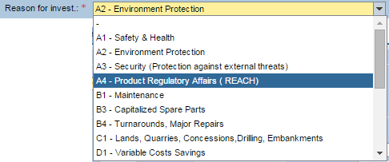
Project Creation: first characteristics (4)
Field | Usage
Reason for Investment | Main Reason for investment. This field updates the “General reason invst” field according to the following table (out of the CAPEX01 procedure): Remark : For large projects, it is possible to define, beyond a main general reason of investment %ages for each of the others

Slide 21
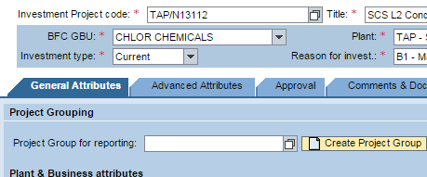
Project Creation: first characteristics (5)
Field | Usage
Bundle | Check this box if you want to avoid to individually update the forecasts for this project. If you check this box, you will be prompted (in the General Attributes form) for the Bundle you want your project to be linked to.
Confirm | When all first characteristics have been filled in, press the “Confirm” Button Thereafter, the General Attributes form appear

Slide 22
Project Creation: General Attributes
19
❸
❶
❺
❻
❷
❹
❼
❽
12
❾
❿
11
16
17
15
14
13
18

Slide 23


General Attributes (1): BFC Activity1 ; Value Stream
Field | Usage
BFC Activity 2 | In BFC, GBUs consist of so-called “activities 2” which somehow correspond to groups of products. For Solvay legacy GBUs, BFC Activity 2 corresponds to the Cheops Division For Rhodia legacy GBUs, BFC Activity 2 corresponds to the CGU (Cash Generating Unit) The list of available choices is determined by the GBU and the plant See BFC Structure for more information
❷ Value Stream | Main value stream concerned by the investment. Value stream is a group of “inseparable products” ; notion rolled out in Rhodia legacy but not yet in Solvay legacy. For Solvay legacy, “pseudo value streams” have been created, corresponding to [Plant-BFC Activity 2] The list of available choices is determined by the plant and the activity 2. (for Solvay legacy, no need to care about that as it is fully defined by the [plant-BFC Activity 2] couple

Slide 24
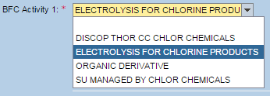
General Attributes (2): BFC Activity 1, Zone/Country/Company Code
Field | Usage
❸ BFC Activity 1 | In BFC, “activities 1” are used Rhodia Legacy: to describe the markets concerned. Solvay Legacy (identity to BFC activity 2, i.e. Cheops Division) The list of available choices depends on the GBU selected (in a future version, this field will not be used anymore ; the GBUs who want to mention the market will use the subaxis 1 or subaxis2 fields
❹ Zone, Country, Company Code, Site | These fields are read-only They are updated by COLMAR according to the plant selected Rem: “site” remains empty because this notion is not managed in Solvay’s group wide master data. This field will be suppressed in a future version

Slide 25
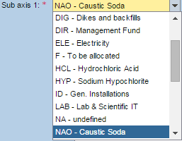
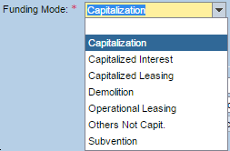
General Attributes (3): Sub Axes ; Funding Mode
Field | Usage
❺ Sub axis 1 ❻ Sub axis 2 | Sub axis 1 and Sub axis 2 are fields the usage and interpretation of which are left to GBUs According to GBUs’ choices, an administrator has defined, for each GBU, a set of available values. In Solvay legacy, Sub axis 1 has been chosen to hold the value of the “heading” (aka “Rubrique” in IM database) A “NA – undefined” value is available anyway in both fields
❼Funding Mode | Values available are: Capitalization (default) Capitalized Interest (only concerns investments > 50 M€) Capitalized Leasing Operational Leasing (not capitalized) Demolition (not capitalized) Subvention (will bear negative amounts) Other Not Capitalized (for other projects such as preliminary studies if managed in Colmar) The Funding Mode value sets the Project Type value CP (capitalized) or (NC-Not Capitalized)

Slide 26
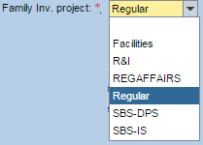
General Attributes (4): Family, Planned
Field | Usage
❽ Family | Default value is “Regular”, which applies to most investments Other values are used to flag investments managed by CBS functions R&I : capitalized research and development managed by R&I for the GBU Regular Affairs: (mainly) Capitalized Product Registration (e.g REACH) managed by Industrial Function/HSE-Product Safety for the GBU SBS-DPS: SBS projects that would be capitalized in the GBU SBS-IS: IT projects led by IT and capitalized in the GBU perimeter Facilities: if a project led by Facilities is eventually capitalized in the GBU.
❾ Planned | Until this check box is checked, forecasts amounts are not taken into account into GBU’s consolidated totals. Investments not set to “planned” are just ideas which are being matured and documented in the system Equivalent to the “Portfolio” notion in Solvay Legacy’s IM Not planned ⬄ Portfolio ; Planned ⬄ No Ptfl

Slide 27
General Attributes (5) : Intercompany ; PS Project ; startup date
Field | Usage
❿ Intercompany Project | Check this box if the project concerns a transfer of assets within the Group (from Solvay company to Solvay company). Intercompany projects are not taken into account in the totals (as there is no cash-out from the Group’s point of view)
PS Project | Read-Only Any investment created with this interface is supposed to be a “PS project”, ie an investment which will be created in PS upon approval. However, for plants who don’t have SAP-PS implemented, there is a “mass upload” interface which allows to create or update Colmar investments from an (Excel) spreadsheet. “Non PS” projects can be created so.
Startup Date | Date of project completion and startup of the equipment/facility concerned Before completion: expected date of startup After completion: actual date of startup Rem Completing and updating this information is important to inform all stakeholders and following up the project pipe
11
12

Slide 28
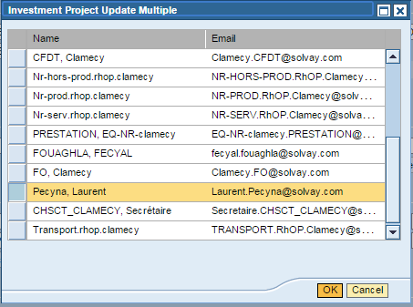
General Attributes (6) : Project Contributors: Creator, Forecaster
For all fields concerning people:
Type the e-mail or
Search the Group’s active directory
Type the a part of name, with wildcards (*)
and press [F4] or click on
Select the name in the list
❷
❶
❸
Field | Usage
Creator | Read-Only. E-mail address of the person who has created the project in COLMAR ; set by the system at creation
Forecaster | E-mail address of the person who is be accountable for quarterly updating this project forecasts Will be reminded to do so if he/she has not updated the forecasts This person is selected by the GBU and can be, for example: The project manager The engineering office manager The site Capex correspondant If left blank, the forecaster will be set to the Creator (see here above) Attention: mentioning a forecaster does not grant this person any authorization. Authorizations are managed separately!
13
14

Slide 29
General Attributes (7) : Project Contributors: Correspondents, project director, project manager ; technical validation
Field | Usage
Capex Correspondent | Local correspondent: main local contact in charge of Capex ; Person who gathers the investment needs of the plant, who can help find people concerned, explain the project better. This person will be considered as the first back-up in case of unavailability of the forecaster
Project Director | Usually appointed for medium and major projects ; Person who represents the GBU in the project and is accountable for the cost and delay. This mention is used for information to the stakeholders
Project Manager | Person in charge of the engineering part of the project. Usually reports to Corporate Engineering (GEC), to Site Engineering Office (SEO) or to the GBU
Technical Validation | Check the Process, Automation, HSE, IT or Energy box if an advice from these departments is required. Will help these departments list the projects they are involved in.
15
16
17
18

Slide 30
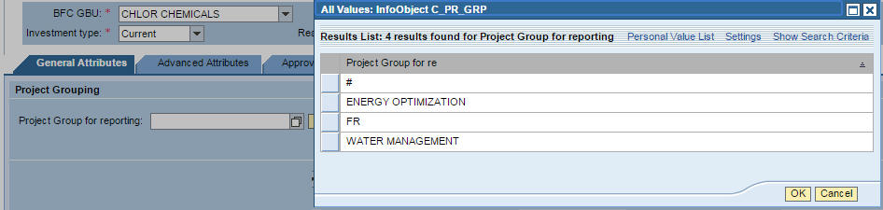
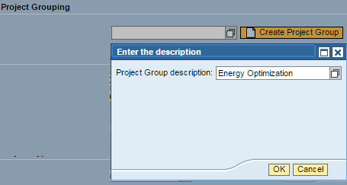
General Attributes (8) : Project Group for Reporting
Field | Usage
Project Group for Reporting | When several projects are considered as a group(e.g. group wide initiative), as a whole (e.g. preliminary study, basic and execution project, associatd demolition), users may use this field to group them in reporting.
19
Select an existing group…
…or create a new group
❶
❷
❸
❶
❷

Slide 31
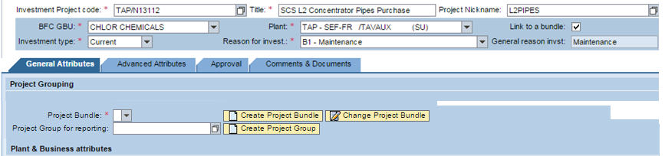
General Attributes – Project bundles
“Project bundle” fields and buttons appear only when the “link to a bundle” box is checked

Slide 32


General Attributes: Project Bundle
Project Bundle (for aggregating forecasts):
  One can gather projects into bundles if and only if all conditions are met:
  projects concern the same plant
  Projects have the same general reason of investment
  Projects have the same project type
  Projects concern the same activity 2 (and thus the same GBU)
  Projects are of the same family
  Example of bundle : regular⁵ capitalized³ MAINT² projects of Rosignano Solvay Chimica Italy¹ – Activity ABS25⁴
  These attributes are attached to the bundle
  Users may select existing bundles which have the same attributes as the project
  Or they may create a new bundle which will inherit these attributes

Slide 33
Comments and documents (text fields)
Field | Usage
Project Summary | More space to detail project’s purpose and motivation (preferably in English or a language that most stakeholders understand) Example: Debottlenecking from 200 to 250 kT/y of chloride is justified by a strong demand in Europe, as a consequence of the major competitor’s bankruptcy. Spread is expected to jump from 4€/T to 7€/T by 2016. The project mainly consists in an additional 20m³ reactor and associated P&I
Project History | log of the main changes brought to the project, managed manually. Suggestion is to start with the date followed by the event Example: 2014-12-02: authorized amounts reestimated from 120 to 135 kEUR 2014-12-12: decision to postpone project’start to Q4 2015 2015-01-13: project unplanned (from ‘planned’ to ‘not planned’)

Slide 34
Comments and documents (links)
Field | Usage
Add New Document document | Allows to actually upload a document within the COLMAR database ; Any person allowed to display the project can also access the document Examples: detailed scope, estimation document, value challenge report, financial study, stage gate reports
Add new link to document | Allows to mention an internet/intranet link Access to the document is controlled by the application/server hosting the document Examples: link to official news; to a detailed confidential marketing study in eRoom, Teamsites or Documentum, to the engineering document management system (Powow or Chapoo), …

Slide 35
Advanced attributes
Fields in this pane shall be filled in for medium and major projects (all projects ≥ 1 MEUR)
Filling it for current projects is possible as well
Available sections are:
Economical indexes: how profitable is the project
Impact on Unit Manufacturing Cost (UMC): unit price before and after the project
Challenges: whether and when they have been carried out
Stage Gates: engineering phases
Sustainable Development: Sustainable Portfolio Management Results
Value Stream ABC: ranking of the value stream
Split by General Reason of Investment
Technically, fields in COLMAR are not mandatory,
but users shall complete them to comply with CAPEX 01

Slide 36
Advanced attributes: economical indexes
Reminder: indicators meaning and calculation forms are described in the Controlling Teamsite.
Economical indexes are to be used for any project the main reason of which is “Development”)
For Maintenance and HSE projects, when possible, these indicators shall also be mentionned.
Field | Usage
Discounted Payback (in months) | It determines when the cumulative cash-flow of a project gets to zero. That means, generally speaking, when the future gains pay back the initial investment. Introducing such notion of time, it can contribute greatly to rank projects with similar NPV One important note: to be significant, the calculation must be made on discounted financial flows (to consider the time value of money) This duration will be mentionned as whole number of months
Net Present Value (in kCurrency) | Through the application of the actualization rate to all the cash flows of the investment, it simulates that the entire project happens at the present time, and evaluates its net creation of financial value
Modified Internal Rate of Return (in %) | It is defined as the actualization rate which makes the Net Present Value equal to zero. The Modified Internal Rate of Return assumes that the weighted average cost of capital is used for reinvesting the interim cash flows

Slide 37
Advanced attributes – Impact on UMC
Impact on UMC are to be used for any project the main reason of which is “Development”)
For Maintenance and HSE projects, when possible, these indicators shall also be mentioned
Unit costs are splitted in variable costs, fixed costs and depreciation
  Value without the project
  Value with the project
Costs are mentioned in local kCurrency (e.g. kEUR, kUSD, kTHB) / Ton

Slide 38
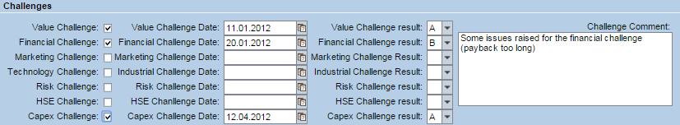
Advanced attributes – Challenges
Helps user notify
  Whether the challenge was carried out
  When the challenge came to its conclusion
  The result:
    A: project is OK from the challenge point of view
    B: some concerns have been raised or no clear conclusion can be drawn
    C: project fails as to this set of criteria – the project should not be approved
A common text field allows to comment conclusions for all challenges carried out
We advice users to upload challenge conclusion documents (Comments & Documents section)

Slide 39
Advanced attributes – Stage Gate Dates
Those fields are related to the engineering status of the project
In most cases, they will be updated by the engineering project manager
Field | Usage
Stage Gate | In which phase the project Gate (G1, G2, …) is the next gate which will be assessed
Date of completion of Basic Study | If the basic study is not yet started or completed, the date will be the date of the expected completion. When completed, this date is the date of completion.
Date of Mechanical completion | If the mechanical completion is not over, the date will be the date of the expected completion. When completed, this date is the date of completion.
Date of completion of Startup | When the facility concerned by the project will actually start or has already started

Slide 40
Advanced attributes – Sustainable Development
All major projects (> 1 MEUR) must undergo a Sustainable Portfolio Management (SPM) assessment carried out by the Sustainable Development Department
Conclusions from the SD Department are reported in the form:
  Production environmental costs (how the process impacts the environment)
  Market alignement (how the product and its usage are sustainable)
  Sustainable Development Megatrend

Slide 41
Advanced attributes –Value Stream ABC
CAPEX01 procedure reminds that each value stream shall undergo a ABC ranking analysis, to be reviewed on a yearly base.
As a reminder, ABC ranking is a methodology which aims to analyze value streams’ health as to profitability and site adequacy.
Results are coded A, B or C:
A : Value Stream to be developed,
B : Value Stream in dilemma position,
C : abandoning or transfer of activities to be studied; optimal management of profitability
Structured Excel forms are available to do so.
Ranking the value stream concerned by the project is compulsory for all major projects above 10 MEUR
The result of the value stream’s ranking is selected by the person in charge of requiring approval

Slide 42
Advanced attributes – Split by general reason
Normally, projects only have a single reason for investment (and a single general reason of investment)
But some large projects may be motivated by several reasons.
For example a project aiming to replace mercury electrolysis by more performant membrane cells might be motivated by Development and Maintenance as well, in addition of HSE
The fields split by general reasons allow to assign multiple general reasons to a project.
The general reason (top fields) of the project is not editable. It is updated from the value of the other 3 general reasons
In the example, having assigned 10% of development and 20% of maintenance leads to a HSE general reason of 70% (the remainder)
Remark: Analysis reports won’t take this into account directly ; this split will need to be done manually in ad-hoc excel reports.

Slide 43
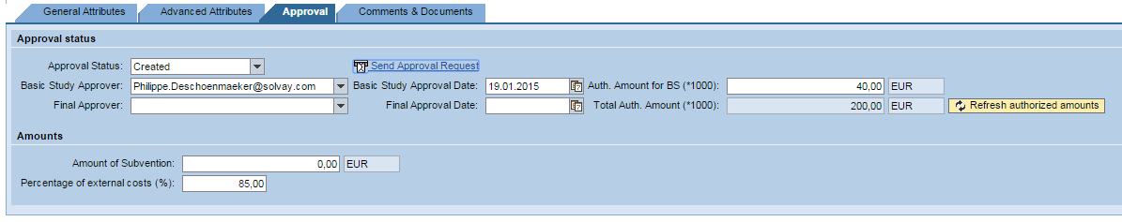
Approval (approval process detailed further)
Field | Usage
Approval Status | Present approval status of the project Possible values depend on The present value The user rights (whether the user is a global, a local approver or not)
Basic Study Approver (optional) Final Approver | Email of the approver Selected by the requester (before approval) Who has approved (after approval)
Basic Study Approval Date Final Approval Date | Date of approval Foreseen (before approval). Please fill it in to help stakeholders plan their intervention Date of approval (once approved) ; set by Colmar
Authorization Amount for BS | Amount for the basic study ; to be edited by the requester the project will be created in PS with this budget amount upon basic study approval
Total Authorization Amount | Amount for the whole project, including the basic study. Not editable: copied from the Authorization Pane (will be addressed further) press to make sure the amount is well refreshed
Amount of subvention | Mention the subvention amount if any
Percentage of external costs (%) | Estimation of the proportion of costs related to purchases of goods and services that will be paid after a payment term. Used to estimate Capex forecasts from Capspend

Slide 44
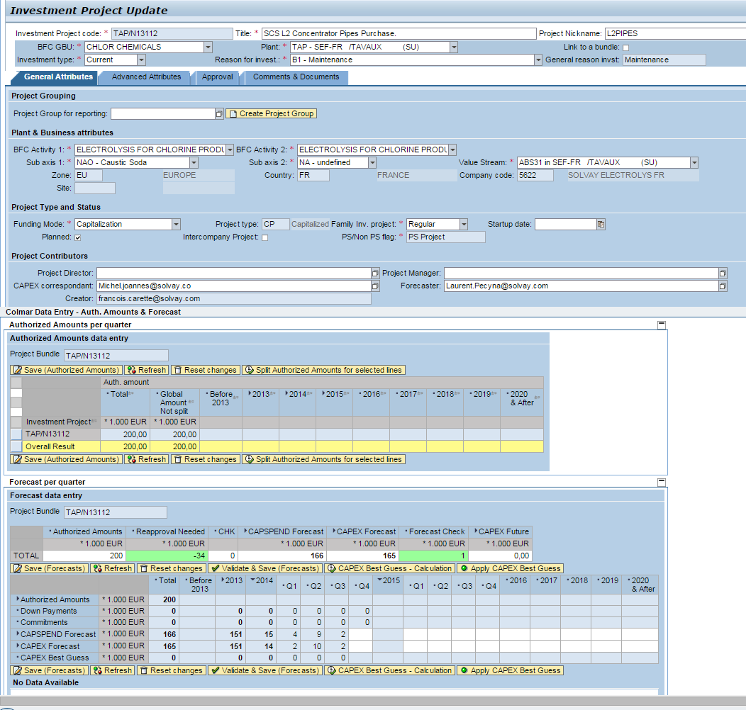
Figures
When a project is created, two additional panes appear below the attributes pane:
The authorization pane
Total project amounts
  To be approved (before approval, editable)
  Approved (not editable)
The forecasts pane
  Actual past Capspend and Capex (from SAP)
  Forecasted Capspend and Capex (filled in and updated by the user)
All figures in thousands of local currency (kEUR, kUSD, kTHB, …)
Reminder: Local currency depends on the plant

Slide 45
Figures – Authorized amounts (without bundle)
Authorized amounts are always expressed in thousands of local currency (kEUR, kUSD, kTHB, …) in relation with the plant
Amount to be approved or already approved
Once the project is approved, the amount cannot be changed unless the project is formally reapproved
The authorized amount can either
  Be granted with no time constraints: no split over years and quarters
  Be granted with time constraints: split over years and quarters

Slide 46
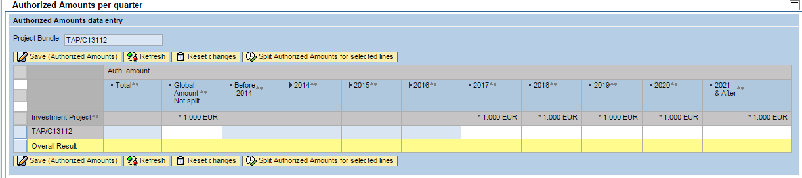
Figures – Authorized Amounts (without bundle) (2)
When done, press ‘Save’ to save the authorized amounts
Press ‘Refresh’ to have the total and the yearly sums of quarters calculated
‘200’ in ‘Total‘column only appears thereafter
Get back to the last saved amounts
Helps split a total amount on quarters and years
Click on
to display quarters
If the authorized amount is not related to years and quarters, enter it here
If the authorized amount is related to years and quarters, display quarters ( ) and enter amounts.
For current and next year (Y and Y+1), amounts cannot be entered at the year level, they always need to be entered at quarter level
After Y+1, no detail related to quarters is required and authorized amounts are to be entered a year level.

Slide 47
Figures – Forecasts (without bundle)
The forecast pane lets the user declare the Capspend and Capex forecasts of the project.
The pane displays
Authorized amounts (as declared in the Authorization pane)
Actual past capspend and capex
Down payments and Commitments so far
Forecasts made last quarter
The pane features
cells to let users enter capspend and capex quarterly forecasts
conversion of the Capspend and Capex to Euro
a ‘best guess’ calculation that helps users to transform Capex to Capspend
Calculations (totals, difference between forecasts and authorized amounts, difference between total capspend and total capex)

Slide 48
Figures – Forecasts – source of actual past data
After a project has been approved and created in PS,
Past Capspend and Capex are automatically extracted from BW for the project for which Colmar investment project code = the PS project ID
Capspend data come from PS (via BW)
Capex data come from a calculation available in BW (PEC & Cash query) which takes into account, project by project, of
  the orders settled onto the PS project (on any of its WBS elements)
  their delivery dates
  the payment terms
  information as to the invoice has been actually paid
Down Payments and commitments* are also extracted from PS
When a project is not yet approved (e.g. when it is just created), no data is extracted from BW
*Commitment: costs that will be incurred in the future for materials and services that you have requested or ordered.

Slide 49
Figures – Forecasts – project types
WBS elements taken into account are only those which have the same project type as the COLMAR project
    For capitalized projects, past Capspend and Capex will take into account WBS elements to be capitalized
    For not capitalized projects, only WBS elements that are not capitalized
If one wants to authorize, forecast and follow up not capitalized projects in COLMAR (e.g. preliminary), they need to be created in PS as individual not capitalized projects.
Use the “Group for reporting” field to group not capitalized and capitalized projects which in are related to each other

Slide 50
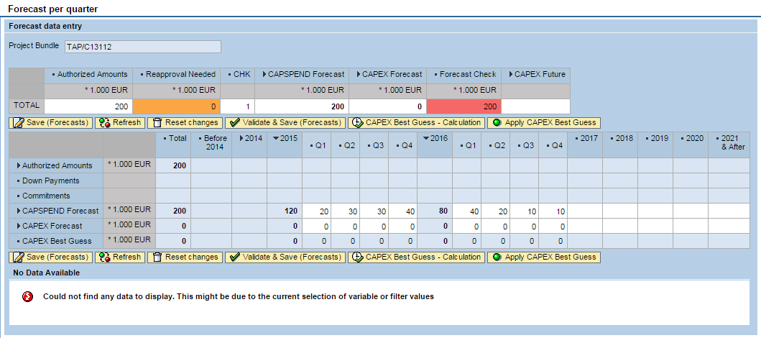
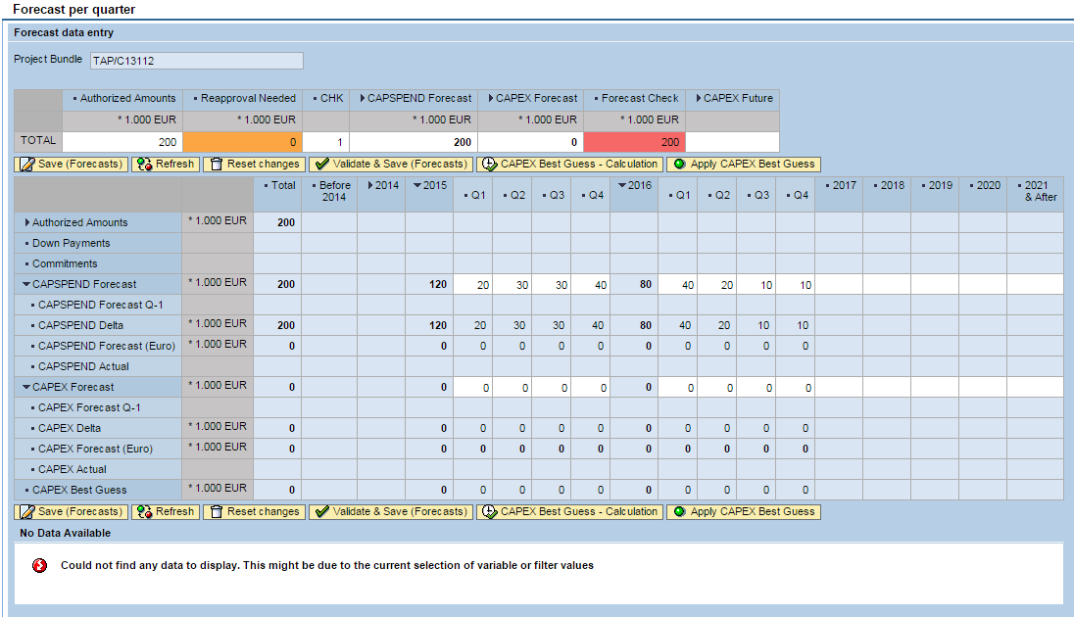
Forecasts (without bundle)
Click on
the to display extra information

Slide 51
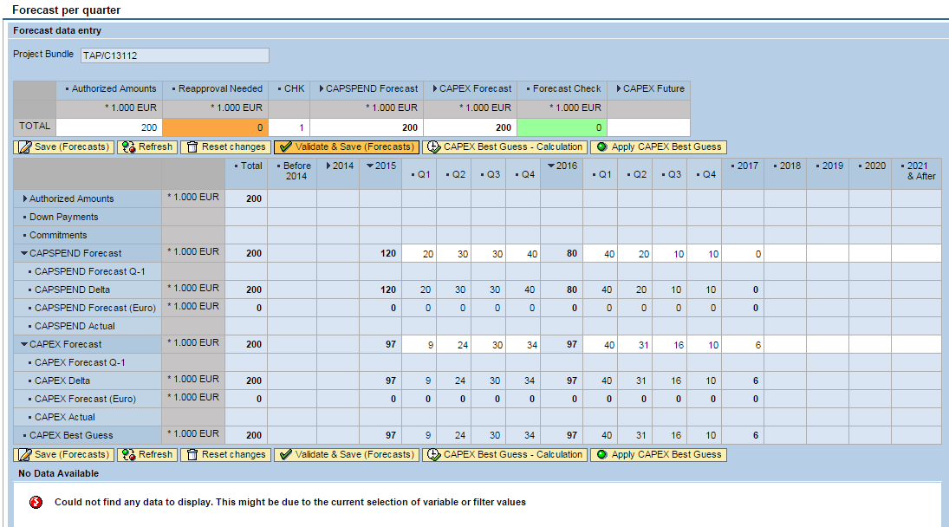
Forecasts
(without bundle)
Example of a newly created project
Difference between total Capspend and authorized amount
Green if ≤ 0 Orange if < 10%
Red if ≥ 10% of the auth amount
Difference between total Capspend and total Capex
Green if = 0 Red if ≠ 0
Values in Euro are calculated only after the forecasts are saved
just a copy of the authorized amounts pane values
Enter the quarterly (Y, Y+1) and yearly (> Y+2) Capspend forecasts
Enter the quarterly (Y, Y+1) and yearly (> Y+2) Capex forecasts or
Ask a best guess
And apply the best guess
Save the forecasts (but don’t mention that forecasting process is finished
Update all calculations:
Yearly and overall totals
Differences and checks
Get back to the last saved amounts
Save and validate: tell that your forecasting process is over (it’s your last word)
Get a guess of the Capex, based on the Capspend entered and past data
(see further)
Copy the Capex best guess into Capex forecast

Slide 52
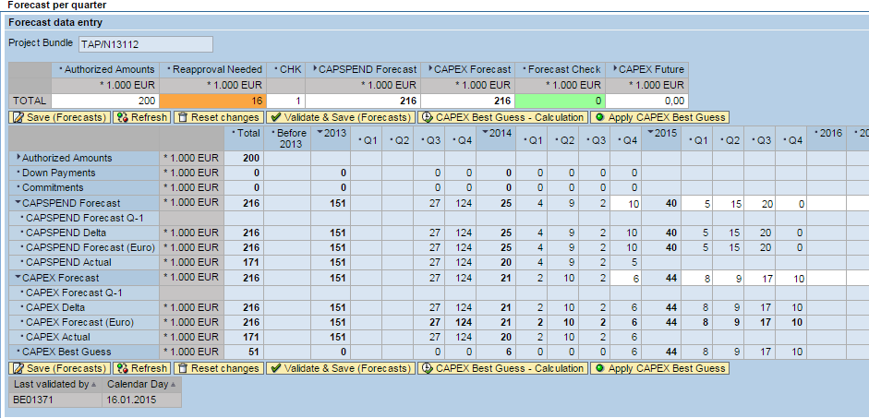
Forecasts (without bundle)
Example of an approved project
(created in PS with actual expenses)
Forecasts values as mentioned last quarter
Difference between last quarter forecasts and current forecasts
Conversion to EURO (calculated after save only)
Actuals : same values as the forecast line except for the current quarter
Way to get actuals of the current quarter
Past Capspend (values from PS via BW)
Past Capex (values from PEC & Cash query)
Forecast values to be entered by the user
Who has saved and validated and when

Slide 53
Forecasts – Capex Best Guess
Reminder:
if a good is received in month M, a capspend corresponding to its amount is booked in month M
When it is paid (in Month µ = [M + payment term]), a capex is assigned to month µ
The Capex best guess function
Assumes that for purchases are related to an average payment term for the country in which the investment is made (a table is maintained in COLMAR)
Takes into account actual past monthly Capspend and future quarterly Capspend forecasts
Takes into account the percentage of external costs (no delay on internal costs [salaries] ) [this %age is defined in the approval tab if the project is not bundled, else within the bundle definition – by default = 85%]
Check that total Capspend = Total Capex, taking into account the actual past Capex.
The best guess applies the average payment term on external costs proportion so that the total capex = total capspend

Slide 54
Approval for basic / full approval
Capex01 mentions 2 approvals
Approval for a budget for basic study, after which a more accurate estimation of the full project will be known (Status=Approved for Basic)
Approval for the full project (Status =Fully Approved)
Distinct approval for basic study is required for all major and most medium projects.
However, the Basic approval step is not compulsory in Colmar and can be bypassed : a project can be directly approved.
The amount mentioned in the approval pane is the amount for the full project, including the basic study.
It is copied in the Approval tab and is not editable.

Slide 55
Approvers
COLMAR features two kinds of approvers:
Global Approvers: they can approve all the projects they have access to
Local Approvers: they can approve all the projects < 1 MEUR they have access to
According to Total Authorization Amount the list of available approvers will include
The global approvers of the GBU
The local approvers of the plant (if the amount < 1 MEUR)
As it was chosen to leave to GBUs the complete freedom to define one’s own delegation scheme, it was not possible to implement them all in COLMAR.
Budget requesters, approvers and SBS who’ll create the project in PS will all need to know and apply the GBU rules (select the right approver in the list)
COLMAR will not care for checking that project are authorized by the right approver

Slide 56
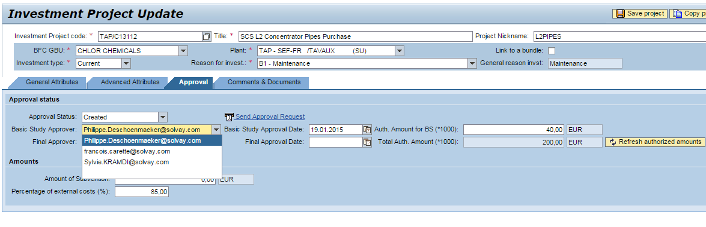
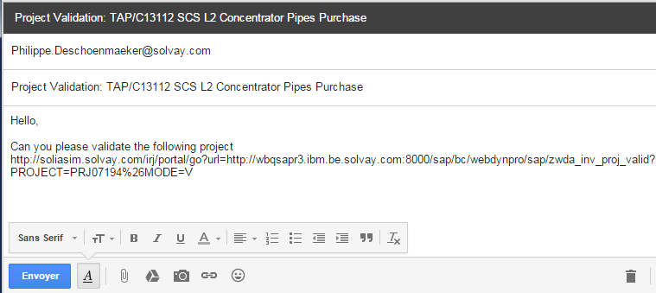
Process to ask for an approval for a basic study
2 Choose the approver you want the basic study to be approved by
1 If you ask a budget for a basic, write the amount requested here
3 Save so that the approver and the amount are kept
4 Send Approval Request (create a message with the hyperlink to the project)
5 Complete the message in GMAIL and send it
Hyperlink to the approval page of the project

Slide 57
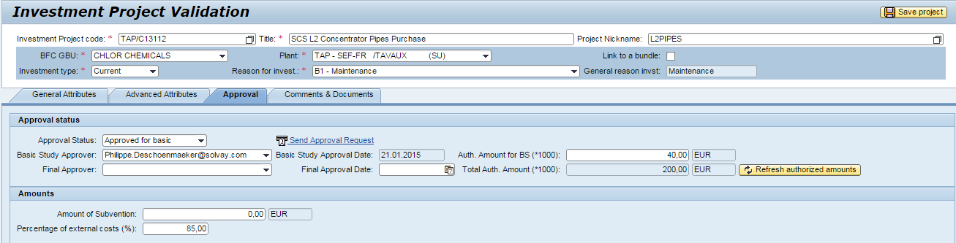
Process to approve a basic study
Message
0 If you are not the right approver, simply forward the message to the right one
Hello,
Can you please validate the following project
http://solia.solvay.com/irj/portal/go?url=http://wbpsapr3.ibm.be.solvay.com:8000/sap/bc/webdynpro/sap/zwda_inv_proj_valid?PROJECT=PRJ00491%26MODE=V
1 Click on the link!
2 Select ‘Approved for Basic’
3 Check your email is mentioned as Basic Study Approver
4 Save
The actual date of basic approval is set by Colmar
(possibly replacing the forecasted date previously entered)

Slide 58
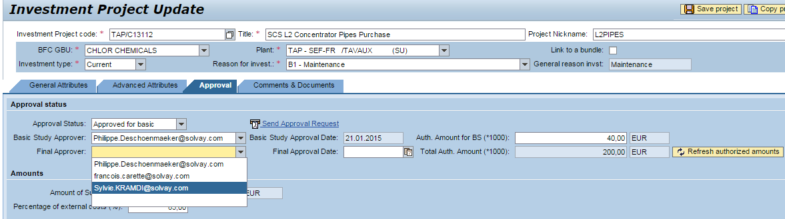
Process to ask for a full approval
1 check the amount requested ; if incorrect press
Or check approval pane
2 Choose the approver you want the project to be fully approved by
3 Save so that the approver and the amount are kept
4 Send Approval Request (create a message with the hyperlink to the project)
5 Complete the message in GMAIL and send it
Hyperlink to the approval page of the project

Slide 59
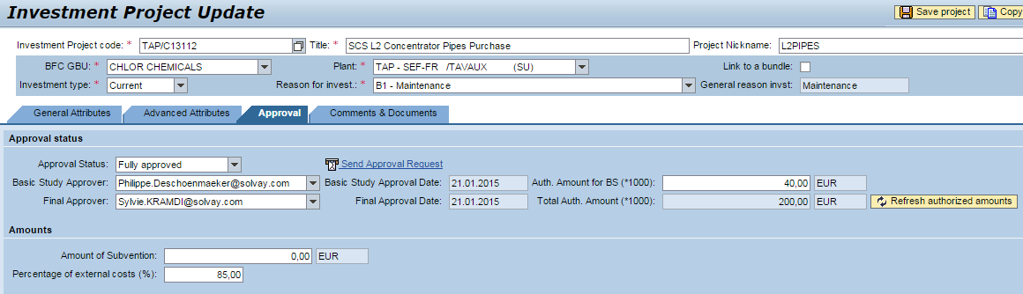
Process to fully approve a project
Message
0 If you are not the right approver, simply forward the message to the right one
Hello,
Can you please validate the following project
http://solia.solvay.com/irj/portal/go?url=http://wbpsapr3.ibm.be.solvay.com:8000/sap/bc/webdynpro/sap/zwda_inv_proj_valid?PROJECT=PRJ00491%26MODE=V
1 Click on the link!
2 Select ‘Fully Approved’
3 Check your email is mentioned as Final Approver
4 Save
The actual date of approval is set by Colmar
(possibly replacing the forecasted date previously entered)

Slide 60
Project creation / update : which attributes are needed
Though the following attributes are not made compulsory by COLMAR, filling them in is expected
General Attributes tab : description, plant, reason, activity 2, funding mode, planned, family, forecaster
Approval tab : approval status ; approval date (please mention the expected date for projects not yet approved)
Comments & Documents tab: Project Summary

Slide 61
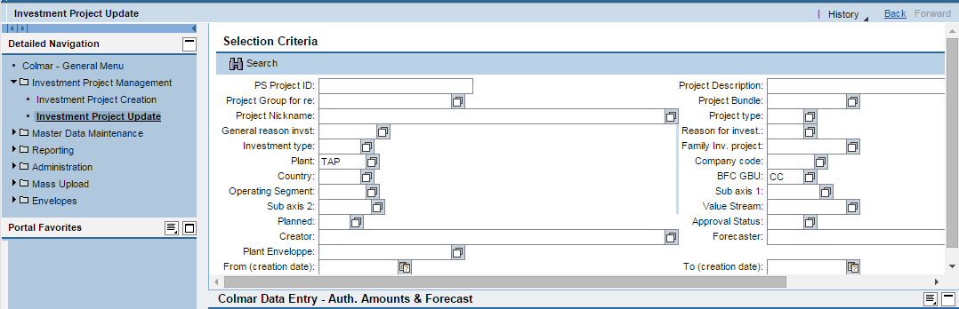
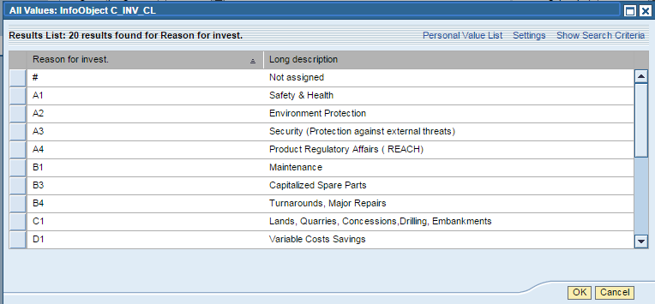
Project Update: select
Use GBU codes (F4)
Enter your criteria and press
You can select possible values thanks to or by pressing F4 where your cursor is in the field
Ex: values for Reason for Invest:

Slide 62
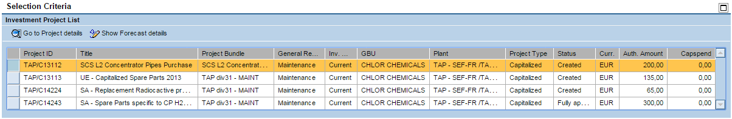
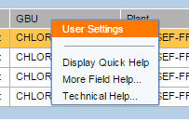
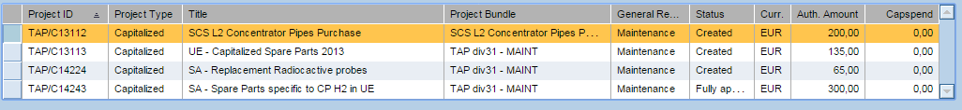
Project Update: list of projects
Display project details
Directly display approval/Forecast panes
Column order can be changed with drag & drop on column headers
Click on column header to sort
Get back to selection form
Select a project
For advanced users:
right click – User settings: hide/display columns
(example without plant, GBU and
Project Type columns)

Slide 63
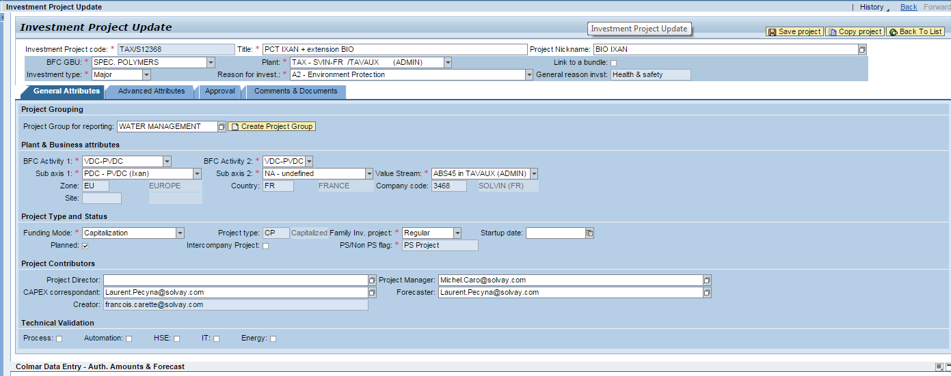
Get back to the list of selected projects
Press to get back to the list of selected projects

Slide 64
Copy a project
To copy a project, use “Update investment projects”
Select the project you want to copy and press
In the project sheet press
Update the attributes and Save

Slide 65

Easier Forecasting: Excel Forecast Entry Sheet
COLMAR Web application allows to open and modify projects in individual forms.
When updating forecasts, opening and modifying forecasts one by one can be tedious and does not give an overview of the investment plan.
To solve this issue an Excel Forecast Entry Sheet is available.
It uses BW client excel add-in: Analysis
The same tool will be used for all excel reports and
extractions
Trainings to Analysis are provided by SBS.

Slide 66
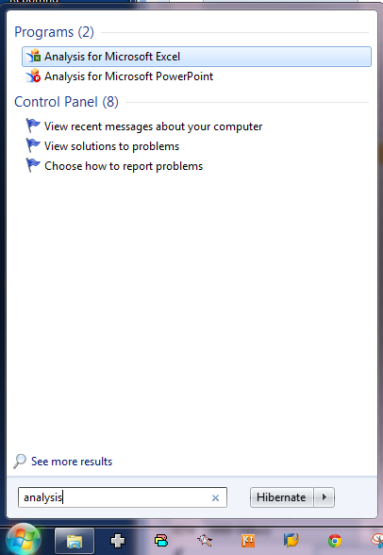
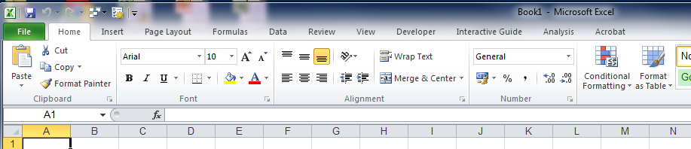
Excel Forecast Entry Sheet – Start Analysis
Easiest way to access Analysis: click on Start Menu and type “Analysis” in the Search box
Select Analysis for Microsoft Excel
Excel is launched, but an additional “Analysis” Menu is available
❸
❷
❶

Slide 67
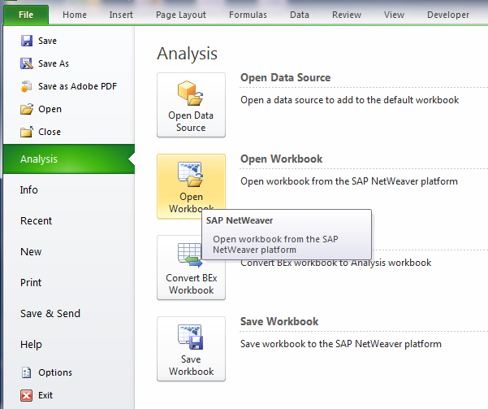
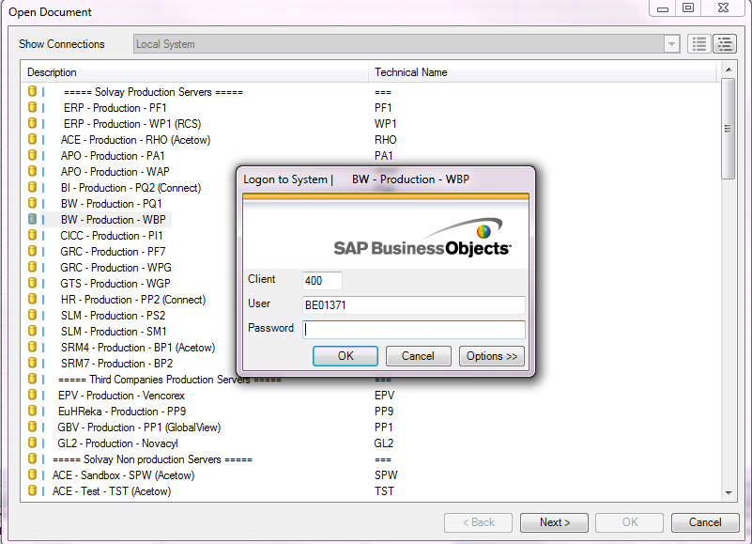
Excel Forecast Entry Sheet – Connect to server
File menu – Analysis – Open Workbook
❶
❷
❹
❸
❺
You’re prompted for selecting a connection. Double click BW – Production - WBP ;
Enter your UserID and Password*
* Unfortunately, connecting to BW from Excel is not yet “single-sign-on” and you need to know your userid/password

Slide 68
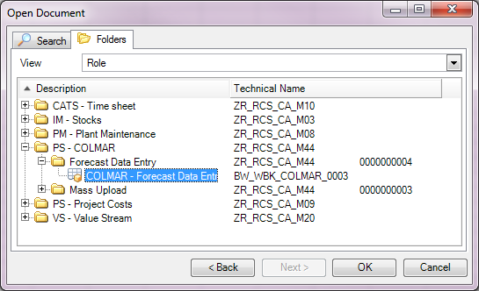
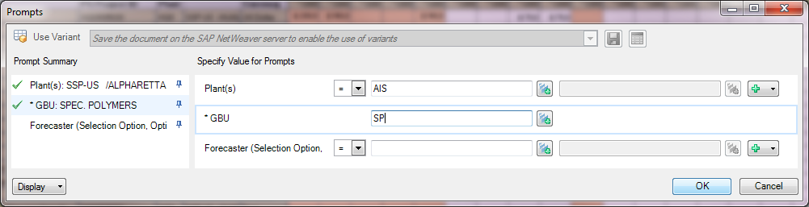
Excel Forecast Entry Sheet – Open Forecast Entry Worksheet
❶
Select Folders
Select PS-COLMAR
Select Forecast Data Entry
Double click on COLMAR – Forecast Data Entry
❷
❸
❹
❺
The excel sheet opens and you are prompted for selection criteria
Click on to get the list of possible values
Write your mail address if you want to select projects you’re the forecaster of

Slide 69
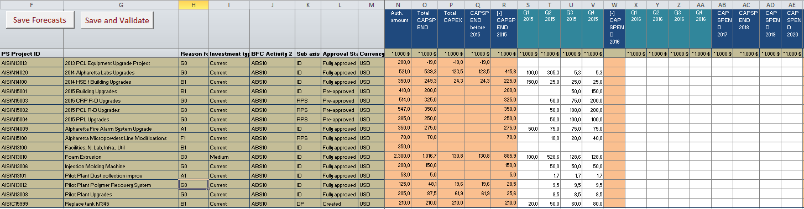


Excel Forecast Entry Sheet – Fill in the entry sheet
Read only, attributes, extracted
from COLMAR
Read only,
(past data,
totals
calculated by
COLMAR
Forecasts to
be edited
Uploads the entered forecasts into COLMAR (I’ve changed some figures but my update is not yet finished ; it may not be my last word) ; I’m not flagged as having finished my forecasting taks.
Uploads the forecasts into COLMAR and raise the flag ‘validated’ (I’ve changed some figures and my update is finished. It’s my last word!)

Slide 70
Excel Forecast Entry Sheet – some remarks
Lines correspond to bundles as forecasts are attached to bundles only. In case of unbundled projects (one project = one bundle), lines correspond to individual projects
Only forecasts can be changed so ; project attributes update cannot. You cannot add or delete projects either.
In this version, you need to enter both CAPSPEND and CAPEX forecasts. An automatic guess of CAPEX will be available soon.
Totals shown in columns are refreshed only upon save
In Analysis, you may display any attribute in your list (menu Analysis-Display) like in a pivot table
You may type formulas in the entry cells but they’ll be reset when you save

Slide 71
Mass Upload : bulk creation/update/deletion of COLMAR projects
Create/update/delete projects from list in an Excel Sheet
Usage:
First load of projects
Forecasts and expenses of projects which are not managed in PS (not PS sites) : the only way to create projects and update their figures
Capital Investment Decision Meetings: in order to play with the investment plan with a good reactivity,
  Download the excel list from COLMAR
  Update, change, delete …
  Upload it back to COLMAR

Slide 72

Mass upload: overview
COLMAR
Mass Upload
(Colmar Web applciation)
Download
(BW analysis)
Project download
Data
Entry
CSV
File
Copy to
Data_entry
Export to
CSV
COLMAR Mass upload
Excel Worksheet

Slide 73
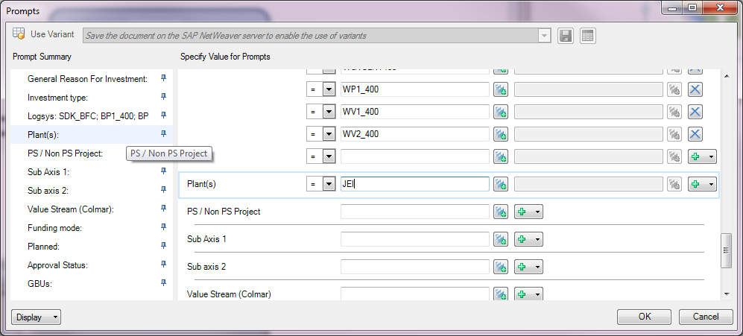
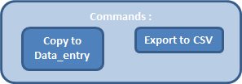
Mass Upload: process
Use Analysis
  connect to WBP as for the forecast entry
  sheet
  File-Analysis-Open Workbook
  Select COLMAR-Mass Upload
Complete the
Selection Form (prompt)
(eg. Choose a plant and/or a
GBU)
  Projects are downloaded in the “project download sheet
In the Command sheet, press
“copy to data entry” -> the project list is copied
in the sheet “data entry”
In the data entry sheet, suppress the lines you don’t want to modify
Modify the remaining lines in data entry.
Press the button “Export to CSV”

Slide 74
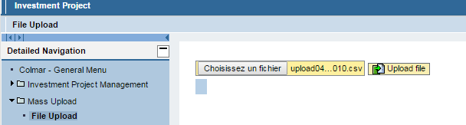
Mass Upload
In COLMAR, select mass upload
Select the CSV file you’ve generated and press “Upload File”
Remarks:
The key for modifying budgets is the “Technical ID” ; if no technical ID is defined, the upload program creates a new project
When relevant, possible values are proposed (drop down list)
To delete a project, set the approval status to ‘XX’
To understand keys (e.g Approval status ‘FA’), see “value lists” sheet
Bundles are created as separate lines ; projects which report to that bundle will have their ‘technical ID project bundle’ equal to the Technical ID of the bundle ; all projects reporting to a same bundle should have the same GBU, plants, main reason, family, %age of external costs, forecaster.
Hint: create some examples in COLMAR and download them to get the syntax in the mass upload excel file

Slide 75
Reports
As to Capital Investment projects, two environments exist:
  “PS” (“PEC & Cash”) BW_QRY_MPR_PS014 (CBS – Project costs)
    Down payments, commitments, (past) capspend, capex
    Purchase information : providers, orders, invoices, dates
    Detail down to the WBS
    No forecast information
    More information -> slower for large lists
    Source: SAP PS, MM
  COLMAR : BW_QRY_MVIPCO17 (BW – COLMAR – Synthèse)
    Down payments, commitment, capspend, capex (actual and forecasts)
    COLMAR attributes (actors, challenges, financial indicators etc.)
    Less detail -> more responsive even at GBU level
    Consolidated figures (taking into account consolidation)
    Figures in local currency or in Euro
  Access: same as forecast data entry : Analysis

Slide 76
Envelopes
Envelopes are total amounts authorized for
A year
A well defined perimeter
There are:
One envelope by GBU (consolidated target for the GBU)
  Usage of GBU envelopes is aimed at comparing the total consolidated forecasts of the GBU to the envelope
Envelopes granted to plants according to:
  Main reasons of investment
  Size (major, medium, current)
  Example of plant envelope: MAINT current projects of Jemeppe-Solvay Chimie
  Usage of plant envelopes is aimed at generating reports that show how plants respect their targets. This function is optional

Slide 77
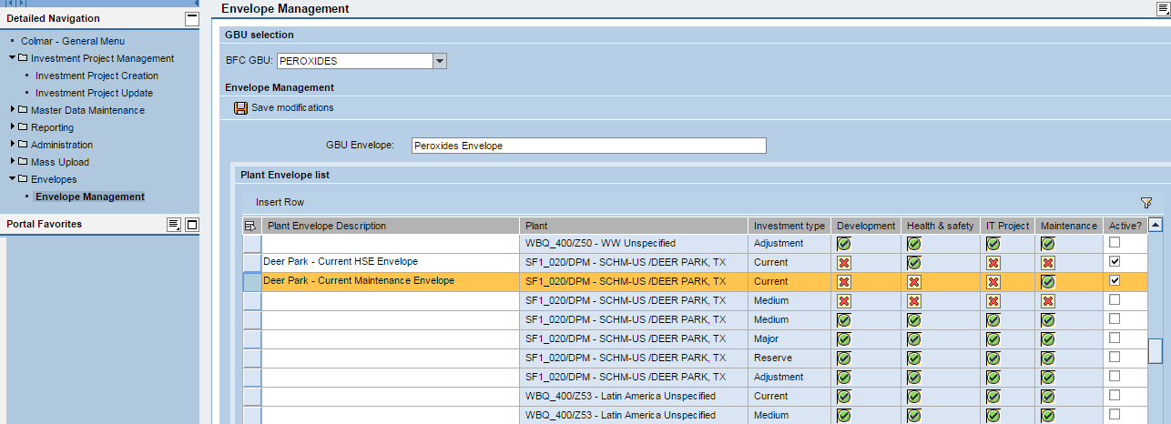
Envelopes (continued)
Envelopes are defined by the GBU Capex coordinator
1 select your GBU
2 give the GBU envelope a name
3 configure your plant envelopes ; click on Insert Row to add similar investment type rows
4 make the plant envelopes active
5 Save them

Slide 78
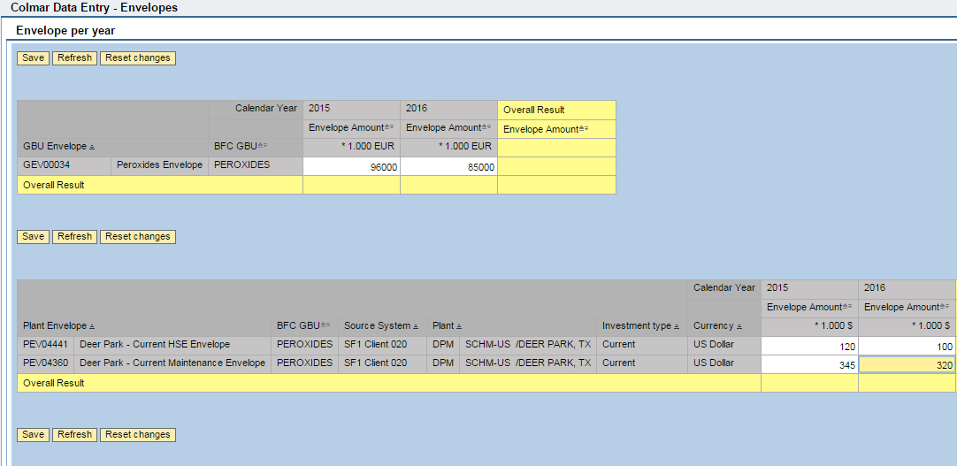
Envelopes (continued)
In the Envelope per year pane (under the envelope definition pane)
1 set the amounts
2 Save

