Slide 1

Graphical Work Order Scheduler
Scott Hagy
IT Applications
Solvay Business Services
6/18/2013
Notes:
0

Slide 2
GWOS is part of the SOLWOM project
Solvay Work Order Management
Consists of:
  Transforming our maintenance organizations and plant processes through the implementation of an effective Planning and Scheduling tool – GWOS
  GWOS is an SAP bolt-on that is fully integrated with the PM module
  Major implementation steps:
    Mapping of the work order process
    Identification of expected gains
    Identification of monitoring indicators
    Identification of gaps in the target process
    Development of an action plan to address required process and organizational deficiencies
    Implementation of GWOS
    Validation of gains in process efficiency
    Project Goals: 10-15% wrench time savings and 15-25% increase in productivity

Slide 3
What is GWOS?
A product of The Prometheus Group, an SAP certified Partner specializing in Plant Maintenance and Project Systems
Part of a suite of process improvement tools
Highly flexible tool for work order planning and scheduling
Major benefits include:
  Graphically schedule work orders in a Gantt chart view
  View, interpret and analyze large amounts of work order data on a single screen
  Complete all SAP planning tasks from within GWOS using drag and drop functionality
  Streamline data maintenance while significantly reducing prep work
  View capacity planning data at high level or in detail
  Auto-level work schedules to control capacity

Slide 4
What is GWOS? cont’d
Software features:
  Order Mass Change – Users really like this feature
    Start and finish dates
    Revisions
    Header and User statuses
  Print Manager
    Allows for printing of shop paper documents, individually or in mass, and any additional documents attached to work order objects
  Navigator
    A transaction that accesses a screen customized for an individual users or a group of users. Buttons execute pre-determined transactions and variants.
    Especially useful for non-pm users needing access to PM data quickly and easily
  Material Shopping Cart
    Vast improvement over standard SAP material searches, makes finding required order components faster
  Order to Task List and Order to Bill of Material
    Allows for creation of task lists and BOM’s from a PM order

Slide 5
Wrench Time
A term referring to the amount of time craftspeople spend “turning wrenches” opposed to chasing parts, gathering tools, or waiting on equipment to become available,
Industry standard wrench time without planning and scheduling is 30-35%
Industry standard wrench time with planning and scheduling is 55%
Why is wrench time management important?
  Labor represents between 50% and 80% of the cost of routine maintenance at Solvay sites

Slide 6
SOLWOM Project Deployment
Status
  Completed
    Europe – 9 sites
    North America – 7 sites
      Green River, Marietta, Vernon, Chicago Heights, Blue Island, Charleston, Spartanburg
      Other US sites such as Deer Park are so anxious, they are using the software well before their scheduled implementation. Good indicator of it’s usefulness
    Latin America – 4 sites
  Full scope to be achieved end of 2015
    Europe – 30 sites
    North America – 18 sites
    Latin America – 12 sites
    Asia & Pacific – 14 sites

Slide 7
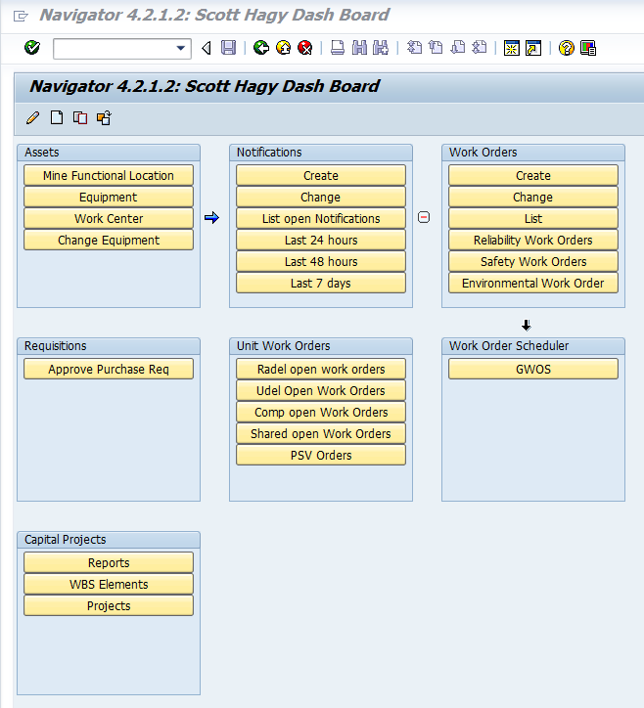
Navigator Screen

Slide 8
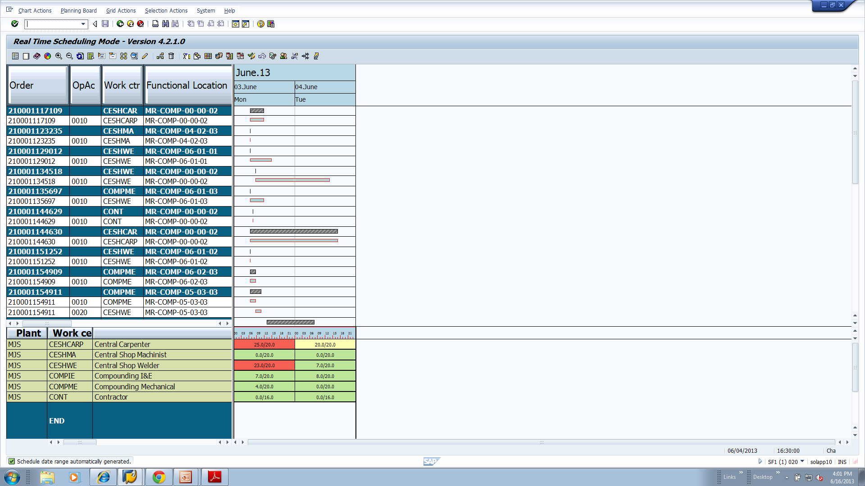
GWOS Screen

Slide 9
Thank you for your attention
Questions?

