Slide 1
Raw material data tracking for sustainability, compliance and product stewardship
Working file 2024

Slide 2
Sustainability, Compliance, Product Stewardship
Raw materials data journey
Data on supplier and / or Raw Mat
Files (doc, sheet)/emails
Application/Database
Data on our product coming from info propagated from Raw Mat
In order to meet disclosure requirements from our stakeholders, we must 1) collect and 2) propagate some raw materials data end to end.
Problem: today the information is collected and stored in a redundant, unstructured and non auditable manner, creating compliance risk (additionally to resource waste)
Files (doc, sheet)/emails
Application/Database
Designing / Innovating
R&I / Platforms
Investors & Rating agencies
Eco Invent (industry emission factors)
Eiffel
Suppliers
Sourcing / Buying
Manufacturing
Marketing / Selling
Customers
Procurement
Industrial
Business
Ethixbase (Human Rights)
RCI
Trade Compliance classif
Regulators
Emails (supplier PCF)
PCF
Reg Data Summary (RDS)
WIP
Sigreen (supplier PCF)
Mass balance tracking
Safety Data Sheet (SDS)
Ecovadis (ESG)
Business certificates (eg “natural”)
BW Stream Value Chains
RMQ, MOC questionnaires
Reporting
Other Reg certificates (eg Nagoya)
3E Protect (SDS updates)
Finance / GCS
Circular sales KPI

Slide 3
Priority topics per domain
Product Stewardship
Procurement Sustainability
Compliance
Group Corporate Sustainability
Raw Materials composition
Nature/origin (vegetable, animal, synthetic)
Conflict Minerals compliance
Supplier PCF
Export and trade control regulations
SVHC
CSRD
REACH and REACH like
inventories
Chemical inventories
Market regulation compliance (food, pharmaceuticals, HPC, waste management…)
Raw mat origin (biobased or fossil) and related data (covering CSRD E5 Inflows metrics, Nagoya protocol…)
Supplier PCF & RCI
Other market specific info: mostly Novecare
  Mass balance mgmt
  Naturality, GMO etc customer requests

Slide 4
Goal of the taskforce: How Might We improve what and how we request information to our suppliers?
Company level information
Code of Conducts
Ethics & Compliance policies (Human Rights, Conflict minerals…)
Ethics & Compliance specific questions (due diligence)
Screening and rating to prioritize companies for which we need further investigation and possible mitigation plan
Suppliers
Sourcing / Buying
Procurement
Ethixbase (Human Rights)
Product level information, certificates and Safety Data Sheet
Emails (supplier PCF)
WIP
Sigreen (supplier PCF)
Is product concerned by regulation X?
Does product contain substance Y or classified as Z or listed in list W?
What is the origin of purchased raw material? (biobased?)
What is the PCF of purchased raw material?
What is the tariff code and trade control classification of the purchased raw material?
Ecovadis (ESG)
BW Stream Value Chains
RMQ, MOC questionnaires
3E Protect (SDS updates)

Slide 5
Product Stewardship questionnaires

Slide 6
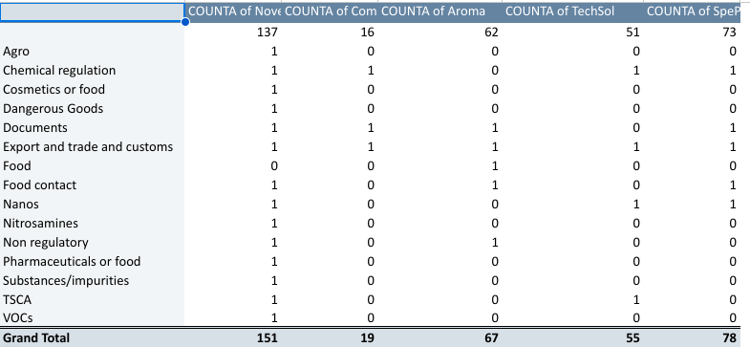
GBU specific questionnaires in different format
Summary of all requested data by GBU

Slide 7
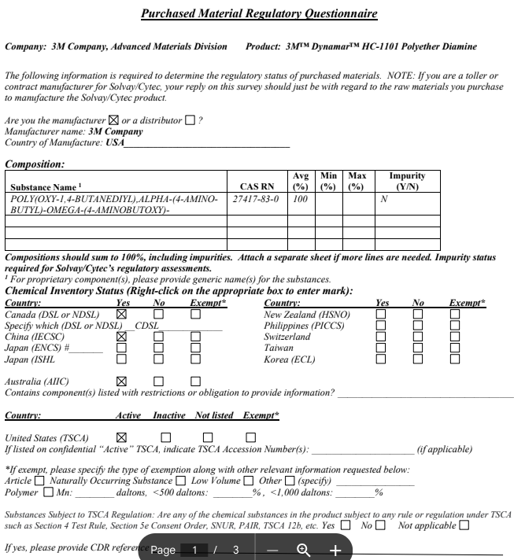
Example 1: Composite

Slide 8
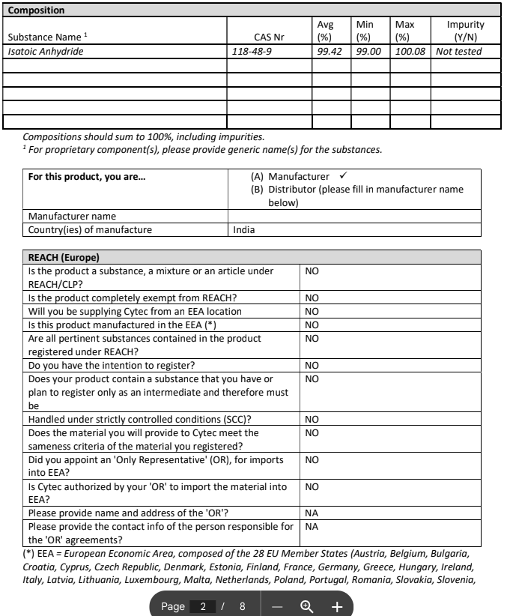
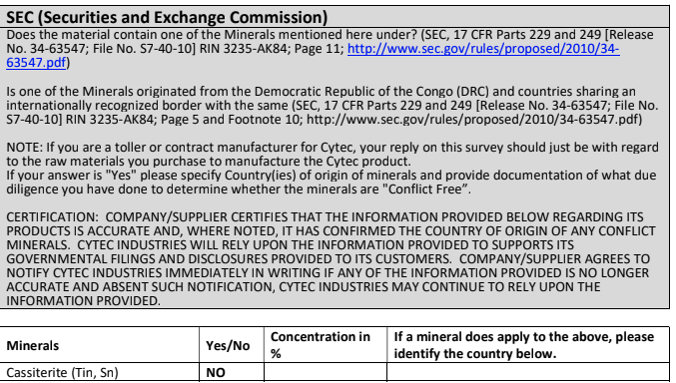
Example 1: Tech Sol

Slide 9
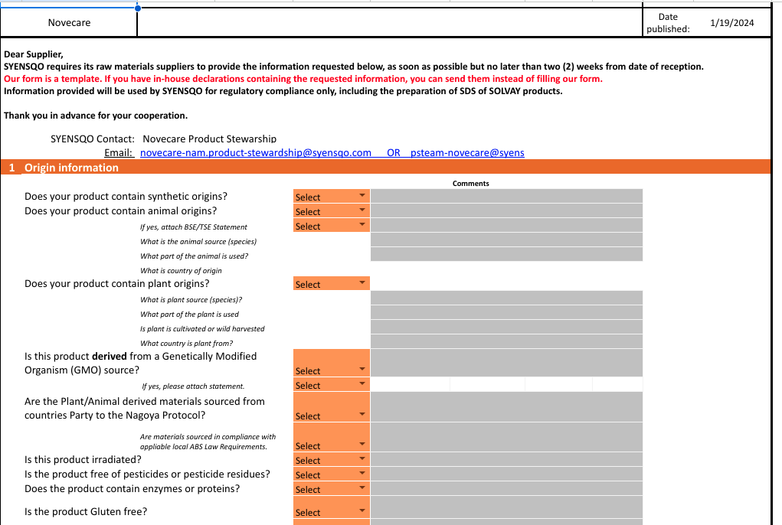
Example 3: Novecare (NEW)

Slide 10
Focus on origin (biochemical versus fossil) and its implications

Slide 11

Novecare example
Auto RCI
PCF
Customers requests
Raw Material Info
(P Delacruz)
Manual RCI (Damien)
SAP EHS
Regulatory Data Sheets
Raw mat qualification questionnaires
bio_based_raw_materials_V2
Circularity_products_novecare_2022_
FINAL
Circular sales listing
Eiffel DB
?
Oleo RM origin?
(K Koh)
STREAM Raw materials master data
RMs origin
(F Charrie)
“Where-used” (BOM extraction)

Slide 12
Proposal
Raw mat qualification questionnaires
Source of truth
Update process
STREAM Raw materials master data
Raw Material Info
(P Delacruz)
Other Purchasing info sources
Customers requests
Auto RCI
PCF
Consistency controls
bio_based_raw_materials_V2
Circularity_products_novecare_2022_
FINAL
Circular sales listing
Oleo RM origin?
(K Koh)
SAP EHS
Regulatory Data Sheets
RMs origin
(F Charrie)
Eiffel DB
?
Update process
“Where-used” (BOM extraction)

Slide 13

Proposal
2024 E&Y management letter follow up
Creation of a global process to be translated into GBU procedures including:
Update at a frequency TBD the list of biobased raw materials
Storage in SAP BW Sprint = source of truth
Update the extraction of the BOMs containing these raw materials in order to have the most up to date %
Manual corrections to be done (eg case of >100%)
Project to use PCF tool to populate RCI for all relevant products
No/Limited IT development nor cost
2024/2025
Solution/Service to strengthen supplier questionnaires and dematerialize / record answers in a structured way (eg like for SDS)
Solution to handle the management of mass balance (based on the same data sources) (stand alone or PCF development)
Investment to be assessed and validated as part of the digital roadmap
2026 and Beyond
Identify a solution to cover the end to end traceability of raw materials and related calculations such as green token in S4/HANA
Additional reporting requirements in the CSRD on this topic!

Slide 14
Context
Support raw material selection and conversion
  Access alternatives
  Simulate downstream impact
Perform calculations
  Circular sales
  PCF
  Mass balance
Manage Labels and certifications
2 main use cases
Serving multiple persona
R&I
SIP team
Platforms
RM Buyer
SD Champion
Marketing Director
SD Reporting team
Site quality manager
Proposal
Priority 1: structure the database - build process and tool to properly flag data
Priority 2: develop new reports with existing technology
Priority 3: identify 1 or several tools to meet the needs in the target application landscape

Slide 15



Data and application landscape
Supplier A
Supplier B
Supplier C
Supplier D
Fossil RM
Renewable/Recycled RM
Materials, Procurement and Purchasing available in SAP (or BW)
Quid of convergence? Is anything inputted there?
Many spreadsheets used
  Raw material origin (buyers, product stewardship)
  Raw materials data such as PCF, RCI
  Mass balance calculations
Packed RM 1 (eg bulk)
Packed RM 2 (eg IBC)
Packed RM 1 (eg bulk)
Packed RM 2 (eg IBC)
Fossil energy
Renewable energy
BOM
Packed FP 1
(eg bulk)
Packed FP 2
(eg IBC)
Labels and certifications
FP
Customer A
Customer B

Slide 16
Current situation & challenges
No version history and product lifecycle management
No “single source of truth” and conflicting information circulating
No assurance that 1 single material code corresponds to 1 single origin

Slide 17
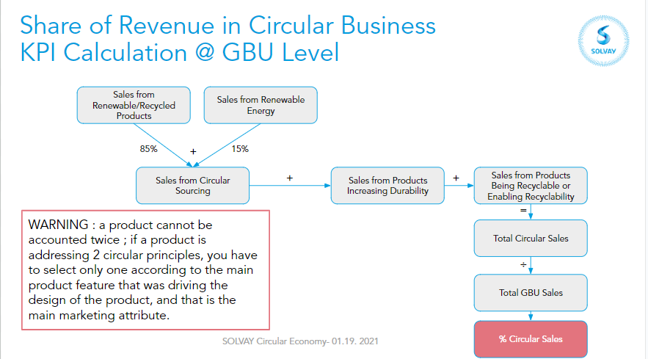
Circular sales KPI calculation (template)

Slide 18
Mock up
What?
Carbon Type
  Biobased.
    If so choose type of feedstock
    And origin
  Recycled based
  Carbon-capture
  Fossil
    Origin: recycled based or virgin
Type
  Mass Balance
  Segregated
  Identity preserved
  Unknown
Crop / Extraction Type
  Responsible
  Regenerative
  with/without GMO
  Etc (organic?)
PCF: define minimum sets of values needed for PCF, Supplier specific
  e.g Biogenic: % (cf file)
  RCI
Certification (list?)
Supplier geographic location
Where?
supplier/raw material combination
For all types of packaging
Do we need cascading?
How?
Information gathering
  Purchasing
  Link to TfS form
Information validation
  Cf Decision chart created for PCF
Information transmission
  Form?
Information recording
  SAP preferred option
  By whom?
Subsequent reporting
  BW report preferred option
Supplier A
RM all packaging
Packed RM 1 (eg bulk)
Packed RM 2 (eg IBC)
1 or several site views
Notes:
Plateforme fast HPC CoO taux de naturalité selon norme ISO 16128
Process NPDI = lancement de nouveau produit

Slide 19
Examples
ZPRC 90066202 COCONUT FATTY ACID WHOLE CUT IV 5
ZMAT
108839 COCONUT FATTY ACID WHOLE CUT IV 5 BULK
Available for plants:
0241 7424 Baltimore
0263 7424 Spartanburg
0269 7424 Winder
7315 7651 Mississauga
8073 7424 / Siltech Mississauga
8227 7523 Itatiba
8980 6409 Itatiba
8990 6409 / LTC - Campinas
165522 COCONUT FATTY ACID WHOLE CUT IV5 MB BULK
Available for plants
8227 7523 Itatiba
8980 6409 Itatiba
8990 6409 / LTC - Campinas
Type of material: coconut
TCC (in Kg C/kg product): 0.78680
Possible suppliers (Winder)
MAGNAKRON CORPORATION, ICOF AMERICA INC, WILMAR OLEO NORTH AMERICA LLC
PCF Supplier: N/A
ZPRC 90057881 CETYLOLEICALCOHOL VEGETABLE50-55
ZMAT
146676 CETYLOLEICALCOHOL VEGETABLE50-55 BULK
146677 CETYLOLEICALCOHOL VEGETABLE50-55 825KIBC
Available for plants:
8298 6301 EES Moerdijk
105265 ALCOHOL CETILOLEICO 50-55 BU
Available for plants:
7704 6062 / Kleio Singapore (Nove)
7851 8090 Ospiate Di Bollate
8245 6062 Singapore Jurong
Alternative trade names: KOLLICREAM OA, Rofanol 50/55 V
Type of material: palm
TCC: N/A
Possible suppliers
BASF SE (56515) PCF Supplier: 4.9
ECOGREEN DHW DEUTSCHE (68725) PCF Supplier: N/A

Slide 20
