Slide 1


ERP Rebuild
SAP Digital Manufacturing
Draft for discussion
Conceptual Design
July 2024

Slide 2
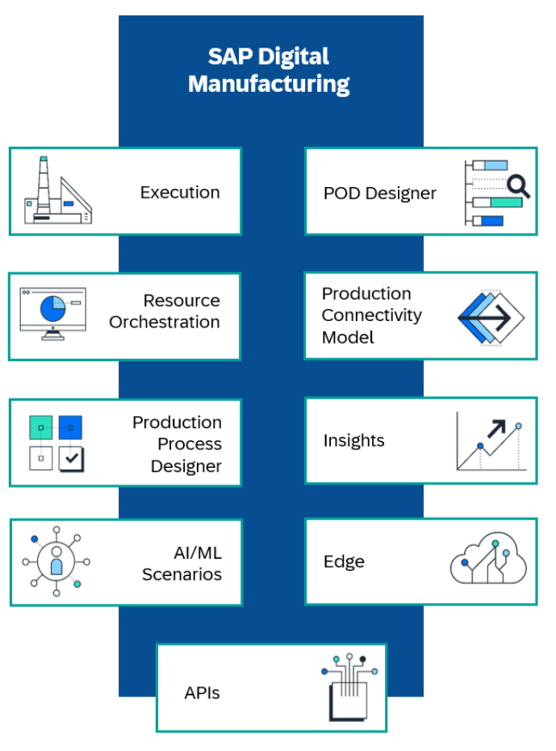
Digital Manufacturing Functionalities
SAP MII Functionalities are now in SAP Digital Manufacturing
SAP ME Functionalities are now in SAP Digital Manufacturing
New Features are added both in the SAP ME and in the MII area, plus completely new objects like Process Designer and Automation, Edge, Connectivity Model.

Slide 3
Digital Manufacturing Functionalities
SAP Digital Manufacturing for Execution is an enterprise-level, scalable, manufacturing solution that enables global manufacturers to manage and control manufacturing and shop floor operations and realize Industry 4.0 scenario
Main features:
Manufacturing Process Modelling: to define Floor Stock Management, Batch management in the shop floor, Printing, Nonconformances, OEE, Routings and Time Tracking
Manufacturing Configuration: define codes, data types, allowed values, events and triggers for each process
Manufacturing Master Data Management: integrate all relevant master data from S4/HANA + define specific shop floor detailed master data if required
Manufacturing Execution: Order management, Floor Stocks, Cancellations, Resource and Tools Assignments, Transport systems, Staging, manage Holds in Shop Floor Capacities, Time Tracking
Run Production Operator Dashboard (see next slide)
Notes:
Name and owner - overview
deadline
Link to signavio
Add visuals; where to take title and levels

Slide 4
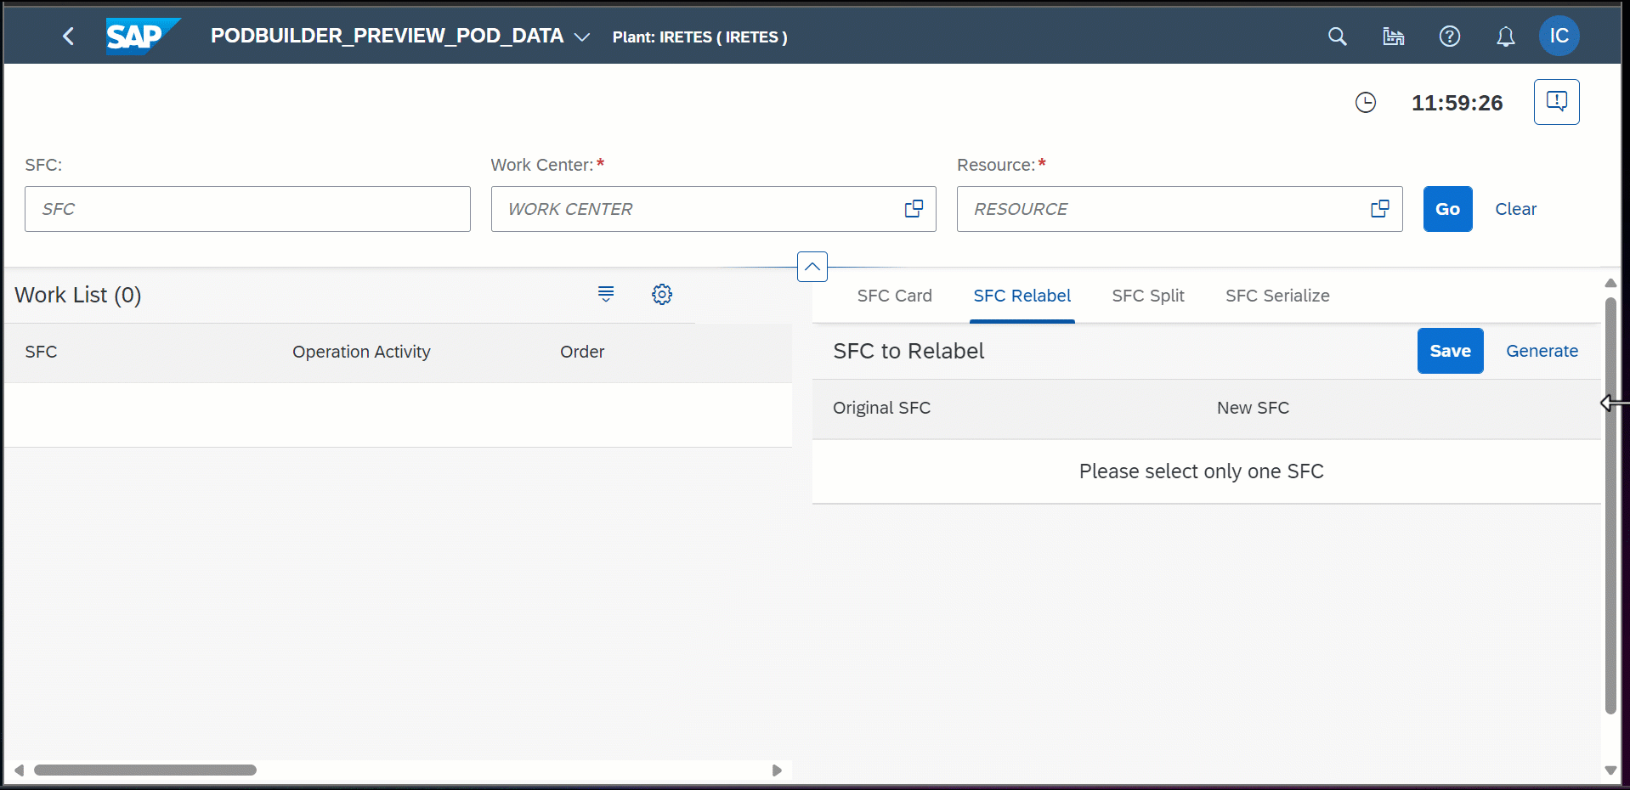
Digital Manufacturing Functionalities
SAP Digital Manufacturing POD Designer allows you to configure various types of production operator dashboards (POD) for your shop floor.
Standard POD Types are:
Operation Activity, Work Center, Order, Line Monitor, Standalone Nonconformance.
Custom PODs can be created: completely tailorized screen layouts with the functionalities required by each operator to complete the job.
Example of objects that can be used in a POD:
Toolbar with buttons:
Dynamic plugin container:
108 Plugins (at 25-Jul-24):
https://help.sap.com/docs/sap-digital-manufacturing/pod-designer/pod-plugins
Responsive splitter, dynamic side content, Popups, etc.
Notes:
Name and owner - overview
deadline
Link to signavio
Add visuals; where to take title and levels

Slide 5
Digital Manufacturing Functionalities
SAP Digital Manufacturing Resource Orchestration is a cloud-based scheduling tool that empowers production supervisors to control shop floor operations and monitor events.
It includes:
The Dispatching and Monitoring app, to schedule and dispatch operations, resolve load balance conflicts, monitor events in the shop floor, execute automatic load balance and automatic dispatching
The Schedule Labor app provides detailed information about labor assignments including availability, qualifications, shifts, and certifications.
The View Labor Schedule app lists assignments and provides an overview of assigned and unassigned workers.
The Schedule Tools app provides information on the allocation of production tools to work centers and resources.
The Scheduler Configuration app allows you to replicate master data.
The Manage Workforce app assists you in onboarding and assigning employees to cost centres.
The Manage Skill Matrix app helps you create and manage employee skills and qualifications.
Notes:
Name and owner - overview
deadline
Link to signavio
Add visuals; where to take title and levels

Slide 6
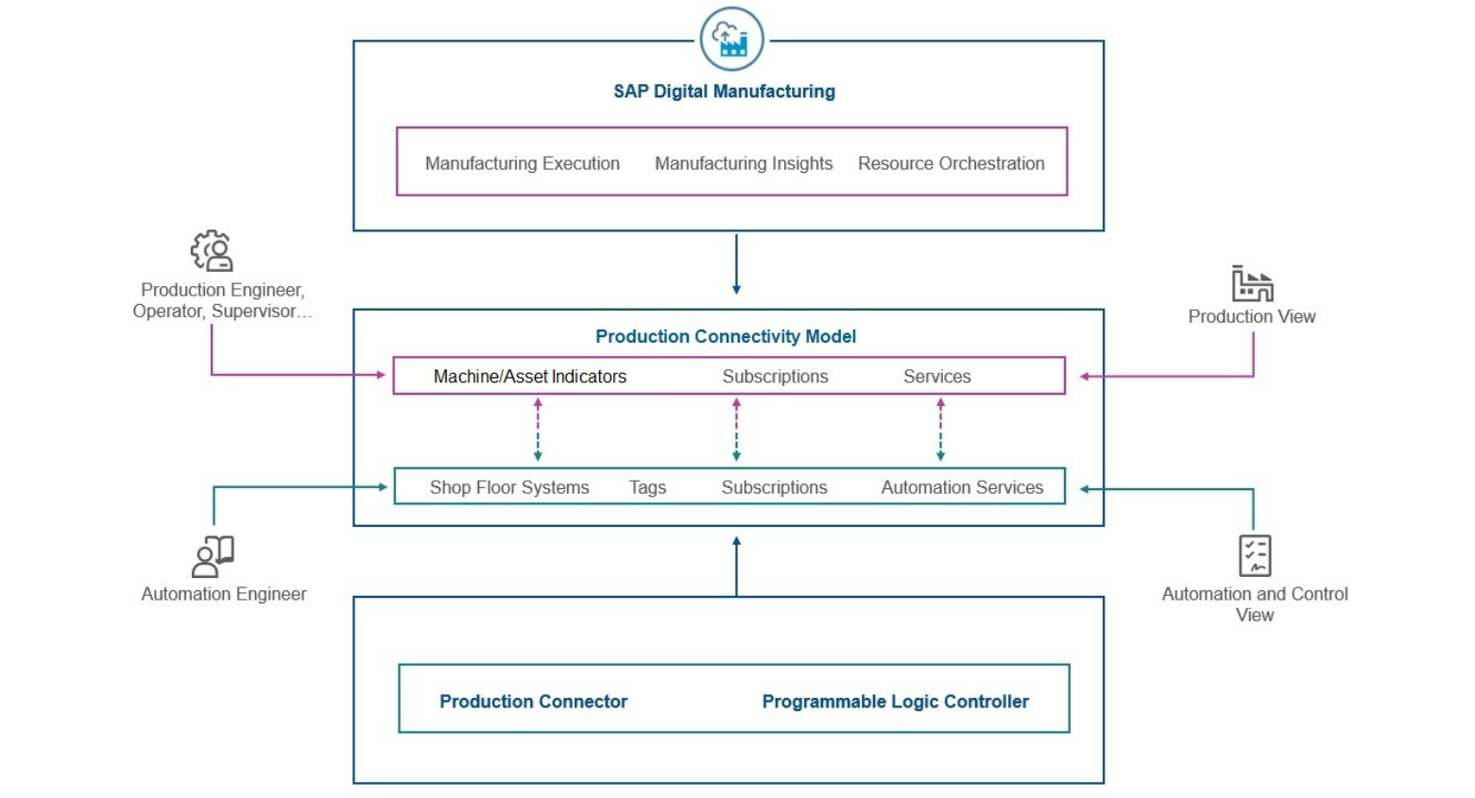
Digital Manufacturing Functionalities
SAP Digital Manufacturing Production Connectivity Model is a digital replica of the machines and assets in the shop floor.
Using Production Connectivity Model, production engineers or production operators can work with the asset in the same way as if they would handle the physical machine. For example, if the production supervisor or operator wants to read the temperature of a reactor, they can read the temperature of the reactor equipment. If they want to change a parameter, like the volume per second entering the reactor from a certain pipe, or the temperature, they can enter the target as a set point to the related indicator. It can fully substitute any PCS / BCS system.
Notes:
Name and owner - overview
deadline
Link to signavio
Add visuals; where to take title and levels

Slide 7
Digital Manufacturing Functionalities
SAP Digital Manufacturing Production Process Designer helps you model production processes and create the layout of your shop floor. Production processes define the interaction between machines or rules, actions, and workflows that control the execution on the shop floor.
Main advantages are:
Model production processes using a visual designer
Focus on business logic instead of on programming skills
Manage configurations centrally instead of programming each piece of equipment individually
Manage different versions of configurations
Adapt configurations easily if the environment changes
Production processes are divided into two categories: cloud processes that are run in the cloud and automation sequences that are run by a Production Connector system. Subscriptions, Automatic Triggers, Timers defined in PCM are used here to run the processes.
Notes:
Name and owner - overview
deadline
Link to signavio
Add visuals; where to take title and levels

Slide 8
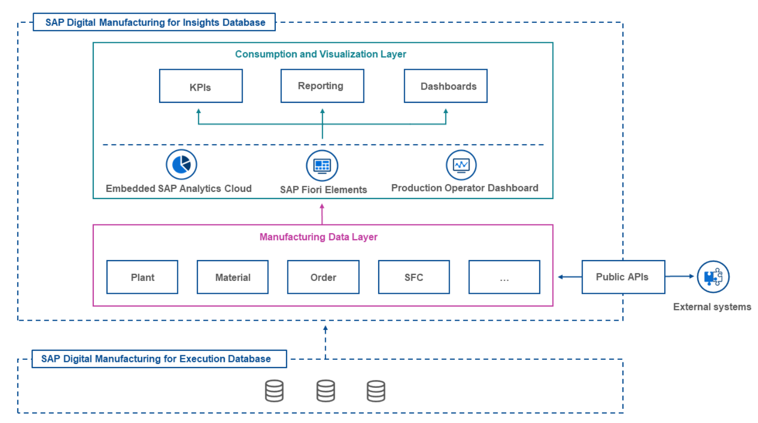
Digital Manufacturing Functionalities
SAP Digital Manufacturing for Insigths analyses and optimises your digital operations based on data delivered by SAP Digital Manufacturing. Production data is transformed and stored in Manufacturing Data Objects (MDOs) that are ready to use for your analytics. Moreover, you can access these MDOs via external APIs. You can live monitor your production processes or analyse data sets that cover longer periods.
To get deeper insights into your production processes, you can benefit from the advanced analytics features.
OEE indicators and any other KPI can be easily calculated and estracted. Reporting functionalities are highly flexible and can be tailor-made.
Notes:
Name and owner - overview
deadline
Link to signavio
Add visuals; where to take title and levels

Slide 9
Digital Manufacturing Functionalities
SAP Digital Manufacturing AI/Machine Learning currently support Visual Inspection Scenario.
Further Business Scenarios will be added in the future.
Using the Manage Visual Inspections Views, Manage Visual Inspections, and Manage Machine Learning Models apps you can create visual inspections that use machine learning models to assist production operators during inspections. You can upload trained models to classify images of inspected SFCs as conformant or nonconformant and map the inspection results to nonconformance codes if a defect is detected. You can also create inspections that don't use machine learning models and run them manually.
Notes:
Name and owner - overview
deadline
Link to signavio
Add visuals; where to take title and levels

Slide 10
Digital Manufacturing Functionalities
SAP Digital Manufacturing AI/Machine Learning currently support Visual Inspection Scenario.
Further Business Scenarios will be added in the future.
Using the Manage Visual Inspections Views, Manage Visual Inspections, and Manage Machine Learning Models apps you can create visual inspections that use machine learning models to assist production operators during inspections. You can upload trained models to classify images of inspected products as conformant or nonconformant and map the inspection results to nonconformance codes if a defect is detected. You can also create inspections that don't use machine learning models and run them manually.
Notes:
Name and owner - overview
deadline
Link to signavio
Add visuals; where to take title and levels

Slide 11
Digital Manufacturing Functionalities
SAP Digital Manufacturing Edge is a tool that allow the definition of Edge Devices, authorized to work off-line and update data asynchronously.
It guarantees that shop floor operations can continue in case of network outages, connection difficulties in specific areas of the plant, scheduled maintenance of the centralized Digital Manufacturing.
Main features are:
Cache master data at the edge: save and retrieve master data like materials and routings directly on the edge.
Process transactions asynchronously at the edge: you can continue working even when you’re offline. The transactions get synchronized with the cloud once the connection is restored.
Monitor edge transactions: You have the option to monitor transactions that occur at the edge. You can do this either through APIs or a cloud application.
Manage edge devices: manage the settings of the devices used for edge installation through a cloud application.
Extensibility and integration: SAP Digital Manufacturing for edge computing can receive inbound calls from external systems, such as the Production Connector. It also can be easily integrated with your custom applications
Notes:
and levels

Slide 12
Digital Manufacturing Functionalities
Anything Else? Everything! With SAP BTP
SAP Business Technology Platform (SAP BTP) is an integrated offering comprised of four technology portfolios: database and data management, application development and integration, analytics, and intelligent technologies. The platform offers users the ability to turn data into business value, compose end-to-end business processes, and build and extend SAP applications quickly.
It is a low-code / no-code development environment natively integrated with all SAP applications (S4/HANA, Digital Manufacturing, and others), which allows to create easily and flexibly maintain:
New Apps to perform business process steps
Automate Business processes
Data Analytics:
                - Infuse trusted AI: Embrace the power of generative AI to automate reporting, discover hidden insights, and create and develop business plans with Joule co-pilot.
                - Deliver mission-critical analytics: Elevate BI capabilities and deliver industry-specific analytics with pre-built business content.
                - Transform enterprise planning: Enable collaborative planning by unifying financial, supply chain, and operational planning with a single solution.
Notes:
and levels

Slide 13
ITAR Considerations
Current ITAR solution is based on local MES systems and local WPX SAP ECC system.
Current ITAR requirements prescribe:
Data must reside in the USA
OR Data must be E2E encrypted
For the S4HANA implementation, the ERP Rebuild Project Team is working on a proposal of E2E encryption based on NextLabs.
For the possible DM implementation, can a dedicate tenant of SAP DM be proposed, based on a Cloud geographically in the US territory? Probably not:
In principle cloud solutions can be ITAR compliant, but not every cloud solution is compliant. The risk here comes from controlling who can access controlled data, and excluding non-US people from doing so - including the vendor support personnel who might have to log into a system to troubleshoot. For example, AWS has its GovCloud offering which guarantees that only US citizens maintain the underlying cloud infrastructure. SAP has something similar via its subsidiary NS2, but it seems this doesn't currently support DMC.
A separate tenant would be necessary but may not be sufficient to satisfy ITAR requirements if SAP cannot guarantee that the software stack, backups, etc. are only accessed by US citizens physically located in the US. SaaS solutions are problematic because all layers of the technology stack are under the complete control of the vendor and the customer has no ability to modify them. Such a modification, is how NextLabs works.
NextLabs's solution works only with S/4HANA, BW, and the HANA database. Not DMC.

Slide 14
Thank You

